Slide 1
The influence of local optimised energy communities on the European electricity market
Christoph Loschan, Daniel Schwabeneder, Georg Lettner
(TU Wien – Energy Economics Group)
12. Internationale Energiewirtschaftstagung
Session 6C: Energy Communities III - 9.9.2021

Slide 2
Overview
1
Introduction
2
Model Formulation
2.1
Market Model
2.2
Energy Community Model
3
Results

Slide 3
Introduction - Motivation
Clean Energy for all Europeans
Renewable Energy Expansion
–> 2030: 32%
Renewable Energy Communities
Citizens Energy Communities
EAG & ElWOG

Slide 4
Introduction – Energy Communities
Renewable Energy Communities
Group of household & mid-sized companies
Produce / store / sell RES-E
Trade with external energy (store / sell)
Objective: ecological, ecomomic, social benefits & financial gain
Citizien Energy Communities
Not limited to RES-E
Includes large companies
No grid level restrictions
Objective: non-profit

Slide 5
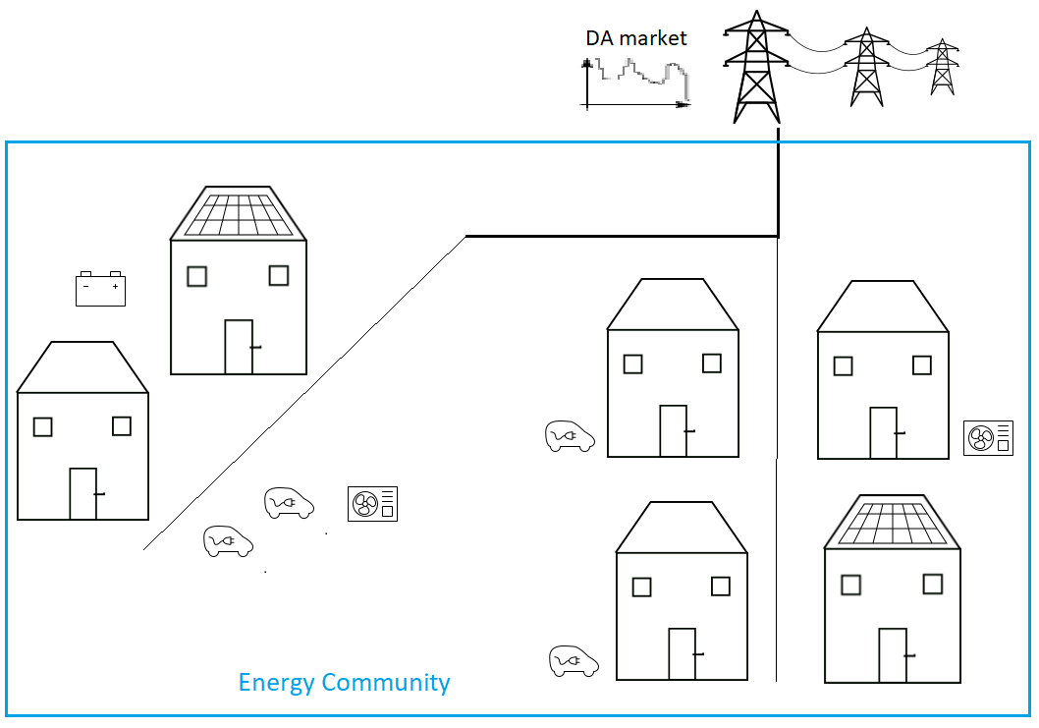
Introduction – Energy Community
External grid tariffs
Internal grid tariffs
Households form EC
PV systems, battery
Producer: smaller economic difference between self-consumption and feed-in
Consumer: Lower energy prices than external
Lower grid tariffs & fees
[1]
Research Question: What are the influences of ECs on the electricity market in terms of electricity generation costs and CO2 emissions?

Slide 6
EDisOn – Market Model
Minimising of the OV generation costs
Pricing through marginal costs of the power plants used
Day-ahead Market Price
Femto – Energy Community Model
Minimising the electricity costs of the energy community
Increased market procurement when market prices are low
Residual Demand
Model Formulation

Slide 7
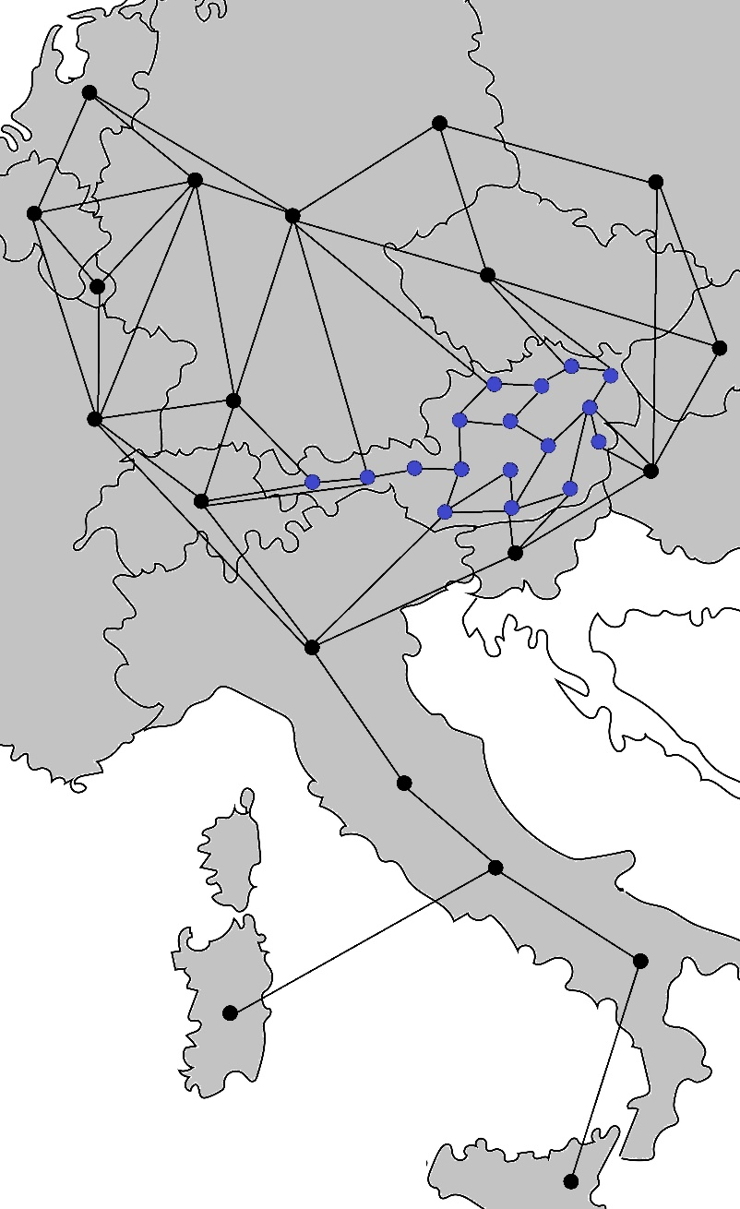
Model overview – nodes & connections
Min. OV costs (Max. social welfare)
(th. PP, RESE, storages)
365 x 1 day optimisation
Detailed power plant allocation
Transmission grid & DC loadflow
Market-model

Slide 8
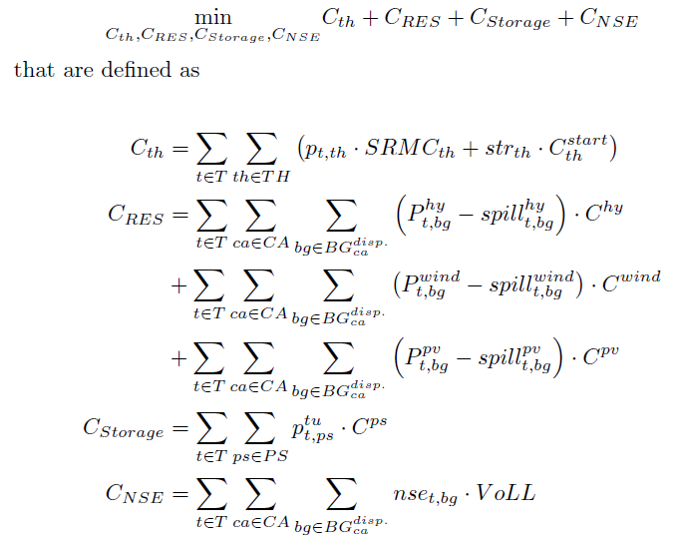
Model Formulation - Objective
365 x 1 Day-ahead optimisation
thermal generation
RESE
Storage usage
Not supplied energy
Market-model

Slide 9
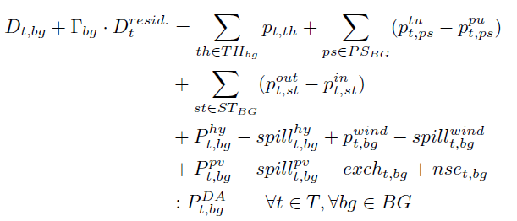

Model Formulation - Constraints
Demand compensation
in every balancing group
thermal PP
for all RES types
Market-model

Slide 10

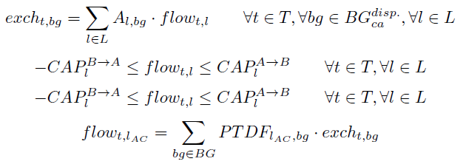
Model Formulation - Constraints
Technical &
Annual pattern storage constraints
Power exchange between
balancing groups
NTC limit
Market-model

Slide 11
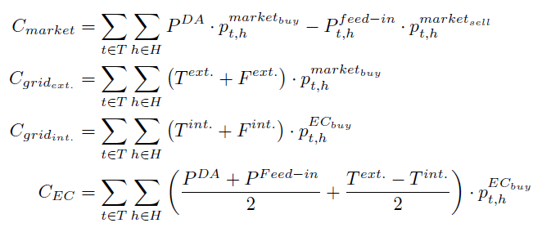

Model Formulation - Objective
Minimisation of ECs operating costs
Market: Energy procurement & feed-in
External grid tariffs & fees
Internal grid tariffs & fees
EC: energy price
Model output -> market model
EC-model

Slide 12




Model Formulation - Constraints
Demand Compensation
for each household
Local PV generation
EC Trade
PV Feed-in
Buy/Sell restriction
EC-model

Slide 13
Preliminary Results - Scenarios
ENTSO-E 2030 NT scenario
Existing power plants and RES-E (100% net. RES-E in AUT)
Electricity demand
3 Different scenarios (Austrias PV/Storage investments)
„BAU“: Business-as-Usual: 9 GW PV / 2.9 GWh Battery (market)
„market optimal“: 12 GW PV / 4.9 GWh Battery (market)
„market & EC it. 1-5“: 9 GW PV / 2.9 GWh Battery (market) &
3 GW PV / 2.0 GWh Battery (Community)

Slide 14
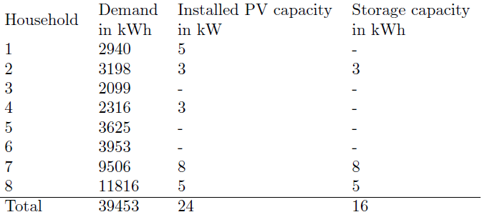
Preliminary Results – EC Set-Up
8 Households per EC
Grid level 7
125000 ECs in Austria (-> 25 % of all Housholds)

Slide 15
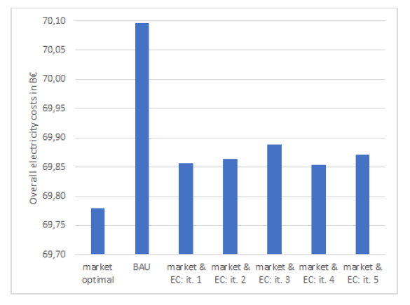
Preliminary Results: OV costs
Several Iterations ->
no significant difference
BAU vs. EC:
0.33 % cost reduction
BAU vs. market optimum:
0.46 % cost reduction
Delta Social Welfare: ~90 M€
EC savings: 50 M€

Slide 16
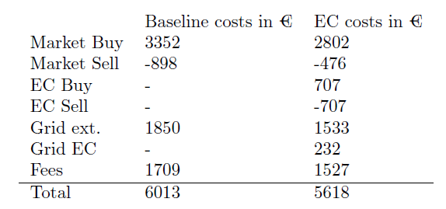
Preliminary Results – EC cost savings
Less PV feed-in
Less ext. grid usage
267€ less grid tariffs & fees
128€ savings: PV & storage usage
6.6 % total

Slide 17
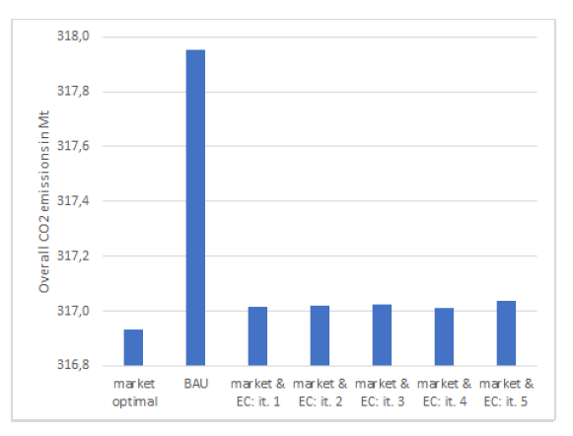
Preliminary Results: OV CO2 emissions
BAU vs. EC:
-0.3 % emissions
BAU vs. market optimum:
-0.32 % emissions

Slide 18
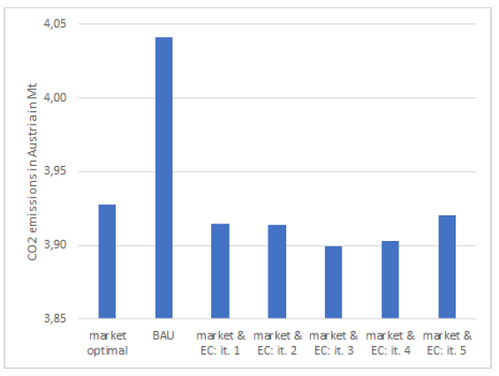
Preliminary Results: CO2 Austria
Lower emissions with ECs than in “market optimal”
Objective: Costs (CO2 price -> CO2)
Oil, Coal, Lignite < Gas usage
Austria 100 % net. RES-E
“Market optimal” more flexibilities (storages)
More Gas in AT
Less Coal NL and DE
Less Lignite CZ and DE

Slide 19
Ausblick
Aggregierte Teilnahme am Regelenergiemarkt
Veränderte Auslastung des Übertragungsnetzes
Einfluss von Leistungspreisen
Danke!
This work is done in the BEYOND project.
The BEYOND project has received funding in the framework of the joint programming initiative
ERANet Smart Energy Systems, with support from the European Union's Horizon 2020 research and innovation programme and is an associated project within Green Energy Lab.
Christoph Loschan, Daniel Schwabeneder, Georg Lettner
(TU Wien – Energy Economics Group)

Slide 20
References
[1] Icons: Were designed by TU Wien ESEA (Source: https://gitlab.com/team-ensys/energy-system-icons)

