Slide 1
Investigating the demand side flexibility of the residential building stock
Philipp MASCHERBAUER, Lukas KRANZL
IEWT 2021
06.09.2021

Slide 2


NewTrends – From Consumers to Prosumagers
Horizon 2020 project
How do New Societal Trends affect energy demand?
Work package 5 focuses on Prosumagers and big data (new data sources) in energy demand models related to the built environment
Link to the project: https://cordis.europa.eu/project/id/893311
My objective:
How can active demand response measures of buildings with heat pumps (HP) in the residential sector affect the aggregate load profile on the national level?
In this regard the potential storage of the thermal buildings mass is considered for every building
Bottom-up energy supply optimization of a national building stock. In: Energy and Buildings 209, S. 109667. DOI: 10.1016/j.enbuild.2019.109667

Slide 3
Method
Scenario
Policy and economics: hourly electricity price and feed-in tariff
Weather: hourly radiation and temperature
Behavior: target indoor temperature, lifestyle
Household
Country
PV
Size
→ profile
Building
Type
Age class
Components
Space cooling
Type of cooling system
Optimization model
Space heating
Type of heating system
Thermal storage size
Reference model
Battery
Capacity
Appliances
Dryer
Dish washer
Washing machine
Hot water
Demand profile from HOTMAPS
Load profiles
Load profiles
comparison

Slide 4
Method
Optimization model
Reference model
Perspective: household
Time resolution: hourly
Objective:
minimize the operation cost (s.t. hourly demand profiles of electricity / heating / cooling / hot water)
Decision variables:
hourly operation of technologies over one year
Perspective: household
Time resolution: hourly
Method of operation:
PV generated electricity is used to cover demand
Surplus of electricity from PV is stored
If storages are full or not available, surplus is sold
Appliances (dishwasher, washing machine, dryer) are started randomly throughout the day between 6 am and 9 pm.
Thermal inertia is not utilized as storage

Slide 5
Buildings
5 representative single family houses taken from the building stock database of the “Invert/EELab” for the case of Austria
Parameters of the representative buildings for calculation of the 5R1C model explained in DIN ISO 13790
Building ID | A_{f} [m²] | H_{op} [W/K] | H_{tr_w} [W/K] | H_{ve} [W/K] | C_{m} factor [J/K] | A_{m} [m²] | Construction year | Number of buildings
1 | 154 | 203 | 86 | 43.595 | 213 505 | 3 | 1961-1970 | 21 451
2 | 163 | 208 | 97 | 46.189 | 213 505 | 3 | 1971-1980 | 97 729
3 | 166 | 144 | 77 | 46.938 | 213 505 | 3 | 1981-1990 | 145 126
4 | 170 | 121 | 69 | 47.964 | 181 194 | 2.8 | 1991-2000 | 208 914
5 | 170 | 95 | 54 | 47.964 | 114 415 | 2.5 | 2001-2008 | 110 345
A_{f} … usable area
H_{op} … heat transmission coefficients for the opaque building components
H_{tr_w} … heat transmission coefficients for windows
H_{ve} … heat transfer coefficient for ventilation
C_{m} … internal heat storage capacity of the building
A_{m} … effective mass-related area

Slide 6

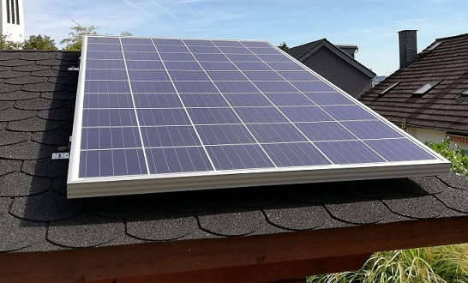



Electricity price type:
Indoor set temperature:
fixed
steady [20°C, 27°C]
Scenarios
variable
“smart” T_{min}=20°C+(T_{outside} – 20°C +12)/8
T_{max} = 27°C
1
2
3
4
5
No PV
No thermal storage
5 kWp PV
1500 l hot
water tank
10 kWp PV
No battery storage
7 kWh battery storage

Slide 7
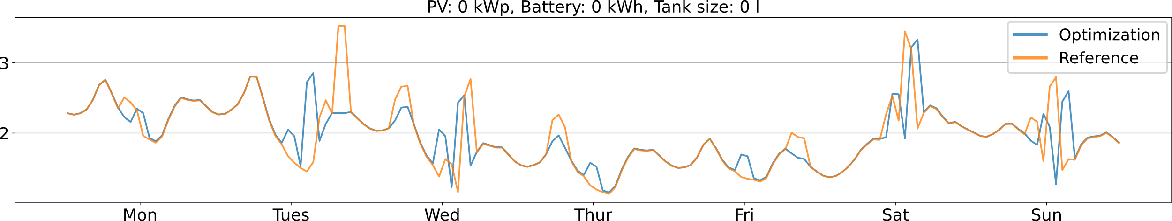
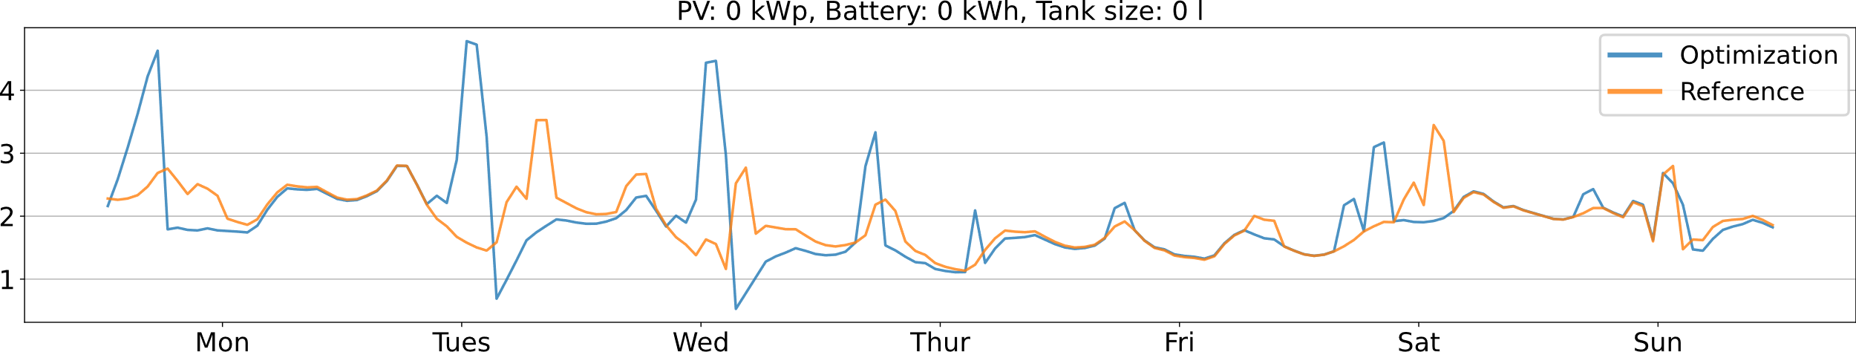
Preliminary Results
A flat electricity price does not promote load shifting without storages
Utilizing the thermal mass shifts peaks but also results in higher energy demand (due to losses)
Smart appliances
Week 8
fixed price
Electricity from
the grid (kw)
variable price
Electricity from
the grid (kw)
Building is preheated

Slide 8
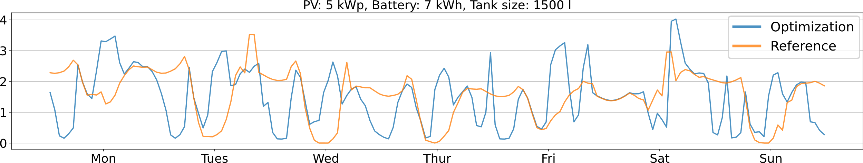
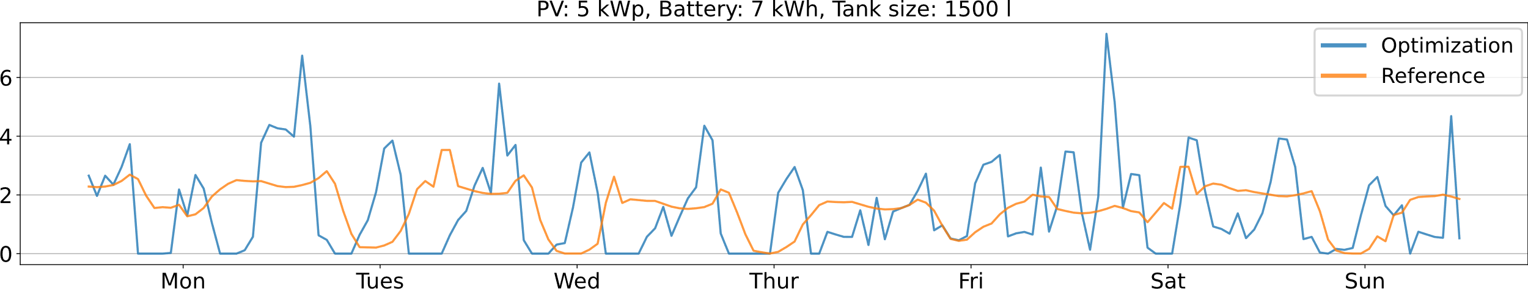
Preliminary results
When storages and PV are implemented the electricity demand becomes volatile especially when the price is variable
Week 8
fixed price
Electricity from
the grid (kw)
variable price
Electricity from
the grid (kw)
Notes:
Right now the heat pump has no restriction on load changing, these results will become less volatile when the heatpump is modeled more accurately in the further course of this research.

Slide 9
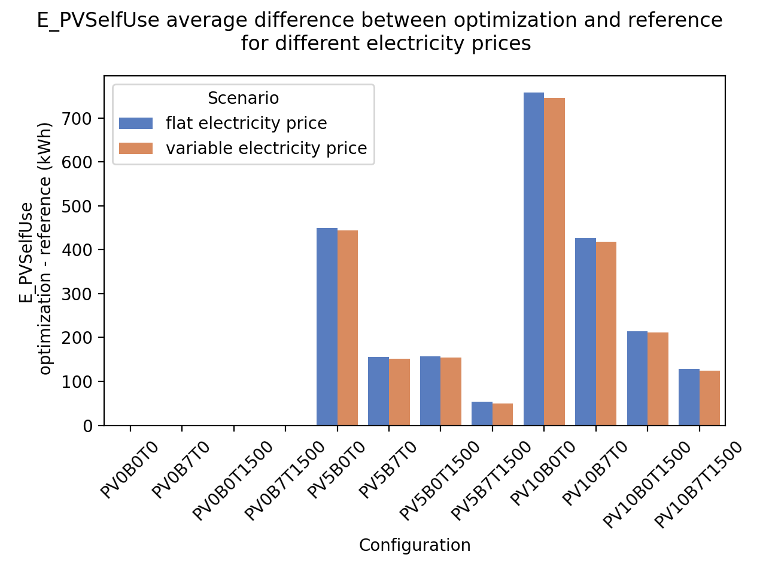
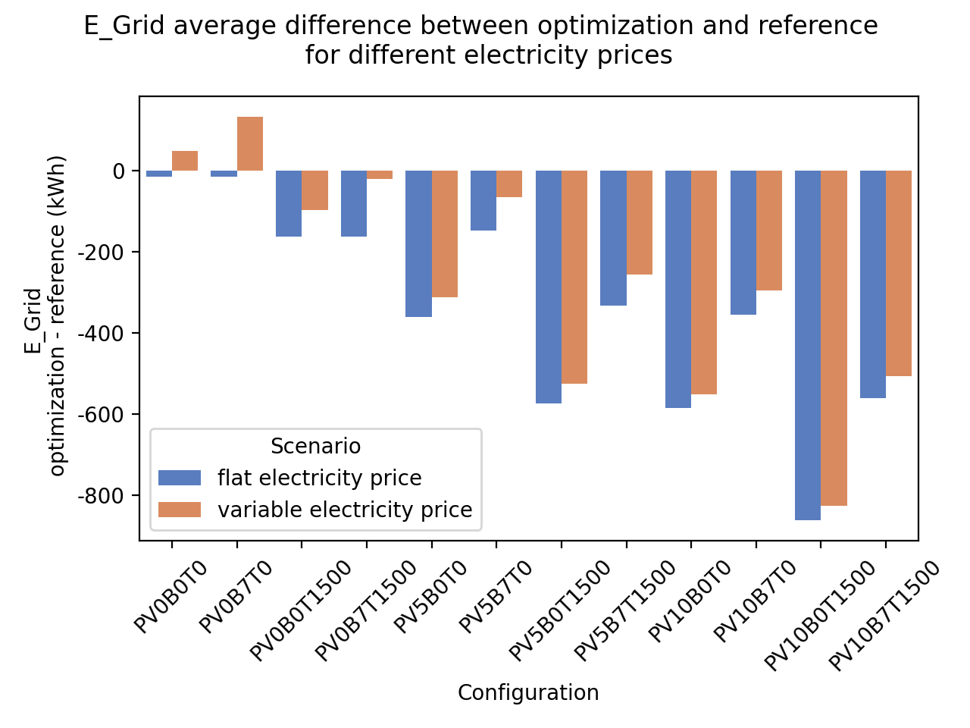
Preliminary results
The scenario with a variable electricity price results in a higher total electricity demand (because of losses)
PV and thermal storages reduce the total amount needed from the grid
The scenario with a fixed electricity always results in lower electricity used from the grid
Fixed price results in slightly higher PV self consumption compared to variable price
PV self consumption average difference between optimization and reference for different electricity prices
Grid electricity consumption average difference between optimization and reference for different electricity prices
Electricity from the grid (kwh)
(optimization - reference)
PV electricity self consumed (kwh)
(optimization - reference)
Preheating of buildings and use of battery
Storage result in higher losses
PV…Photovoltaic, B…Battery storage, T…Thermal storage
→ PV5B7T1500…PV: 5kWp, Battery storage: 7 kWh, Thermal storage: 1500 l

Slide 10
Conclusion and Outlook
Findings
Optimization will always result in lower Electricity demand (fixed price)
Variable electricity price results in large amounts of energy shifted and contrary to the fixed electricity price it will increase the electricity demand when no thermal storage and PV are available.
Even households without any kind of storage and PV can shift their demand considerably with their thermal mass
Outlook
Quantification of overall load shifting potential
Aggregation of load profiles to the whole building stock
Including the actual distribution of heating systems in the buildings as well as installed PV systems
Inclusion of investment costs
Development of different scenarios until 2050 by coupling this model with the building stock model „Invert“
Analyze cooling energy
Analyze effects in other countries

Slide 11
Thank you for your attention!
Philipp Mascherbauer
mascherbauer@eeg.tuwien.ac.at
Notes:
Thank you for you attention! If you have any questions or feedback, I am happy to hear it

Slide 12
