Slide 1

Evaluation of energy autarky-optimal technology portfolio of a local energy system
Frida Revheim, Daniel Schwabeneder, Georg Lettner
TU Wien Energy Economics Group
revheim@eeg.tuwien.ac.at
IEWT 2021
08.09.21

Slide 2
Introduction
Introduction and motivation
Methodology
Model development
Use cases
Preliminary results
Further work

Slide 3
Idea and motivation
Sector coupling could be part of a solution to reach GHG emission targets
Green hydrogen and green heat
Curtailment reduction
Energy autarky: “conceptualized as a situation in which the energy services used for sustaining local consumption, local production and the export of goods and services are derived from locally renewable energy resources.” (Müller et al., 2011)
Autarkic energy systems are able to lower their dependence on external energy systems
Key motivational factors:
Ensure continued implementation and operation of RES
Reduce GHG emissions
Enable energy autarky

Slide 4
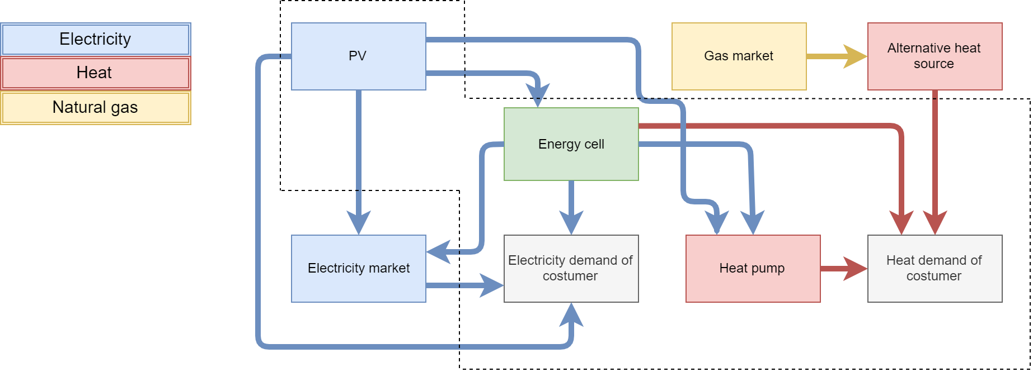
Methodology – model development
Model development builds on energy cell from Johann project [1] and considers the energy demands of a household
Investigated system includes both P2H and P2G technology
Additional heat pump considered in one use case
Remaining electricity and heat demand are met by heat and electricity bought from external sources

Slide 5
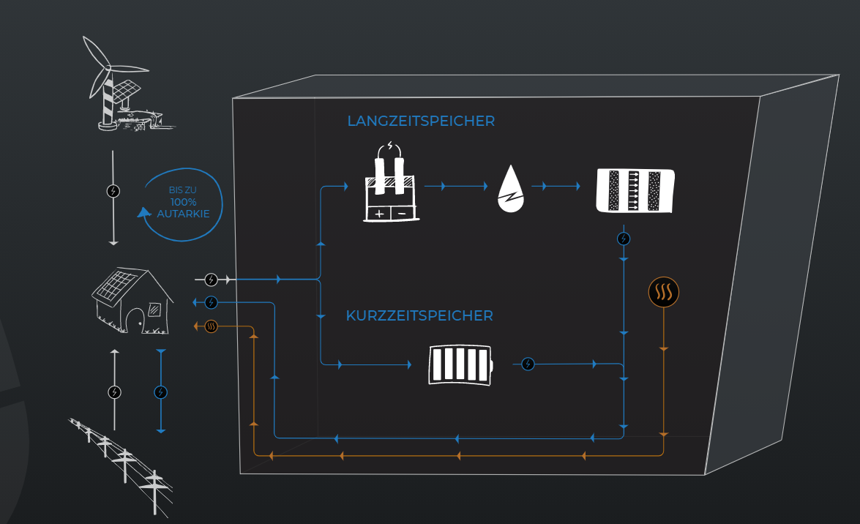
Methodology – model development
Johann energy cell developed by Elements Energy [2]
Battery for short-term electricity storage
Conversion to hydrogen for long-term storage by utilizing electrolyzer and H2 storage tanks
Fuel cell converts hydrogen back to electricity
Electricity is either used by customer or sold to electricity market
Excess heat from electrolysis and fuel cell processes are utilized to cover heat demand
Source: Elements Energy, https://www.elements-energy.at/

Slide 6
Methodology – model development
Optimization model of sector coupled system developed in Julia
Currently optimizing system operation with regards to autarky – further development to perform portfolio optimization
Aim: perform a portfolio optimization to evaluate the energy autarky-optimal technology portfolio of an energy system
Preliminary results are based on current operational optimization model where objective is set to minimize external energy purchase

Slide 7
Methodology – use cases
Two different use cases investigated in addition to baseline
Farmhouse
Heat pump considered in addition to energy cell
Riding stable
No heat pump
Baseline
No energy cell
Baseline
No energy cell
Farmhouse
D_{el} < D_{heat}
Additional heat pump
Riding stable
D_{el} > D_{heat}
No heat pump considered

Slide 8
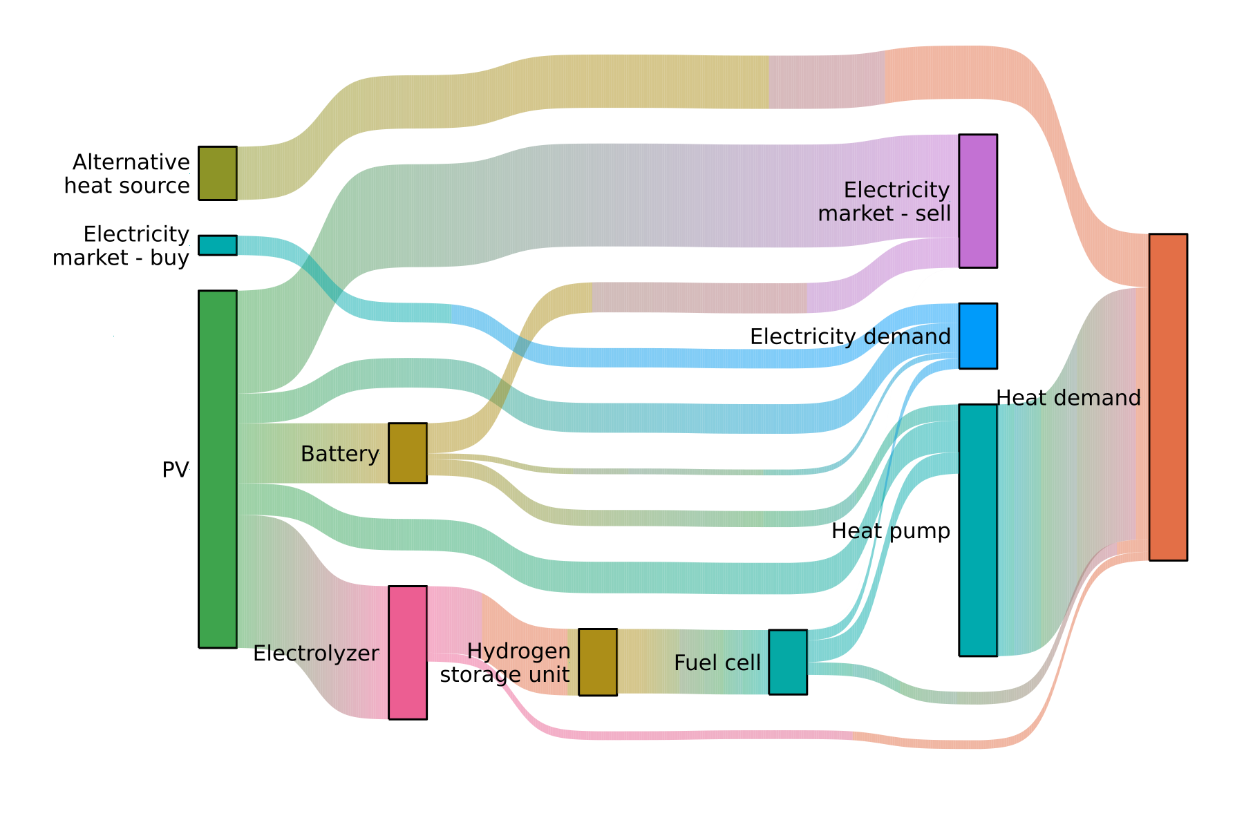
Preliminary results – farmhouse use case
Overview of technology utilization in farmhouse use case
Majority of generated electricity is either fed into energy cell (electrolyzer + battery) or sold to the electricity market
Heat pump covers around 77 % of assumed heat demand

Slide 9
Preliminary results – farmhouse use case
Degree of energy autarky increases under current assumptions
70 % energy self-reliance achieved for electricity demand
Majority of electricity demand met by electricity produced by PV
Both short-term and seasonal storage utilized when needed
84 % energy self-reliance achieved for heat demand
Implementation of heat pump increases the degree of energy autarky related to meeting the heat demand

Slide 10
Preliminary results – farmhouse use case
Significant GHG emission reduction potential
Implementing Johann energy cell results in
47 % reduction of emissions related to covering the electricity demand
68 % reduction of emissions related to covering the heat demand
Reduction potential depends on
Size of technology utilized
Emission factor of electricity mix
Alternative fuel considered (natural gas)

Slide 11
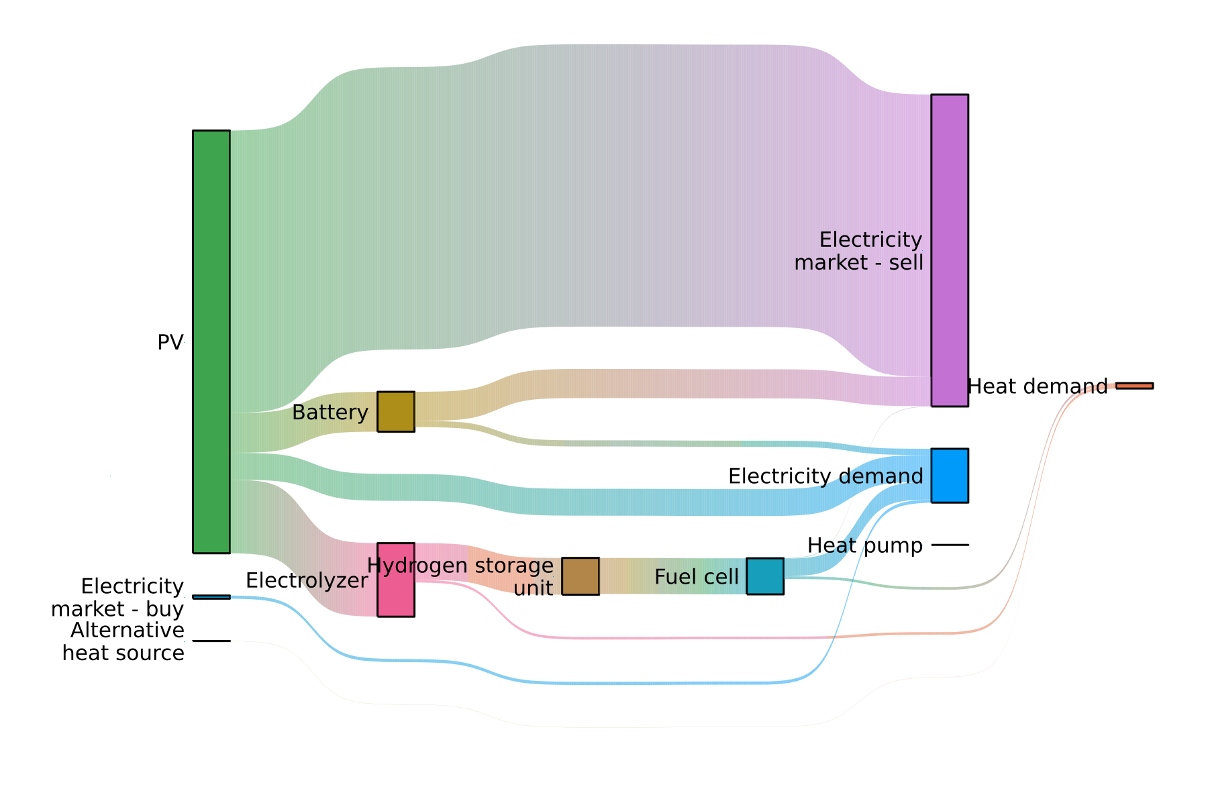
Preliminary results – stable use case
Overview of technology utilization in riding stable use case
Utilizing the energy cell combined with PV significantly reduces the amount of external electricity bought
No heat pump implemented → majority of heat demand is met by excess heat from internal processes

Slide 12
Preliminary results – stable use case
Degree of energy autarky increases under current assumptions
94 % energy self-reliance achieved for electricity demand
Majority of electricity demand met by electricity produced by PV
Both short-term and seasonal storage utilized when needed
97 % energy self-reliance achieved for heat demand
No heat pump implemented in this use case
Relatively low heat demand → excess heat from internal processes sufficient to meet heat demand

Slide 13
Preliminary results – stable use case
Significant GHG emission reduction potential
Implementing Johann energy cell results in
88 % reduction of emissions related to covering the electricity demand
97 % reduction of emissions related to covering the heat demand
Reduction potential depends on
Size of technology utilized
Emission factor of electricity mix
Alternative fuel considered (natural gas)

Slide 14
Concluding remarks and further work
Utilization of sector coupling concepts combined with short-term and seasonal electricity storage has the potential to
reduce GHG emissions
increase the degree of energy autarky
Portfolio optimization is yet to be performed
Further work
Evaluate optimal system topology under consideration of different degrees of autarky
Consider the possibility of having green hydrogen as output from the energy cell – as well as possible ways of utilization
Investigate the impact of local policy levers on influential parameters (e.g. energy demand, available fuel options)

Slide 15
References and acknowledgements
This work is done in the “Energy cell “JOHANN”” project [1] and is supported with the funds from the Climate and Energy Fund and implemented in the framework of the RTI-initiative “Flagship region Energy” within Green Energy Lab.
[1] Energiezelle „JOHANN“, Green Energy Lab, https://greenenergylab.at/projects/energiezelle-johann/
[2] Der Hybrid-Energiespeicher der Zukunft - JOHANN, Elements Energy, https://www.elements-energy.at/
[3] Matthias Otto Müller, Adrian Stämpfli, Ursula Dold, Thomas Hammer (2011). Energy autarky: A conceptual framework for sustainable regional development. Energy Policy, 39(10), 5800-5810. https://www.sciencedirect.com/science/article/pii/S0301421511003028

Slide 16
Frida Revheim
TU Wien
Energy Economic Group, EEG
Gußhausstraße 25-29 / E370-3
1040 Vienna, Austria
Email: revheim@eeg.tuwien.ac.at
Web: http://www.eeg.tuwien.ac.at
Thank you!

