Slide 1
Cost-benefit Analysis of Residential On-Site E-Carsharing
PhD-Day / IEWT, 07-10.09.2021
Carlo Corinaldesi, Georg Lettner

Slide 3
Motivation
“Carsharing is a growing phenomenon in the world. Previous research concerning the subject has established that local governments often enable carsharing by providing privileged access to parking because of the expected benefits associated with it.
(J. Raaska et al. 2020)“
Research question 1: What are the financial benefits of residential on-site E-Carsharing?
Research question 2: How much can the space needed for parking be reduced?
Research question 3: What is the impact of an E-Carsharing concept for a residential building?
Research question 4: In which set up does it become cost-effective to perform V2G?
Research question 5: How can we construct a comprehensive mathematical E-Carsharing model to answer these questions?

Slide 4
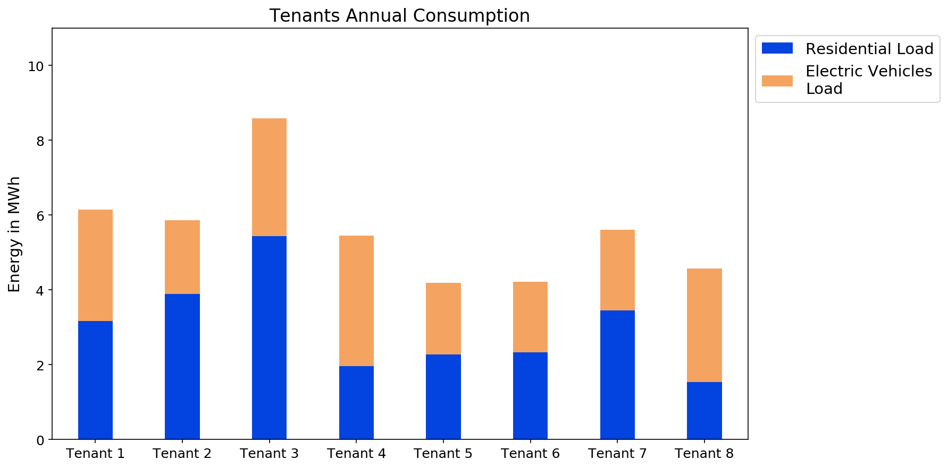
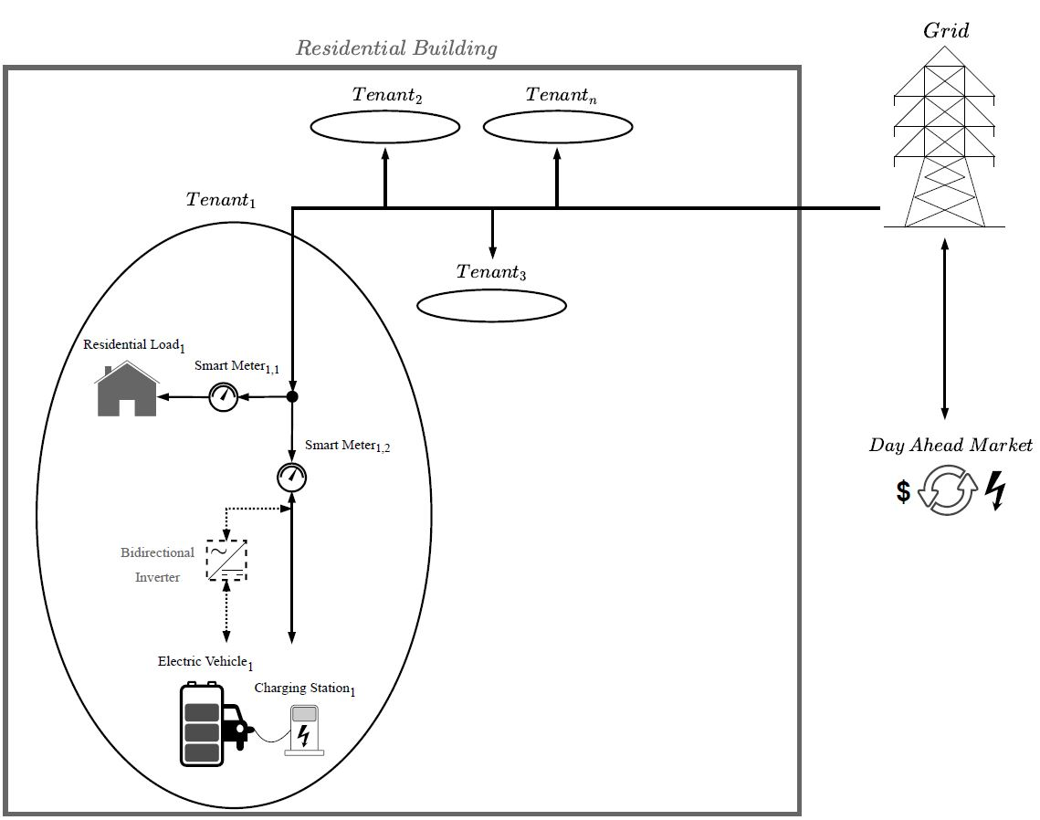
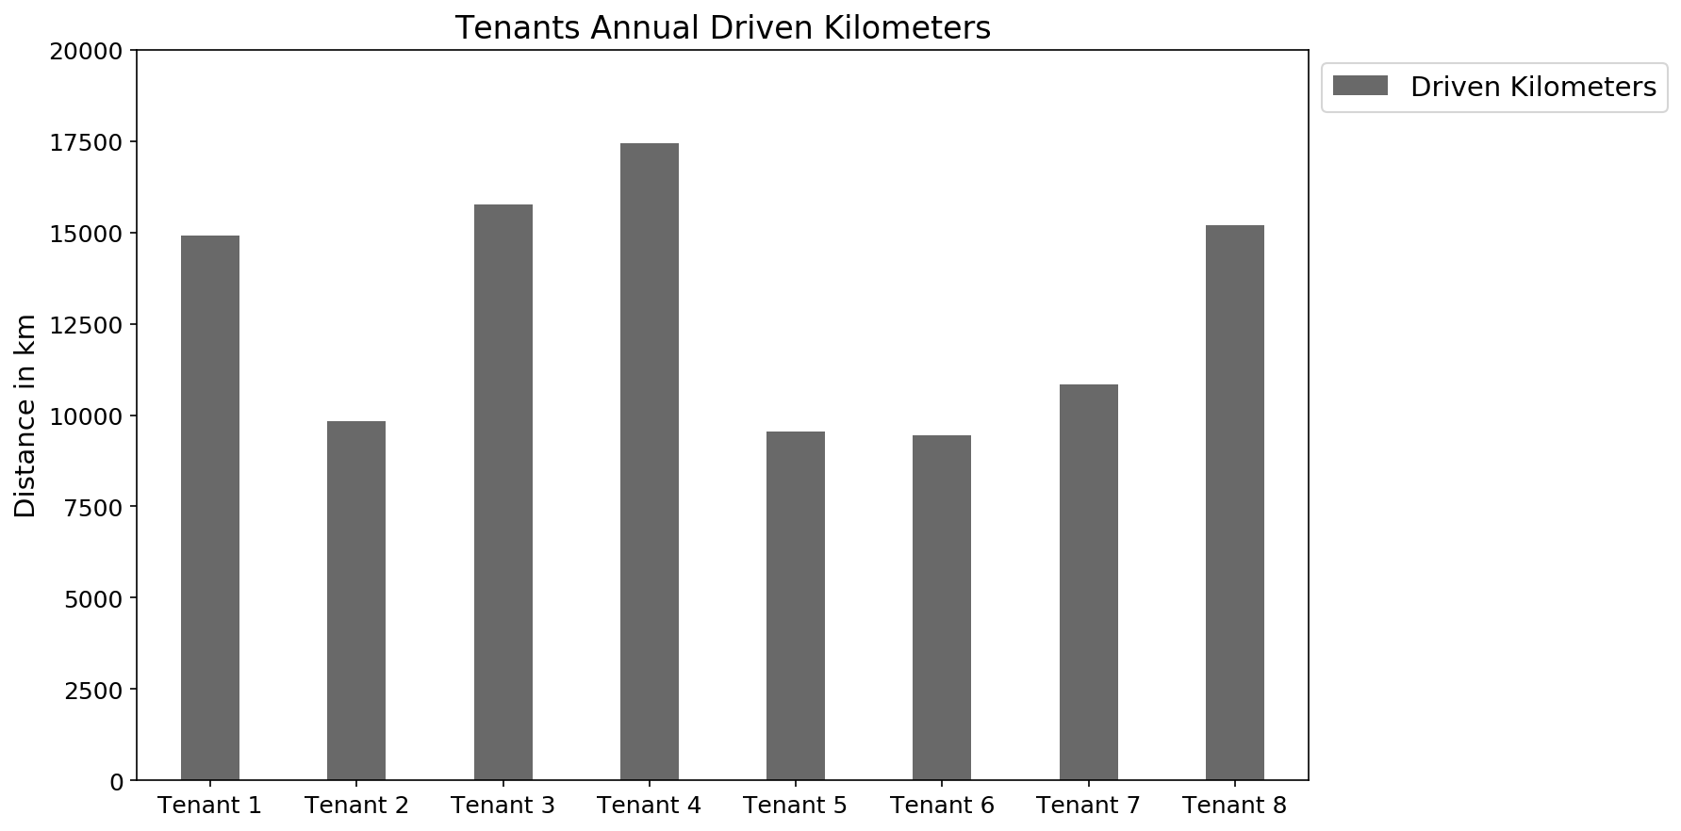
Case Study
Tenant number | Tenant type
1 | Couple, 30 - 64 age, with work
2 | Family, 1 child, both with work
3 | Family, 3 children, both with work
4 | Single man, jobless
5 | Single woman with work
6 | Single woman, 30 - 64 years, with work
7 | Single man, 30 - 64 age, shift worker
8 | Student, woman, Philosophy

Slide 5
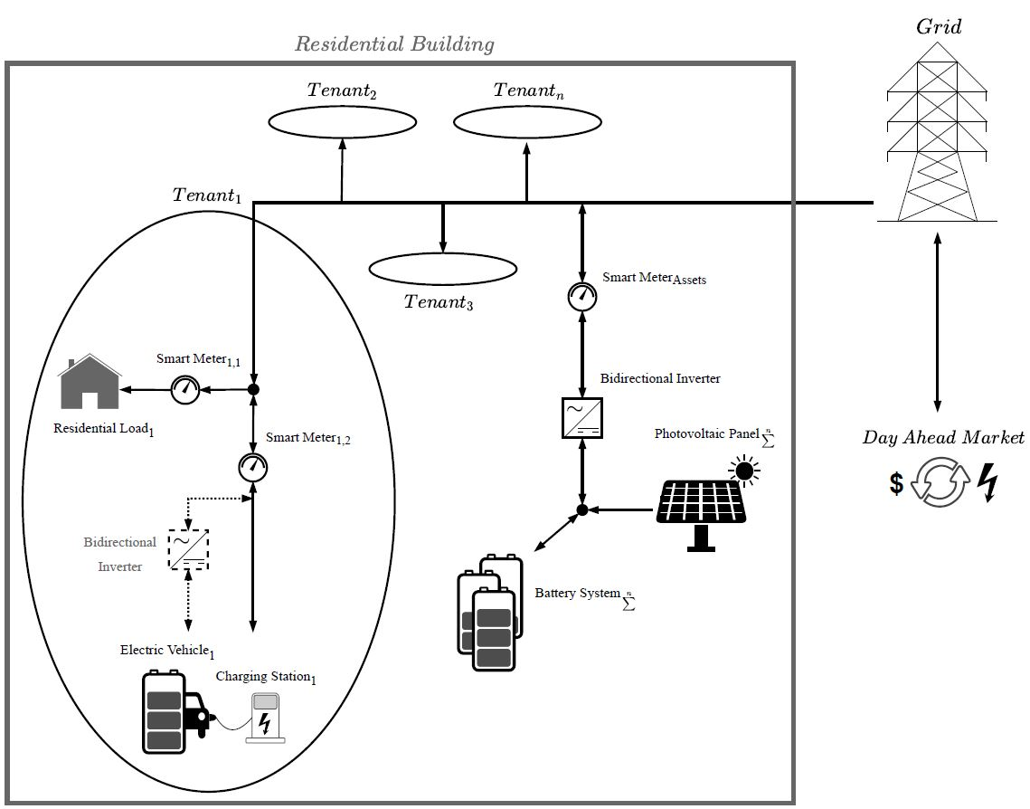
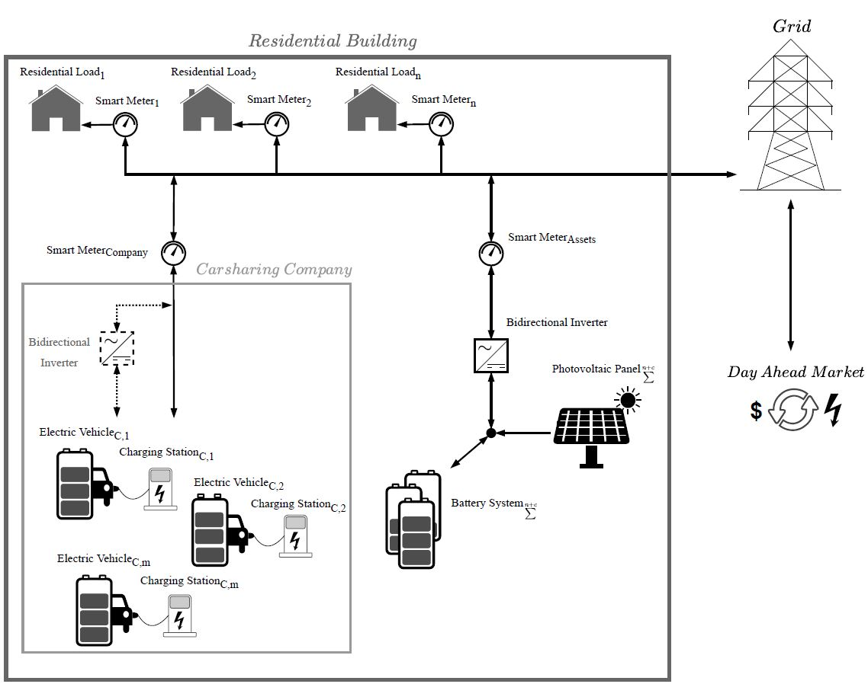
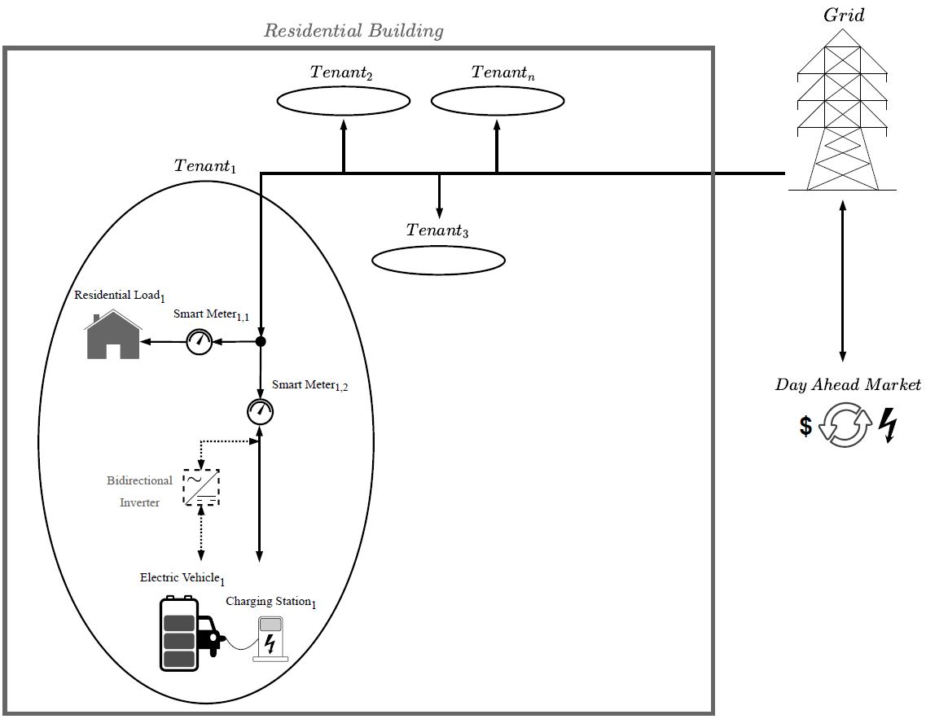
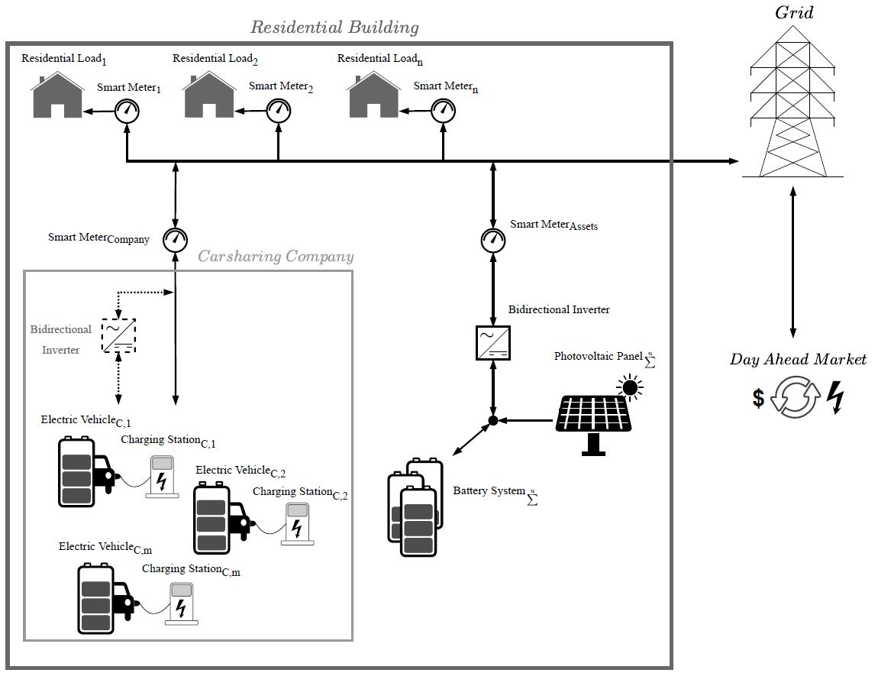
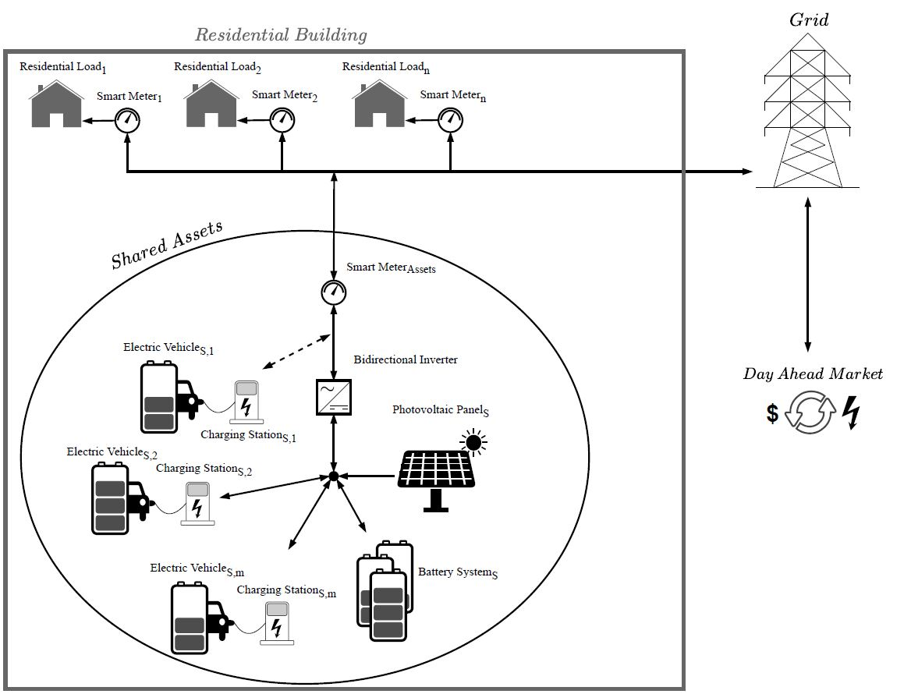
Scenarios
Baseline
Individual
External
E-Car-Sharing Company
Partially integrated
E-Car-Sharing Company
Fully integrated
E-Car-Sharing Company

Slide 6
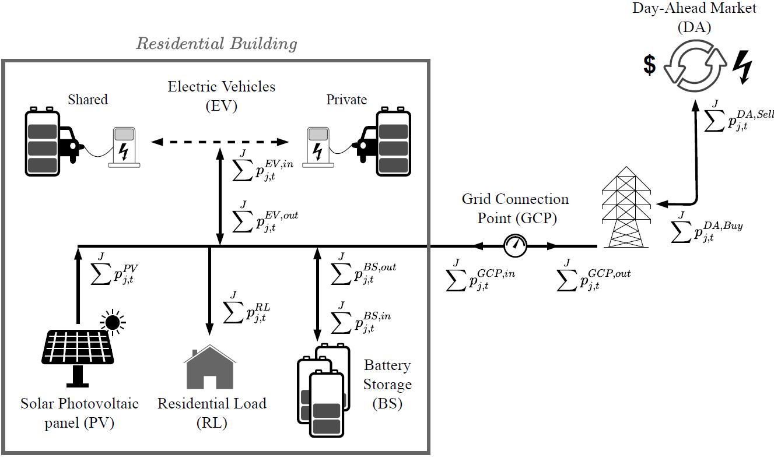

Optimization Framework
Power Balance at the Grid Connection Point:
Total Costs:

Slide 7



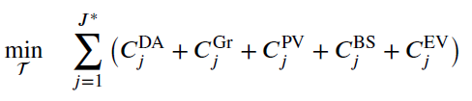
Objective functions in the different scenarios
Baseline:
Individual:
External E-Car-Sharing Company:
Partially integrated E-Car-Sharing Company:
Fully integrated E-Car-Sharing Company:
{
{

Slide 8





Optimization Framework – Costs
Total Costs:
The Day-Ahead costs are given by the product of the power flow at the grid connection point and the Day-Ahead Market prices
The grid costs consist of three components and depend on the grid level: an energy-related component, a power-related and a fixed flat rate.
The photovoltaic costs are given by the product of the installed capacity and the specific investment costs in EUR/kWp.
The battery costs are given by the product of the installed battery capacity and its specific costs.
The electric vehicles costs consist of three components: Ther investment costs of the electric vehicles, the electric vehicles levelized costs of storage and the investment costs of the charging station.

Slide 9
Results – Baseline
Animation

Slide 10
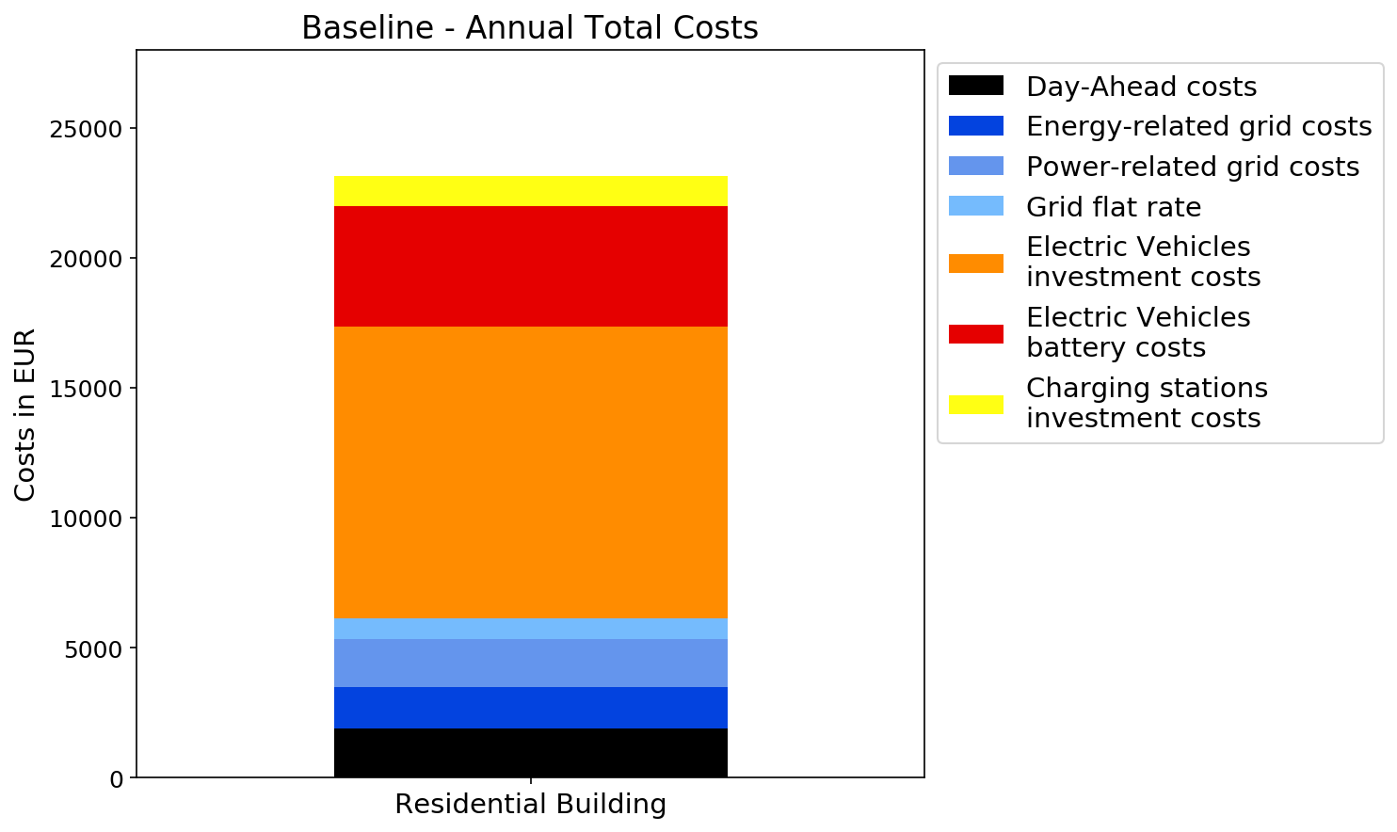
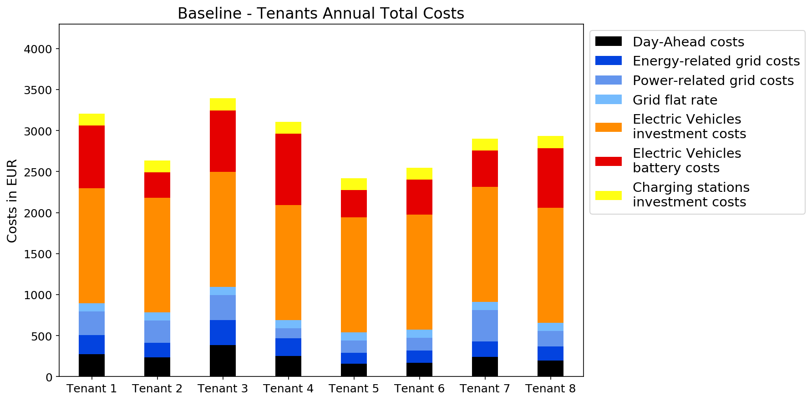
Results – Baseline – Annual Costs
Bidirectional charging stations are not convenient, not even for peak shaving.

Slide 11
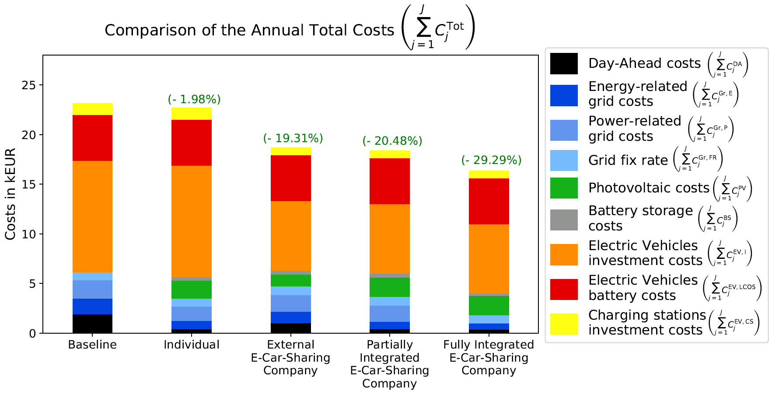
Results – Comparison of the Annual Total Costs

Slide 12
Results – External Carsharing Company
Animation

Slide 13
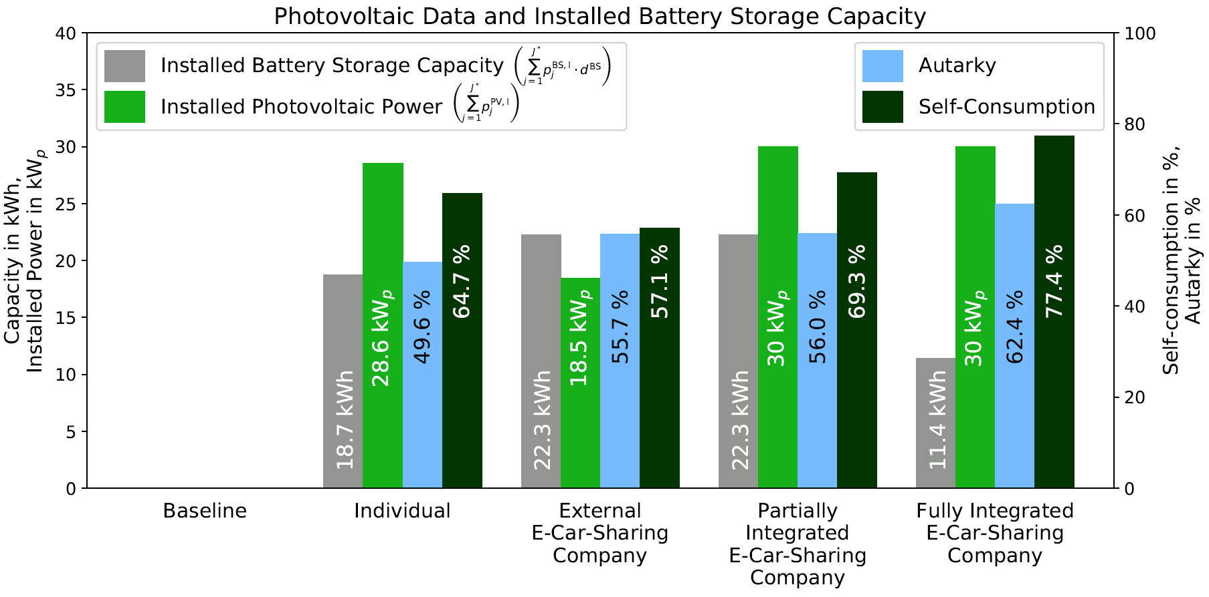
Results – Comparison of the Photovoltaic Data and Installed Battery
Storage Capacity

Slide 14
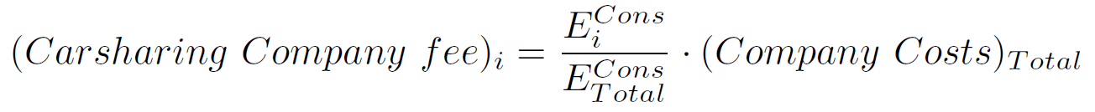
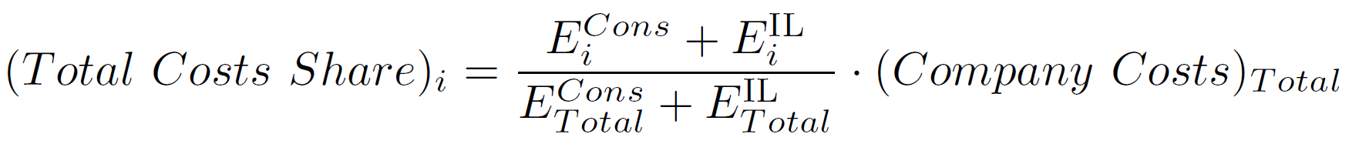
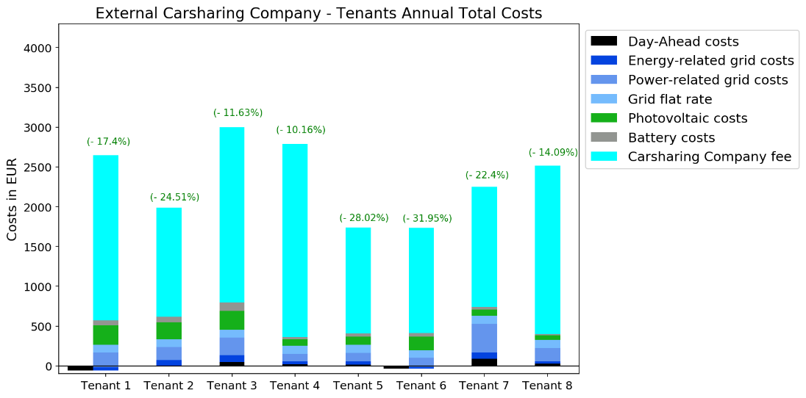
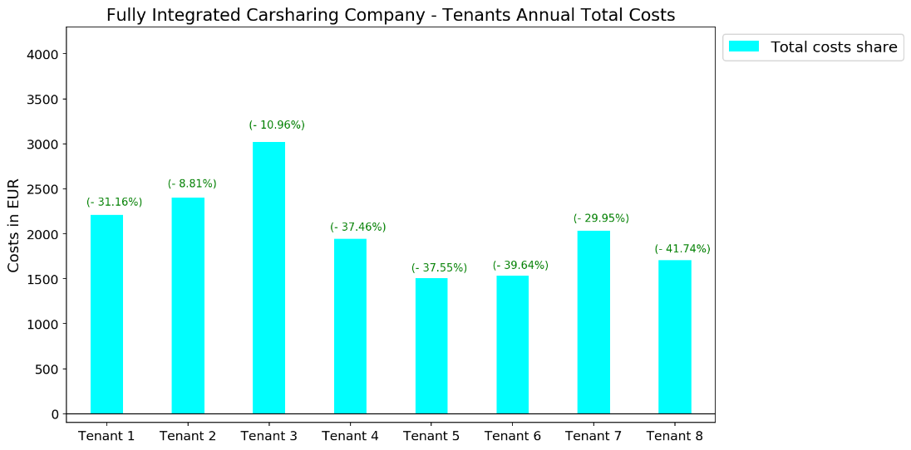
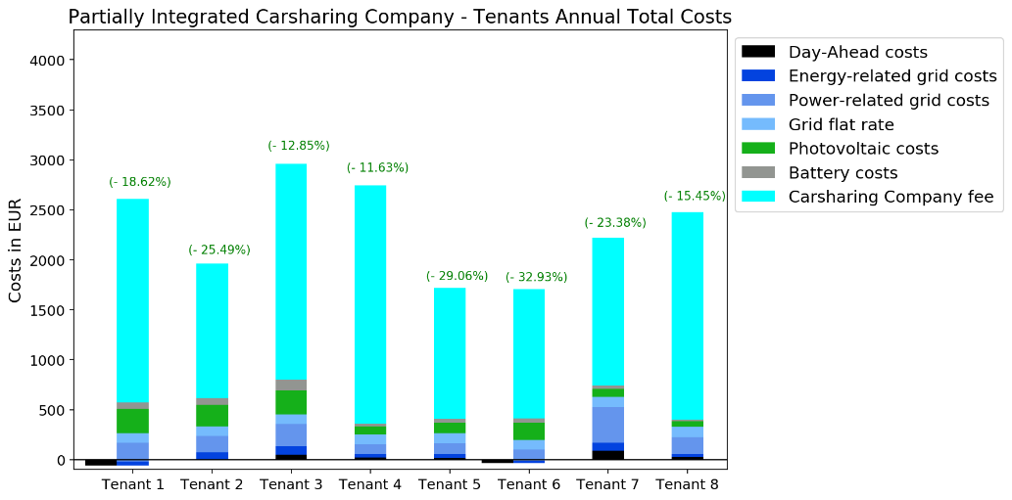
Results – Partially Integrated Carsharing Company – Annual Costs

Slide 15
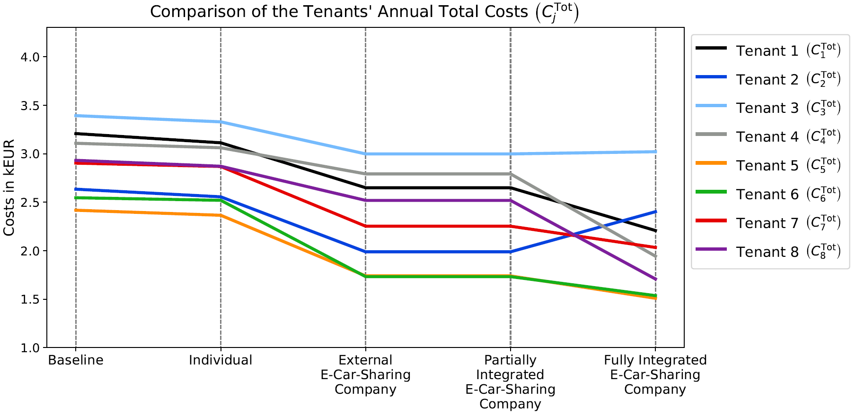

Results – Comparison of the Tenants Annual Total Costs

Slide 16
Conclusions and Outlook
Our work presents a comprehensive overview of modeling and evaluating the potential of a residential E-Carsharing concept and shows how residential on-site E-Carsharing can lead to considerable overall costs reductions.
The E-Carsharing concept allows for fewer cars, but charging stations with higher nominal power are installed.
No cars lead to lower flexibility and consequently to lower photovoltaic self-consumption and autarky.
Managing the charging of electric vehicle reduces the optimal size of the stationary batteries.
The model will be tested and validated in different real-life use cases in Austria within the flagship project Car2Flex.
It will be investigated whether other markets, such as the reserve markets, can make E-Carsharing and in particular V2G cost-effective.

Slide 17
Thank you for your attention
Carlo Corinaldesi
[T] +43-(0)1-58801-370370
[E] corinaldesi@eeg.tuwien.ac.at

