Slide 1

The impact of Grid Tariff design on Energy Communities
Daniel Schwabeneder, Georg Lettner, Frida Revheim, Matthias Maldet
TU Wien – Energy Economics Group
IEWT 2021
12. International Energiewirtschaftstagung
08.-10.09.2021
TU Wien & Online

Slide 2

Motivation
The BEYOND project (https://beyond-project.eu/) implements pilot projects for Local Energy Markets and Energy Communities in Austria, Norway and Ireland.
3 Austrian pilots:
  UC1 Großschönau: Distance-dependent energy prices.
  UC2 Klima- und Energie Modellregion Retz: Local grid tariffs for Energy Communities
  UC3 Klagenfurt: Portfolio optimization for Energy Community of SMEs
In this context, this presentation investigates the impact of different tariff design options (reduced Community tariff, peak load pricing) on the operation of Energy Communities:
  Total customer cost
  Consumption and feed-in peaks
  Local consumption of PV

Slide 3
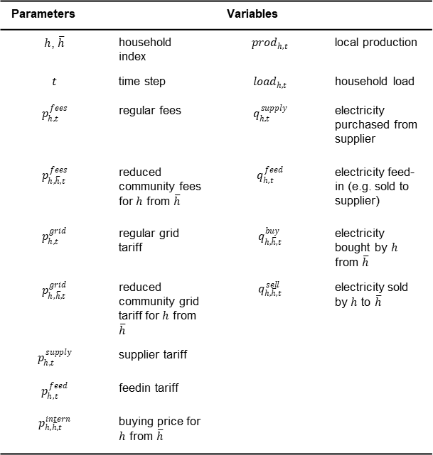
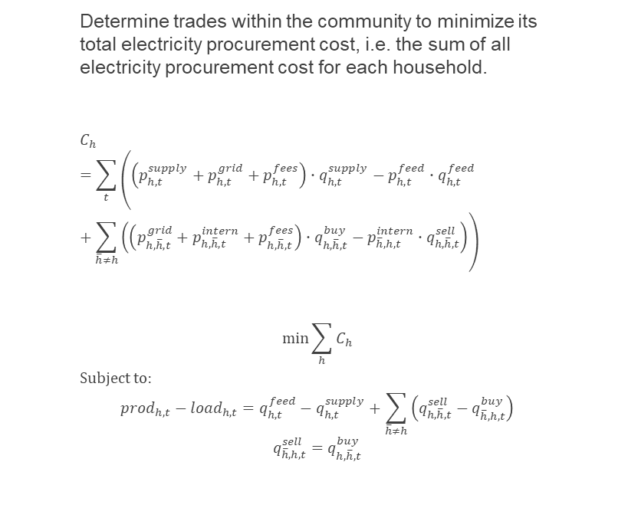
Methods - Operational Community Optimization
Determine trades within the community to minimize its total electricity procurement cost, i.e. the sum of all electricity procurement cost for each household.
$$C_{h}=\sum_{t}{\left(\left({p_{h,t}^{supply}+p}_{h,t}^{grid}+p_{h,t}^{fees}\right)∙q_{h,t}^{supply}−p_{h,t}^{feed}∙q_{h,t}^{feed}+\sum_{\overline{h}≠h}{\left(\left(p_{h,\overline{h},t}^{grid}+p_{h,\overline{h},t}^{intern}+p_{h,\overline{h},t}^{fees}\right)∙q_{h, \overline{h},t}^{buy}−p_{\overline{h},h,t}^{intern}∙q_{h,\overline{h},t}^{sell}\right)}\right)}$$
$$\min{\sum_{h}{C_{h}}}$$
Subject to:
$${prod}_{h,t}−{load}_{h,t}=q_{h,t}^{feed}−q_{h,t}^{supply}+\sum_{\overline{h}≠h}{\left(q_{h,\overline{h},t}^{sell}−q_{\overline{h},h,t}^{buy}\right)}$$
$$q_{\overline{h},h,t}^{sell}=q_{h,\overline{h},t}^{buy}$$
Parameters |  | Variables
$h$, $\overline{h}$ | household index | $${prod}_{h,t}$$ | local production
$$t$$ | time step | $${load}_{h,t}$$ | household load
$$p_{h,t}^{fees}$$ | regular fees | $$q_{h,t}^{supply}$$ | electricity purchased from supplier
$$p_{h,\overline{h},t}^{fees}$$ | reduced community fees for $h$ from $\overline{h}$ | $$q_{h,t}^{feed}$$ | electricity feed-in (e.g. sold to supplier)
$$p_{h,t}^{grid}$$ | regular grid tariff | $$q_{h, \overline{h},t}^{buy}$$ | electricity bought by $h$ from $\overline{h}$
$$p_{h,\overline{h},t}^{grid}$$ | reduced community grid tariff for $h$ from $\overline{h}$ | $$q_{h,\overline{h},t}^{sell}$$ | electricity sold by $h$ to $\overline{h}$
$$p_{h,t}^{supply}$$ | supplier tariff
$$p_{h,t}^{feed}$$ | feedin tariff
$$p_{h,\overline{h},t}^{intern}$$ | buying price for $h$ from $\overline{h}$

Slide 4






Household types and Data sources
6 Household types:
Data sources:
LoadProfileGenerator (https://www.loadprofilegenerator.de/): Electricity load
RenewablesNinja (https://www.renewables.ninja/): PV production and outdoor temperature
Mobility demand: Randomly generated based on probability distributions for plugin and unplug times, km driven and consumption in kWh/km
Sources for grid tariff, fees & surcharges and electricity prices:
Systemnutzungsentgelte-Verordnung 2018 online avaialable at https://www.ris.bka.gv.at/GeltendeFassung.wxe?Abfrage=Bundesnormen&Gesetzesnummer=20010107 (accessed on 21.06.2021)
Ökostromgesetz 2012 online available at https://www.ris.bka.gv.at/GeltendeFassung.wxe?Abfrage=Bundesnormen&Gesetzesnummer=20007386 (accessed on 21.06.2021)
Verordnung über die Bestimmung des Ökostromförderbeitrags für 2020 online available at https://www.ris.bka.gv.at/Dokumente/Begut/BEGUT_COO_2026_100_2_1694894/BEGUT_COO_2026_100_2_1694894.html (accessed on 21.06.2021)
KWK-Gesetz 2014 online avalailable at https://www.ris.bka.gv.at/Dokumente/Bundesnormen/NOR40164194/NOR40164194.html (accessed on 21.06.2021)
Elektrizizätsabgabegesetz 1996 online available at https://www.ris.bka.gv.at/GeltendeFassung.wxe?Abfrage=Bundesnormen&Gesetzesnummer=10005027 (accessed on 21.06.2021)
ENTSO-E Transparency Platform online available at https://transparency.entsoe.eu/ (accessed on 26.06.2021)
Erneuerbaren-Ausbau-Gesetz (EAG) online available at https://www.bmk.gv.at/service/presse/gewessler/20210317_eag.html (accessed on 23.03.2021)
A
B
C
D
E
F

Slide 5
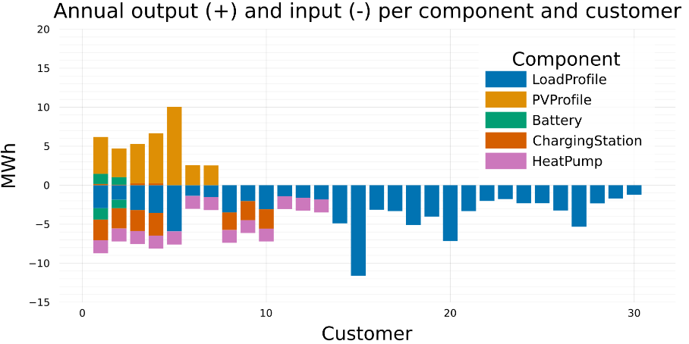
Present Setup
30 Households
Tariff assumptions | Fix component (EUR/a) | Volumetric component (EUR/MWh)
Supply tariff | 69.00 | 40.97 (1.2 * average market price + 1.2)
Feed-in tariff | - | 33.14 (average market price)
Grid tariff | 64.80 | 46.53
Fees & surcharges | 19.97 | 26.75
A
2
B
2
C
3
D
3
E
3
F
17
Individual optimization of each household
Fix supplier tariffs (EUR/MWh)
Grid tariff and fees for non-metered customers

Slide 6
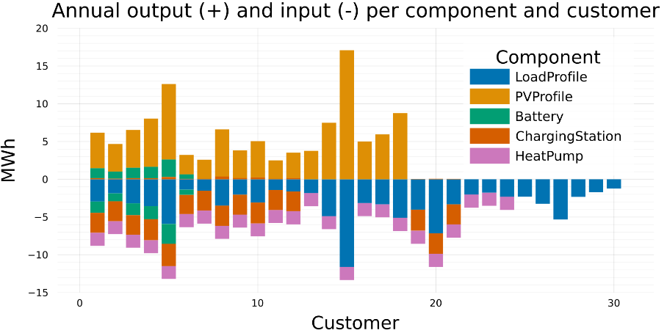
Future Setup
30 Households
Tariff assumptions | Fix component (EUR/a) | Volumetric component (EUR/MWh)
Supply tariff | 69.00 | 1.2 * market price + 1.2 (Ø 40.97)
Feed-in tariff | - | market price (Ø 33.14)
Grid tariff | 64.80 | 46.53
Fees & surcharges | 19.97 | 26.75
A
6
B
6
C
6
D
3
E
3
F
6
Individual optimization of each household
Variable supplier tariffs (EUR/MWh)
Grid tariff and fees for non-metered customers

Slide 7
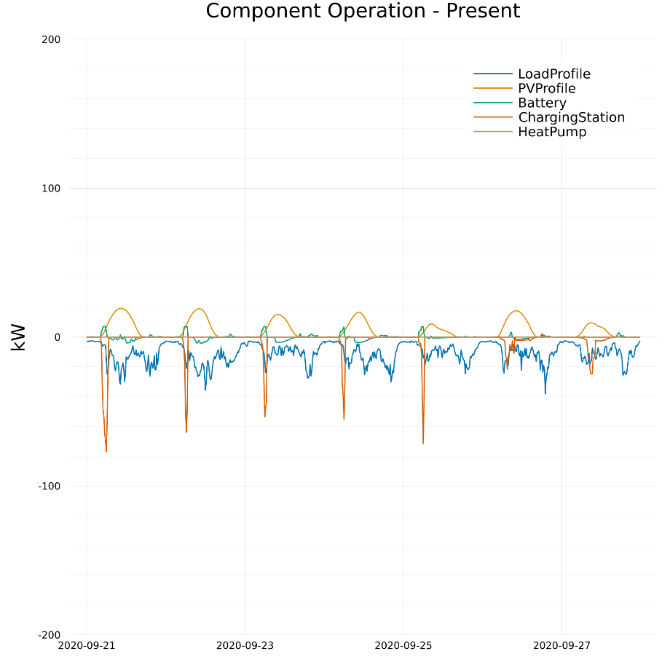
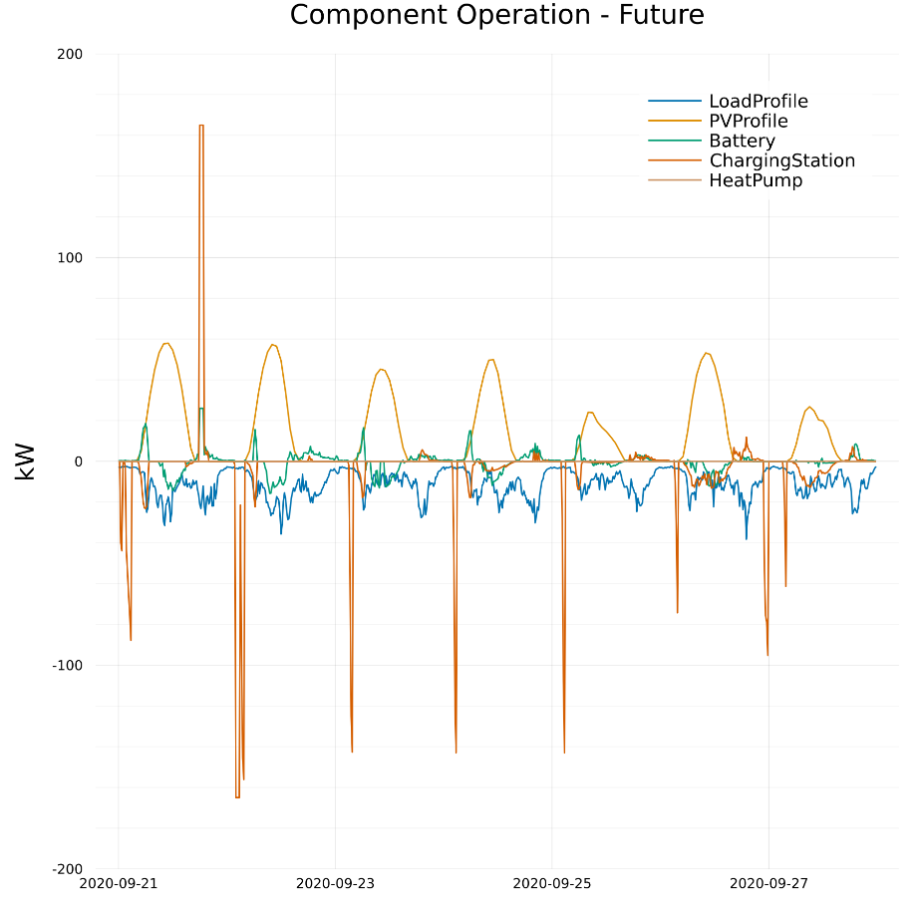
Component operation – Week 39

Slide 8
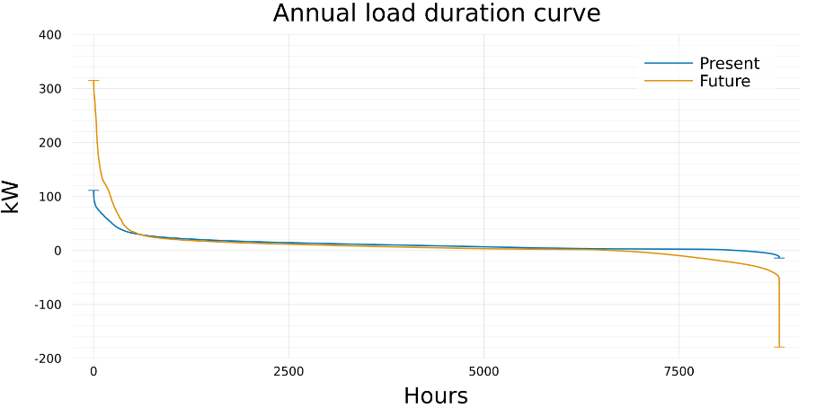
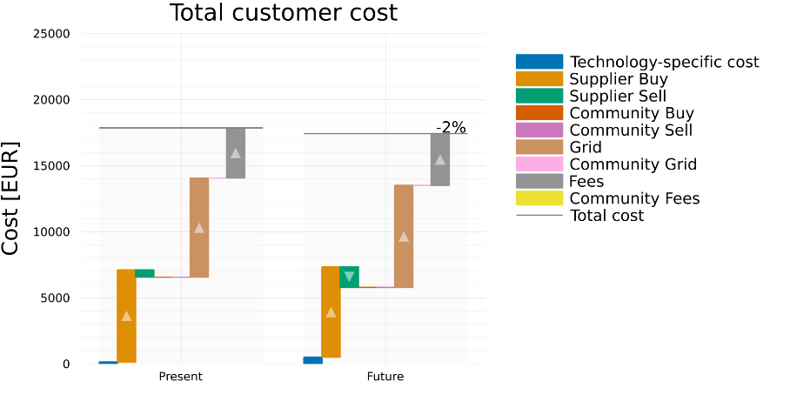
Present vs Future
The maximal load increases by 180 % from 111 kW to 315 kW.
The DSO‘s revenue from grid tariffs only increases by 2.9 % from 7500 EUR to 7720 EUR.
Assuming that the DSO is currently operating their grid efficiently, this may require additional investments in grid infrastructure and result in a financing gap for the DSO.

Slide 9
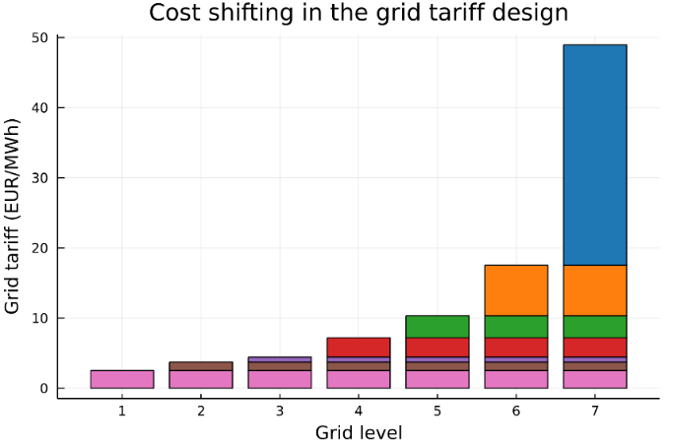
Energy Communities
Can energy communities provide benefits here?
Two cases:
Community with regular grid tariff, fees & surcharges
Community with reduced grid tariff, fees & surcharges according to EAG
Tariff assumptions | Fix component (EUR/a) | Volumetric component (EUR/MWh)
Supply tariff | 69.00 | 1.2 * market price + 1.2 (Ø 40.97)
Feed-in tariff | - | market price (Ø 33.14)
Internal price for community trades | - | (Supply tariff + Feedin tariff) / 2 (Ø 37.01)
Internal price for community trades with reduced grid tariff and fees | - | Internal price + (Grid tariff reduction + Fees reduction) / 2 (Ø 57.88)
Grid tariff | 64.80 | 46.53
Reduced grid tariff for community trades | - | 31.63
Fees & surcharges | 19.97 | 26.75
Reduced fees & surcharges for community trades | - | 0.00

Slide 10
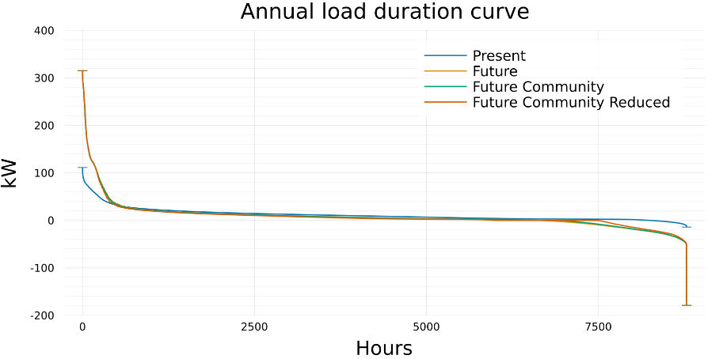
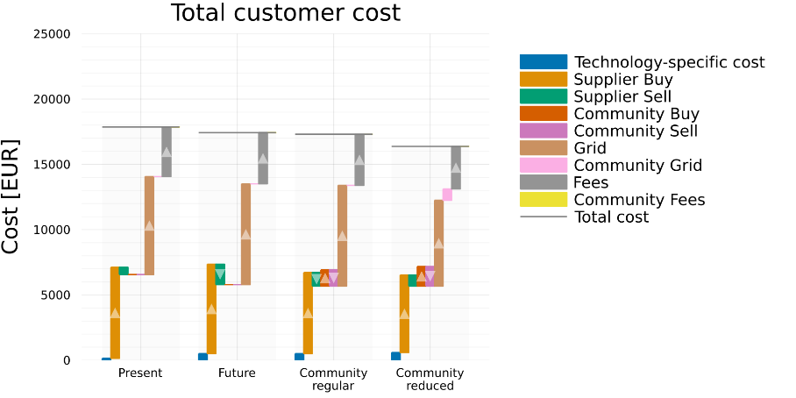
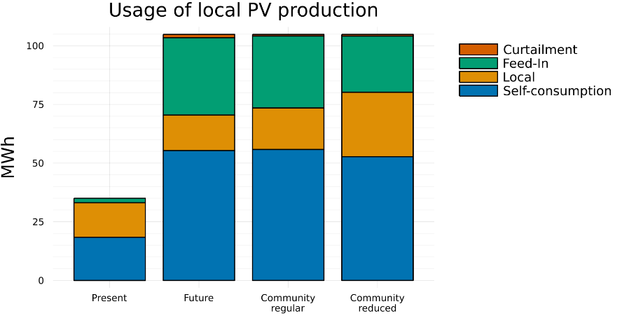
Impact of forming a Energy Community
Community operation does not affect the maximal load and feed-in values.
Community operation provides cost reductions for customers.
Community operation results in higher shares of local usage of PV production.

Slide 11
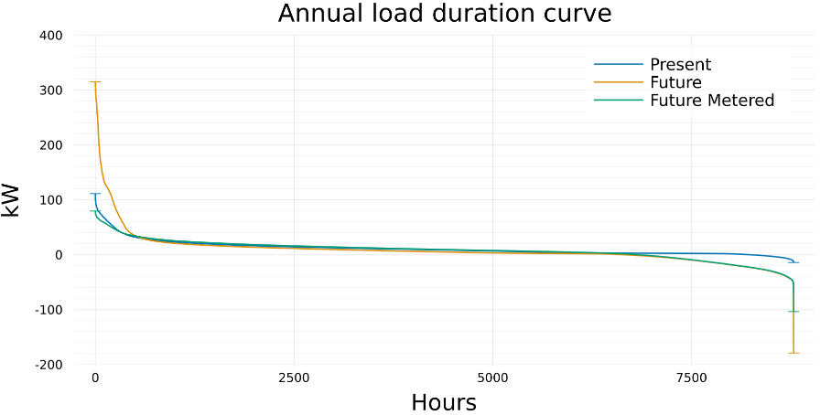
Future Setup with Peak load pricing
Reduction of peaks can be incentivized with peak-load-pricing.
Individual optimization of each household
Variable supplier tariffs (EUR/MWh)
Grid tariff and fees for metered customers
Tariff assumptions | Fix component (EUR/a) | Volumetric component (EUR/MWh) | Peak load pricing (EUR/kW_{p}/a)
Supply tariff | 69.00 | 1.2 * market price + 1.2 | -
Feed-in tariff | - | market price | -
Grid tariff | 64.80 28.80 | 46.53 37.63 | 30.00
Fees & surcharges | 19.97 12.25 | 26.75 21.11 | 10.76
With peak-load pricing the maximal load and feed-in values are significantly reduced.
How does it affect the customer cost?

Slide 12
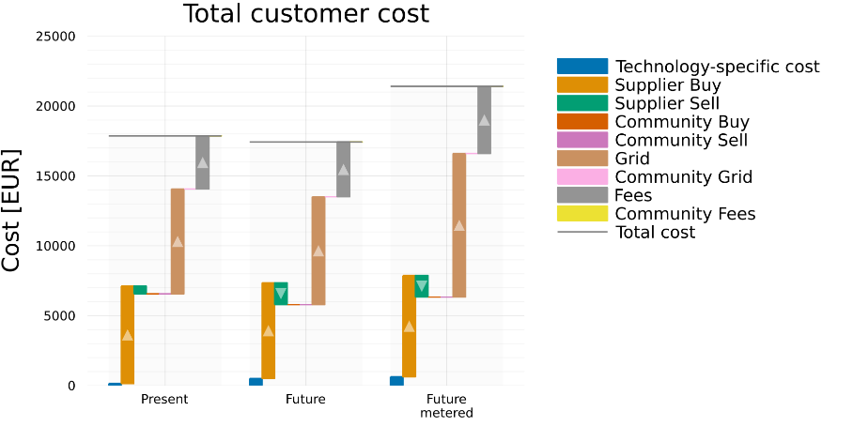
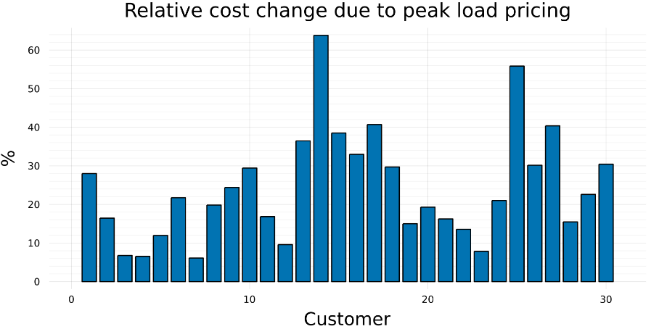
Cost change with peak load pricing
Peak load pricing leads to significantly higher cost for customers.
All household types are affected similarly.

Slide 13
Energy Communities with peak load pricing
How do Energy communities operate with peak load pricing?
Two cases:
Community with regular grid tariff, fees & surcharges
Community with reduced grid tariff, fees & surcharges according to EAG
Tariff assumptions | Fix component (EUR/a) | Volumetric component (EUR/MWh) | Peak load pricing (EUR/kW_{p}/a)
Supply tariff | 69.00 | 1.2 * market price + 1.2 (Ø 40.97) | -
Feed-in tariff | - | market price (Ø 33.14) | -
Internal price for community trades | - | (Supply tariff + Feedin tariff) / 2 (Ø 37.01) | -
Internal price for community trades with reduced grid tariff and fees | - | Internal price + (Grid tariff reduction + Fees reduction) / 2 (Ø 55.06) | -
Grid tariff | 28.80 | 37.63 | 30.00
Reduced grid tariff for community trades | - | 22.73 | -
Fees & surcharges | 12.25 | 21.11 | 10.76
Reduced fees & surcharges for community trades | - | 0.00 | -
With the reduced grid tariff, fees & surcharges, internal trades are not considered for the determination of peak loads.

Slide 14
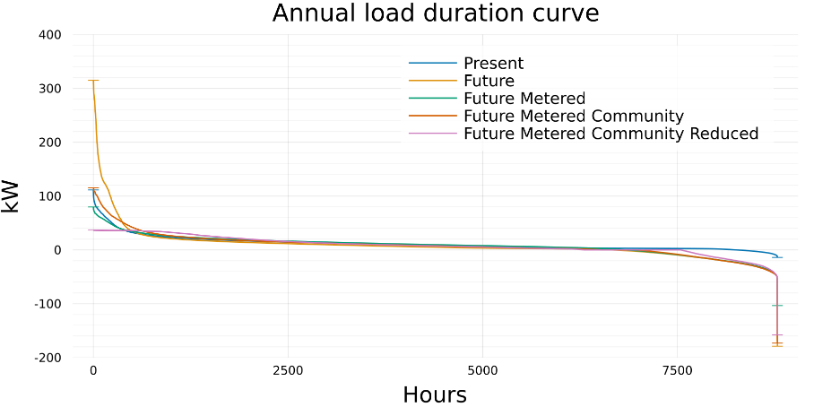
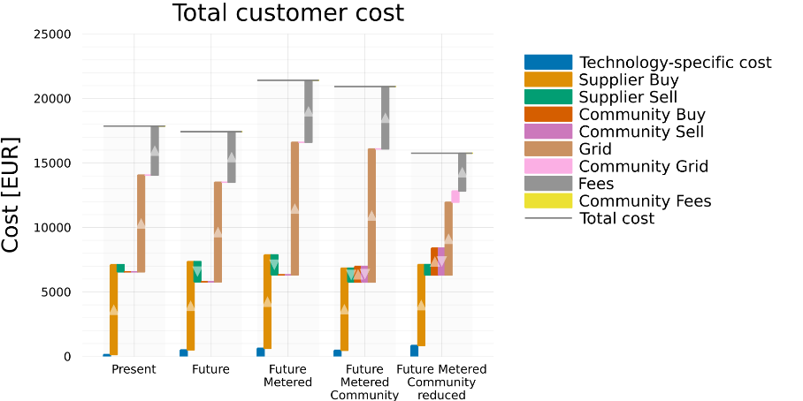
Energy Communities with peak load pricing
Energy Community operation increases (regular) or reduces (reduced) the maximal load and increases the maximal feed-in.
Total customer cost can be reduced by forming a Community.
The case with reduced grid tariffs and peak load pricing looks promising. However, it increases the maximal load / feed-in by 42 % and decreases the DSO‘s revenue by 25 % compared to the present scenario.

Slide 15
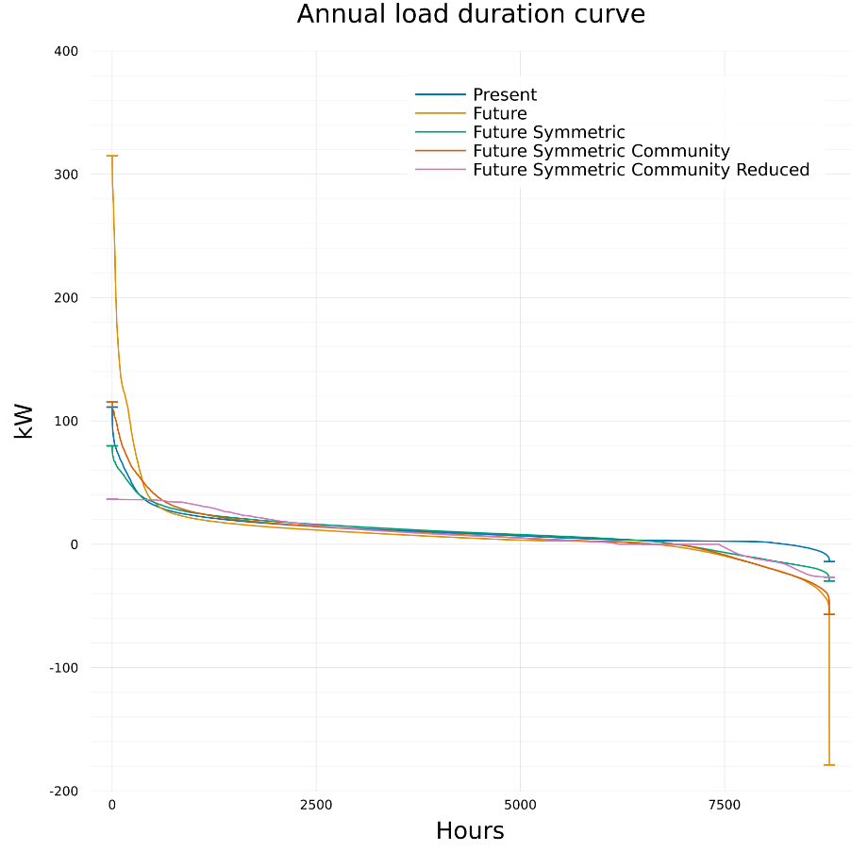
Symmetric peak load pricing
Peak load pricing with community operation decreases the maximum load, but increases the maximum feed-in.
How about a peak load pricing component in the grid tariff and fees for the maximum of load and feed-in?
With Community operation with reduced tariffs this reduces the maximum load / feedin by 67 %.
… but what about the customer cost?

Slide 16
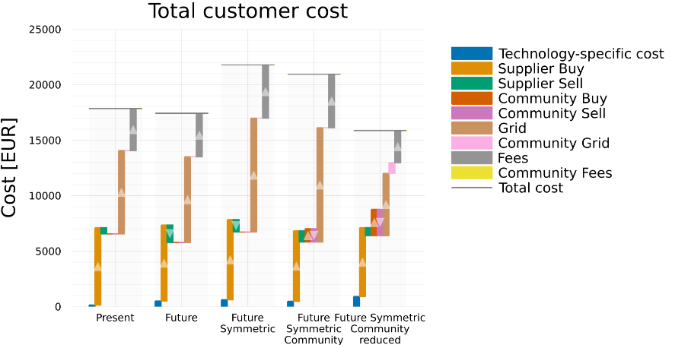
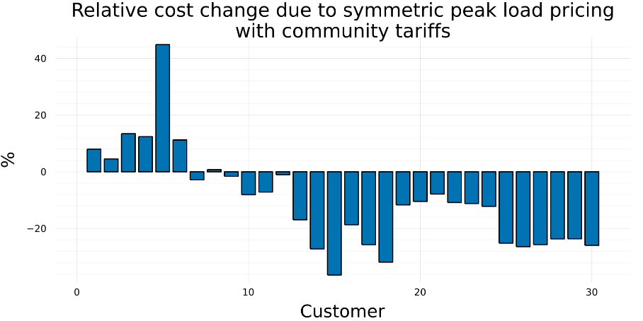
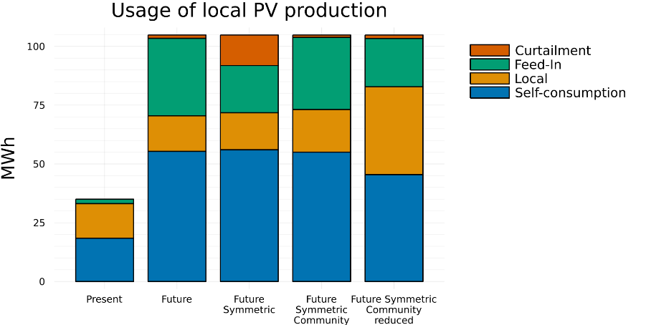
Symmetric peak load pricing
With reduced community grid tariffs, fees & surcharges, customer cost is reduced.
Flexible customers with batteries subsidize others
Symmetric peak load pricing increases PV curtailment. However, community operation reduces it and increases local usage.
In the Community reduced case, the DSO‘s revenue is reduced by 25 %.

Slide 17
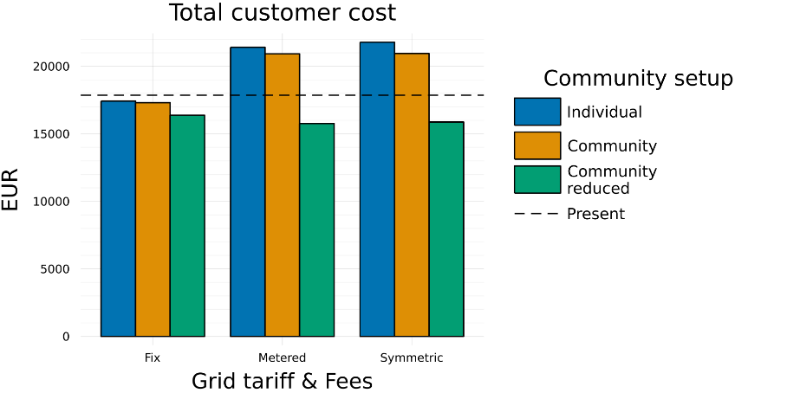
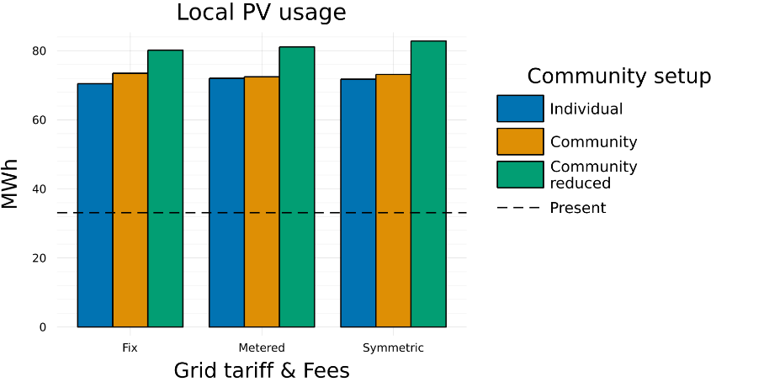
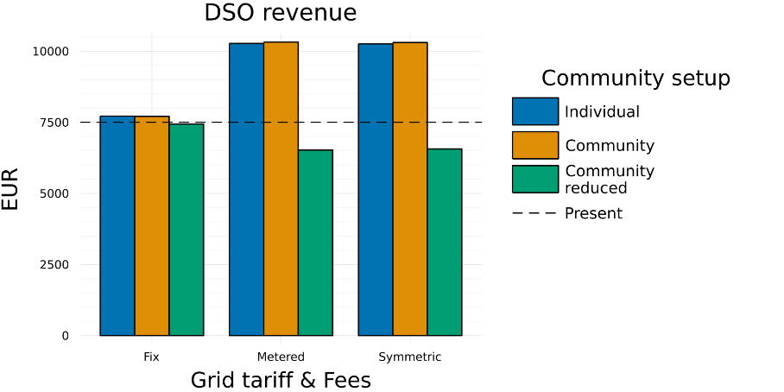
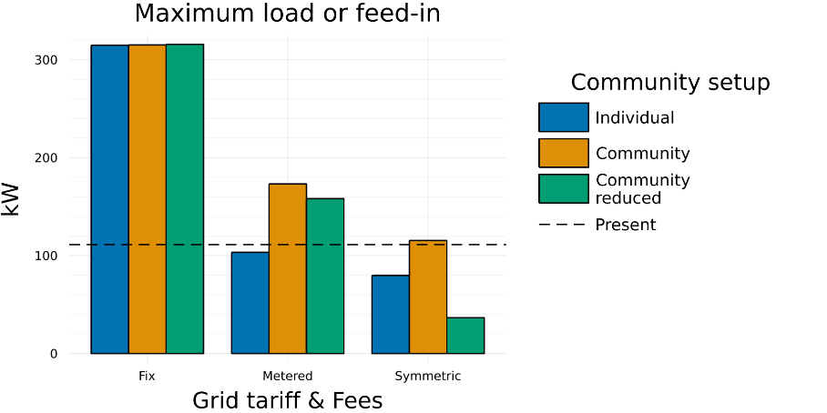
Summary

Slide 18
Conclusions
Peak load pricing reduces maximal load values and results in higher cost for customers.
Symmetric peak pricing (load and feed-in) reduces peaks in both directions and increases cost for customers
Energy Communities do not necessarily affect the peak load and feed-in values.
However, they promote local usage of PV and might incentivize investments in distributed RES and flexibility options.
Energy communities can mitigate or avoid customer cost increase caused by peak load pricing.
Among the investigated concepts, a combination of symmetric peak load pricing with reduced community tariffs seems to provide the best incentives to reduce peaks and increase local usage of PV.

