Slide 1

90% GHG
emissions
70% energy demand
Limited green generation
Credits to Dighital for the art

Slide 2




Electricity-only Positive Energy District analysis in climatically favoured regions and glimpse on multi-energy extension of the analysis
Axel Bruck, Santiago Diaz Ruano, Hans Auer

Slide 3

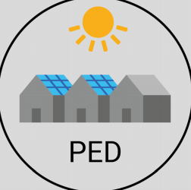








Background
SET-Plan: Positive Energy District (PED)
  System Flexibility
  System Resilience
  Building Energy Efficiency
  Life Quality
  Inclusiveness
  Sustainability
0
CO₂

Slide 4

Addition to Literature
PED analysis including:
  Population density comparison
  Distribution grid impact
  Electricity only → favourable climate
Novel approach of annual primary energy balance
  Optimization integrated
  Hourly primary energy factor (PEF) assessment

Slide 5
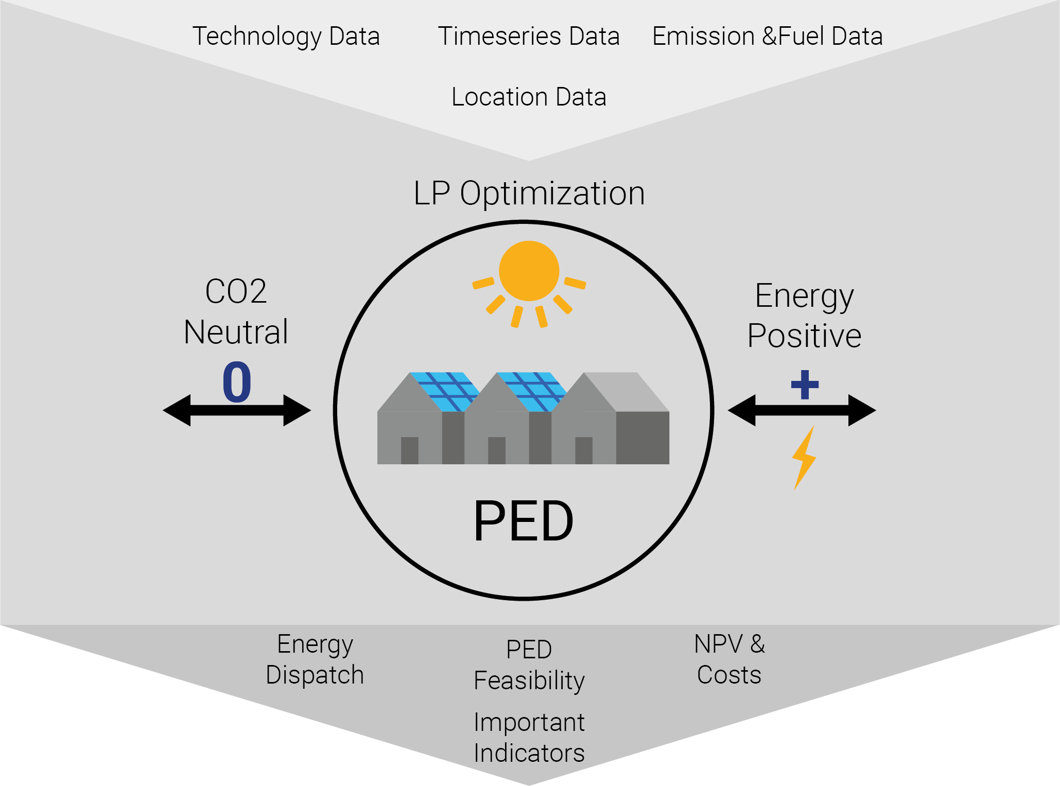
Methodology

Slide 6

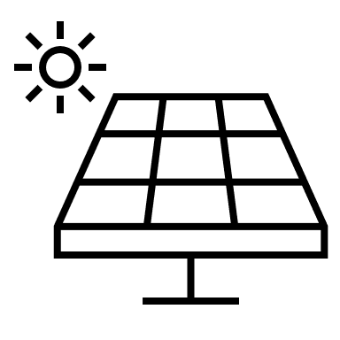

Methodology
PED
System Boundary
Outer Scope
Constant PEF export (PEF of grid mix)
Location-specific grid mix
static
Constant PEF import (PEF of grid mix)
Time dependent PEF export: f_{ex}(ts)
Δ Demand at ts
dynamic
Marginal Cost of Generation [€/MWh]
Time dependent PEF import: f_{im}(ts)
Generation Mix at ts

Slide 7
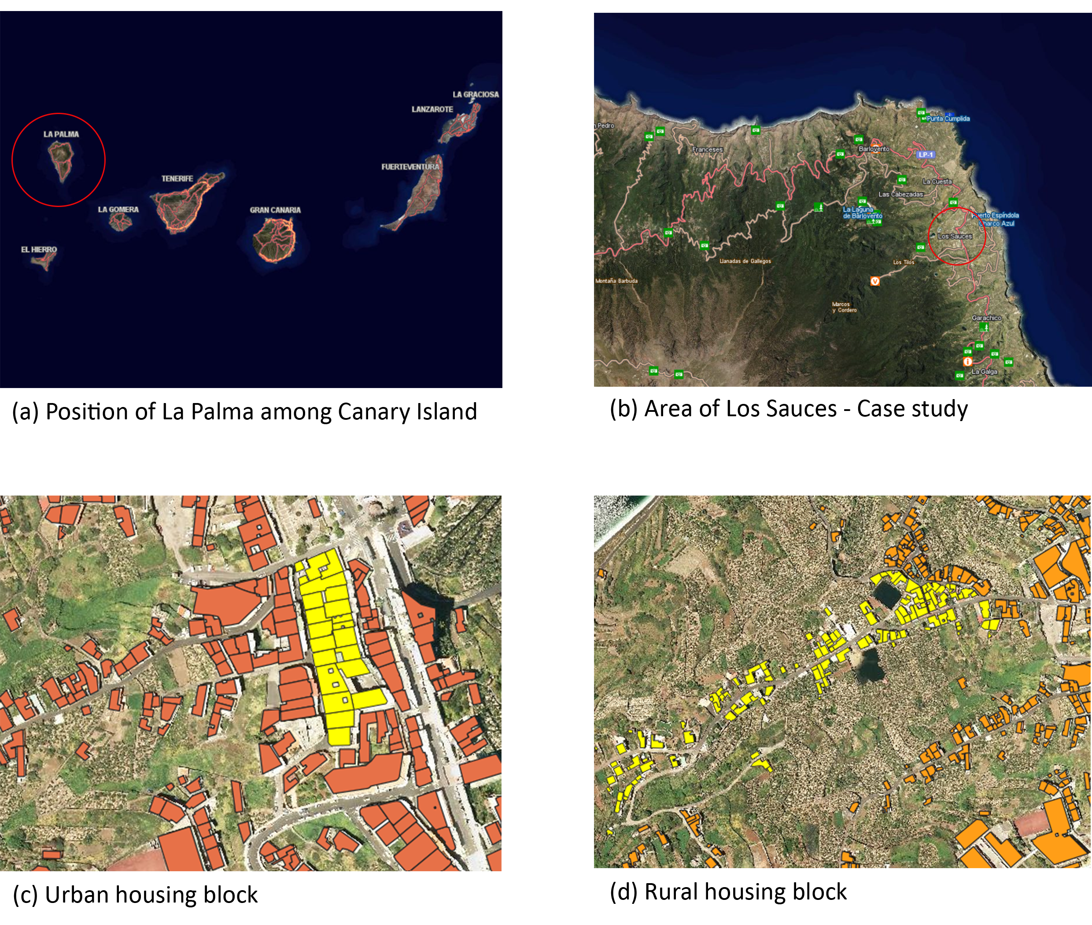





Case Study La Palma
Scenarios rural vs urban:
  Status quo
  PV area variation
  Grid power restriction (GPR)
  High renewable (HRES – El Hierro) vs. Low renewable (LRES – La Palma)
  Grid tariff increase

Slide 8
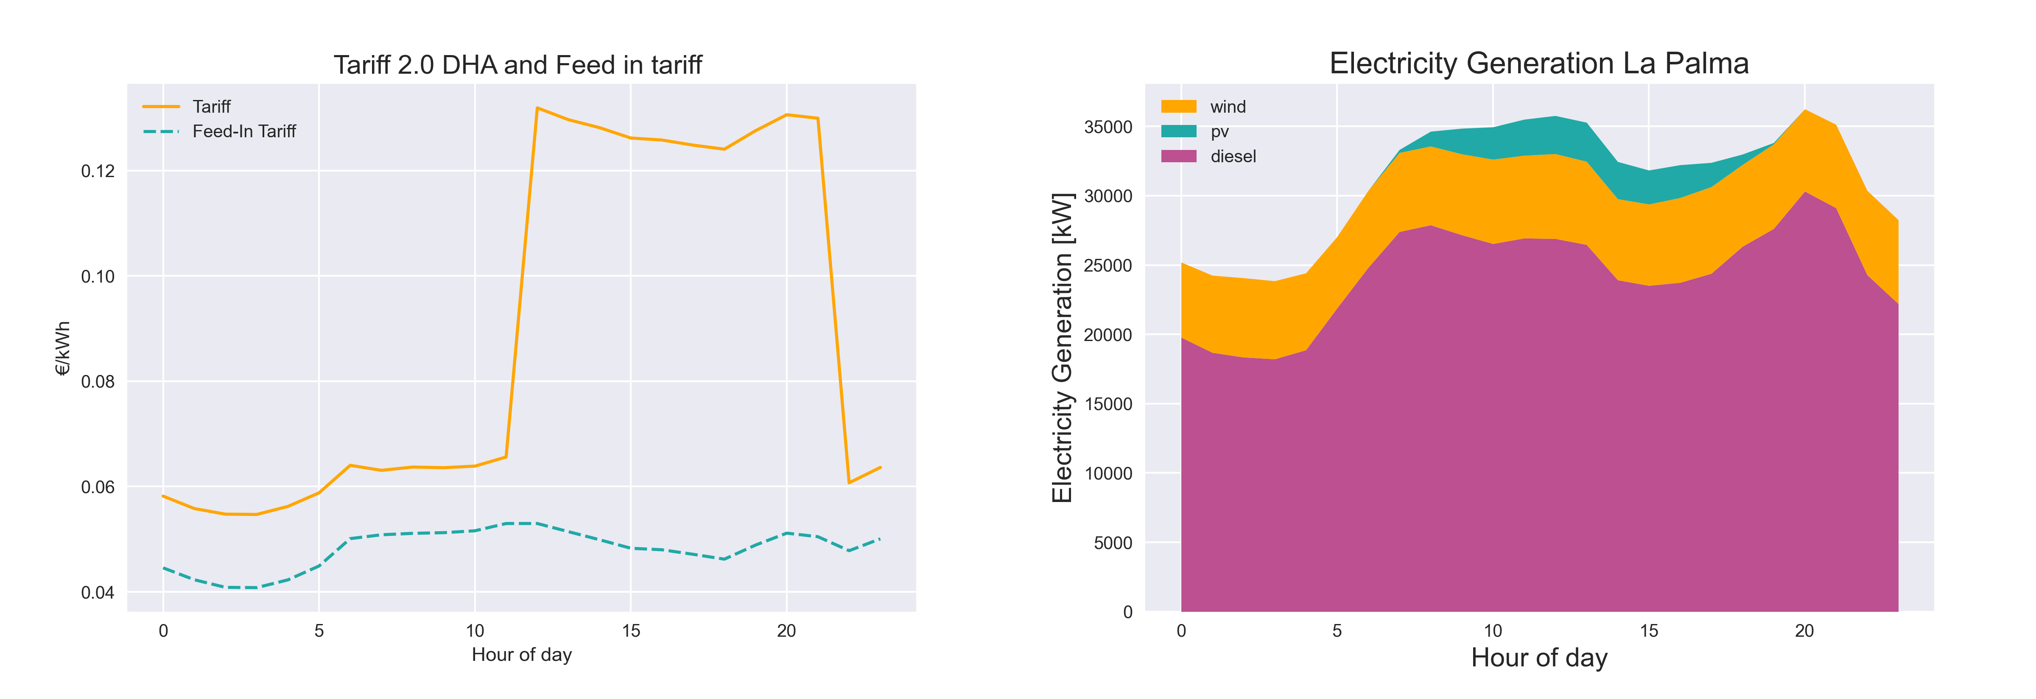
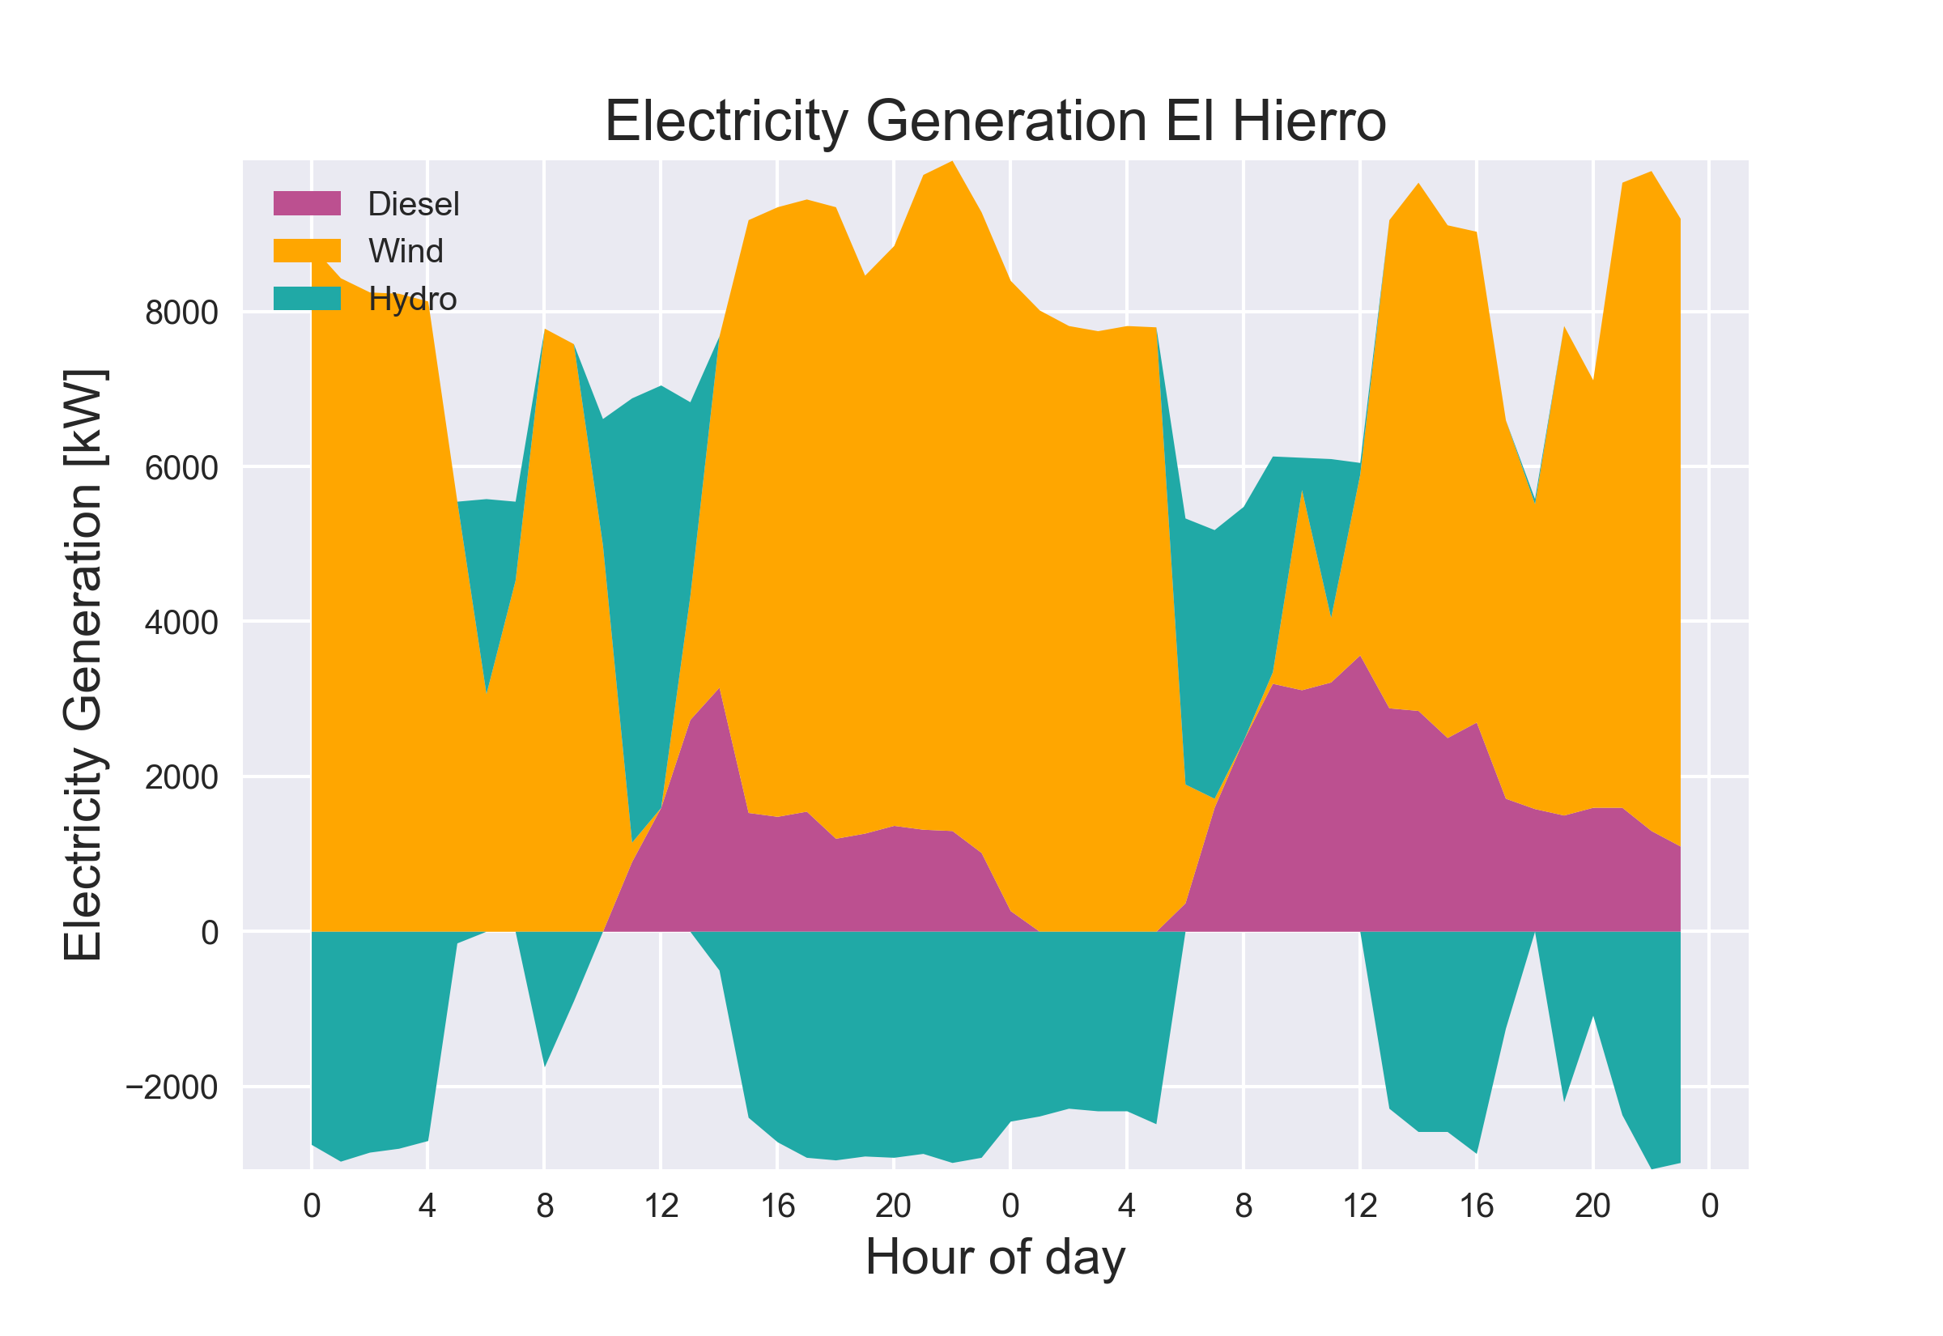
Case Study La Palma

Slide 9
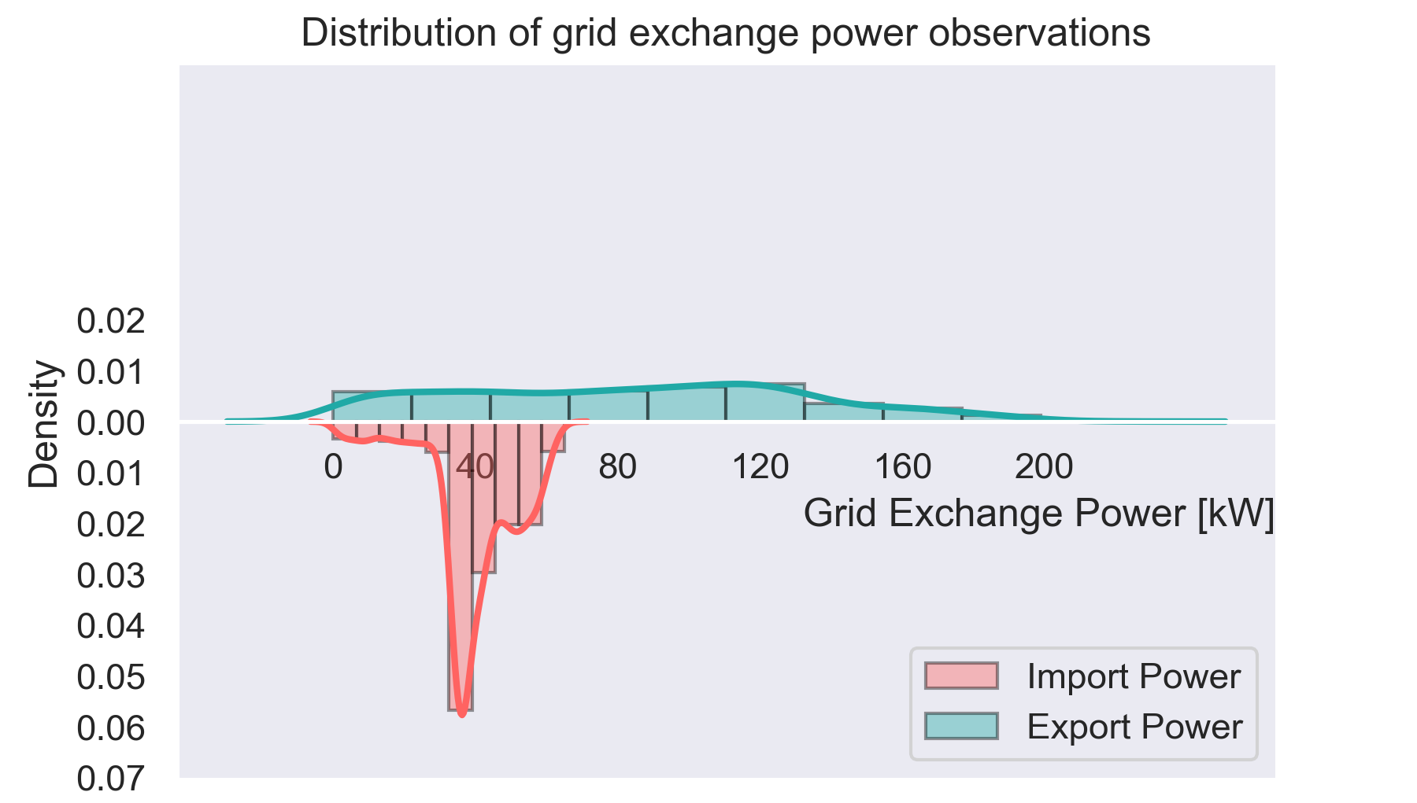
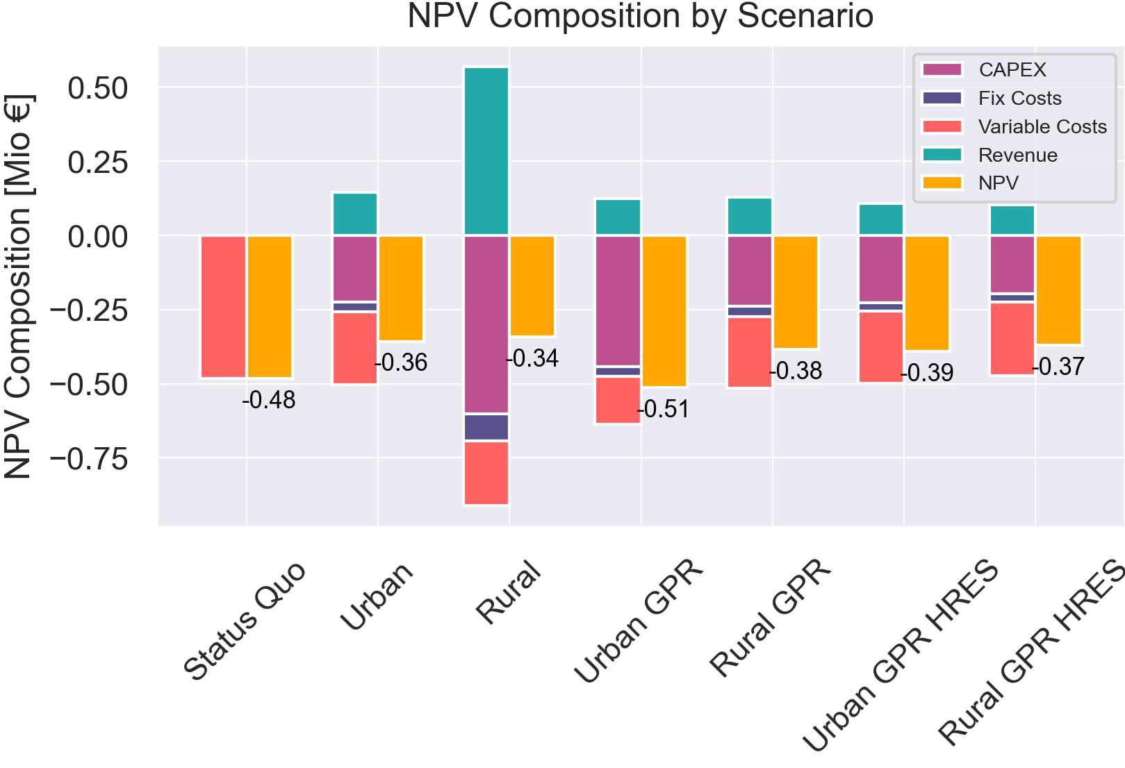
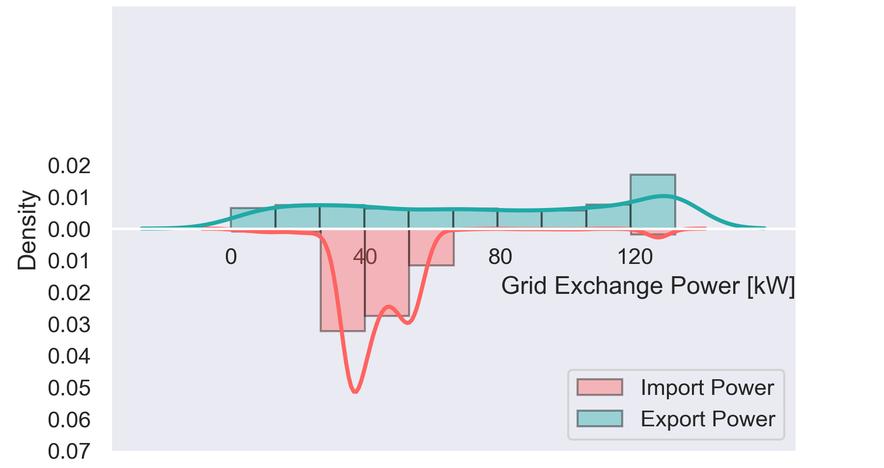
Results

Slide 10
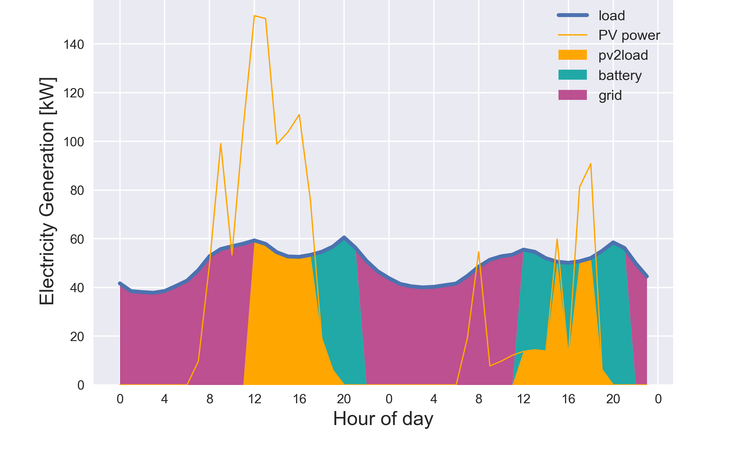
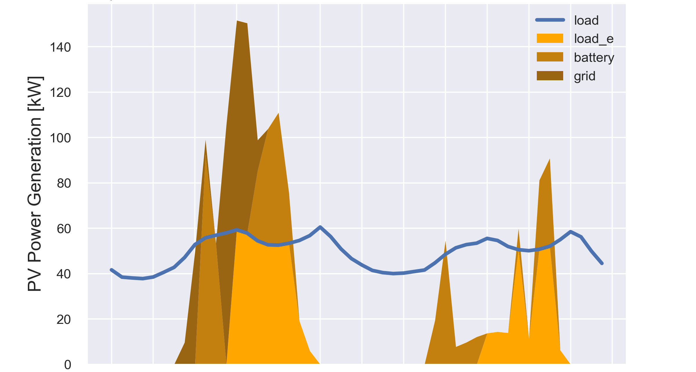
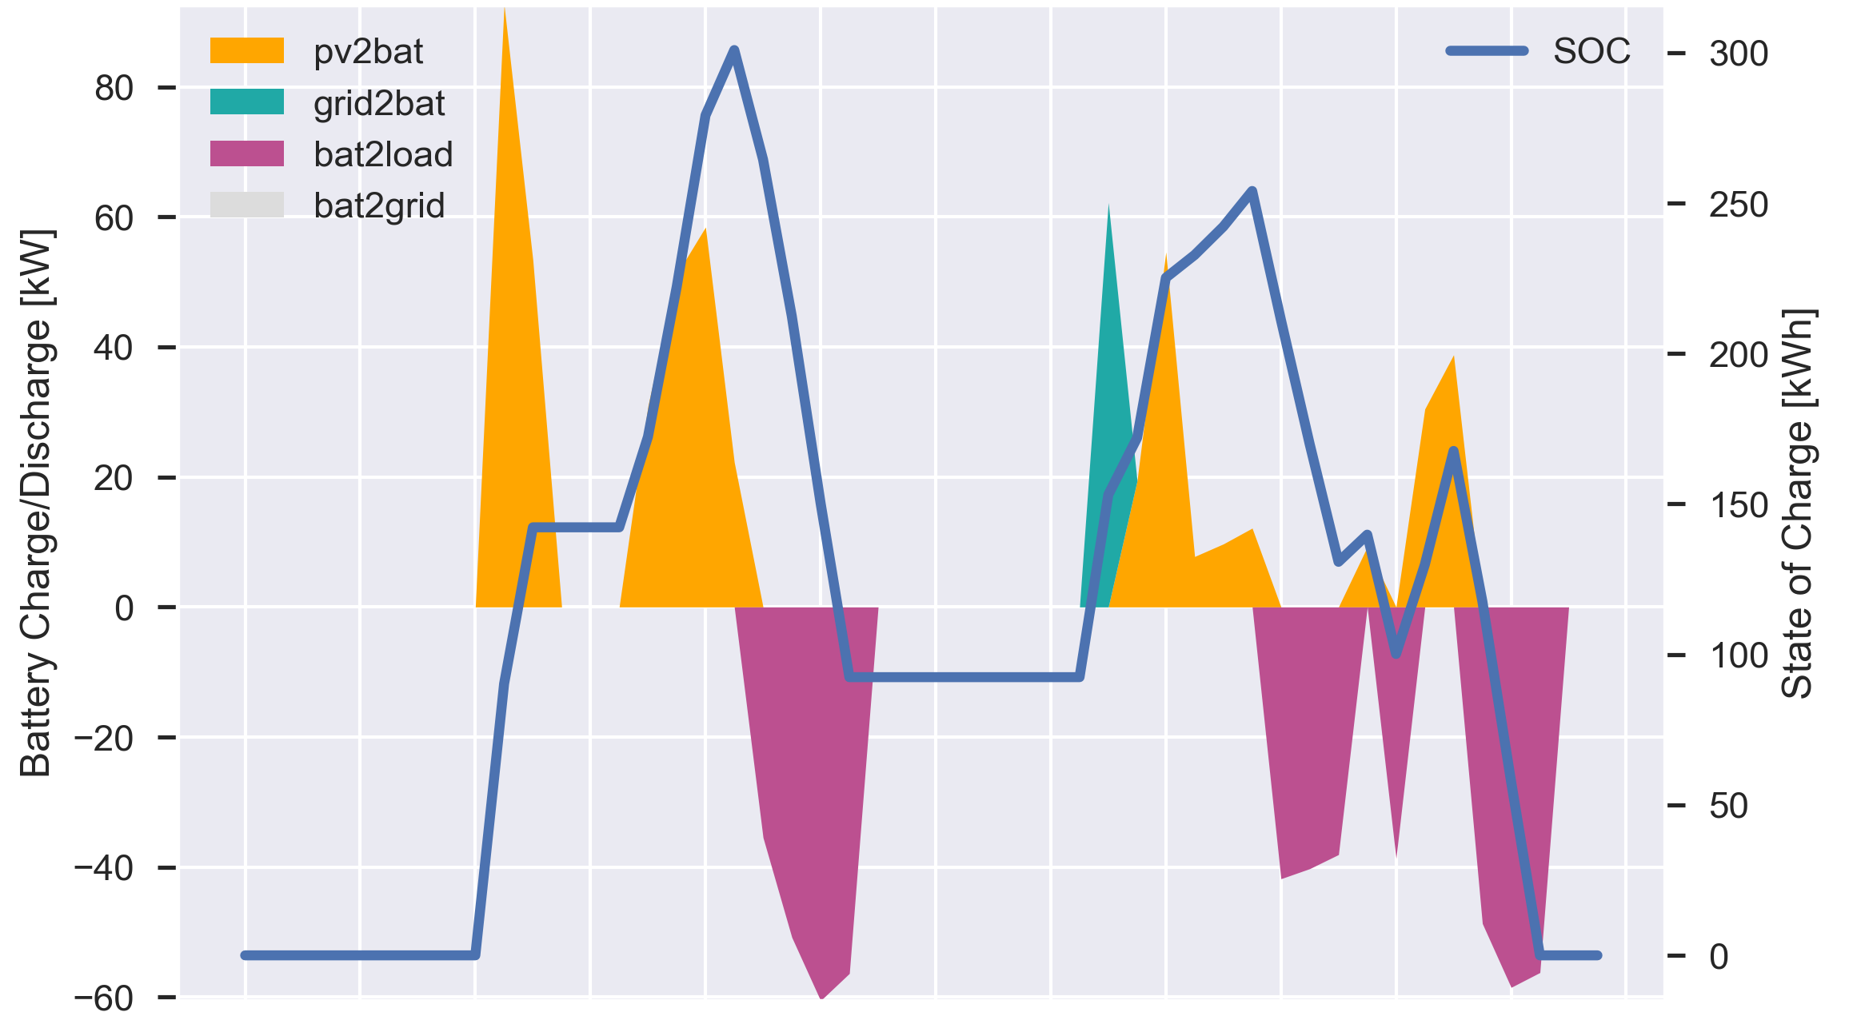
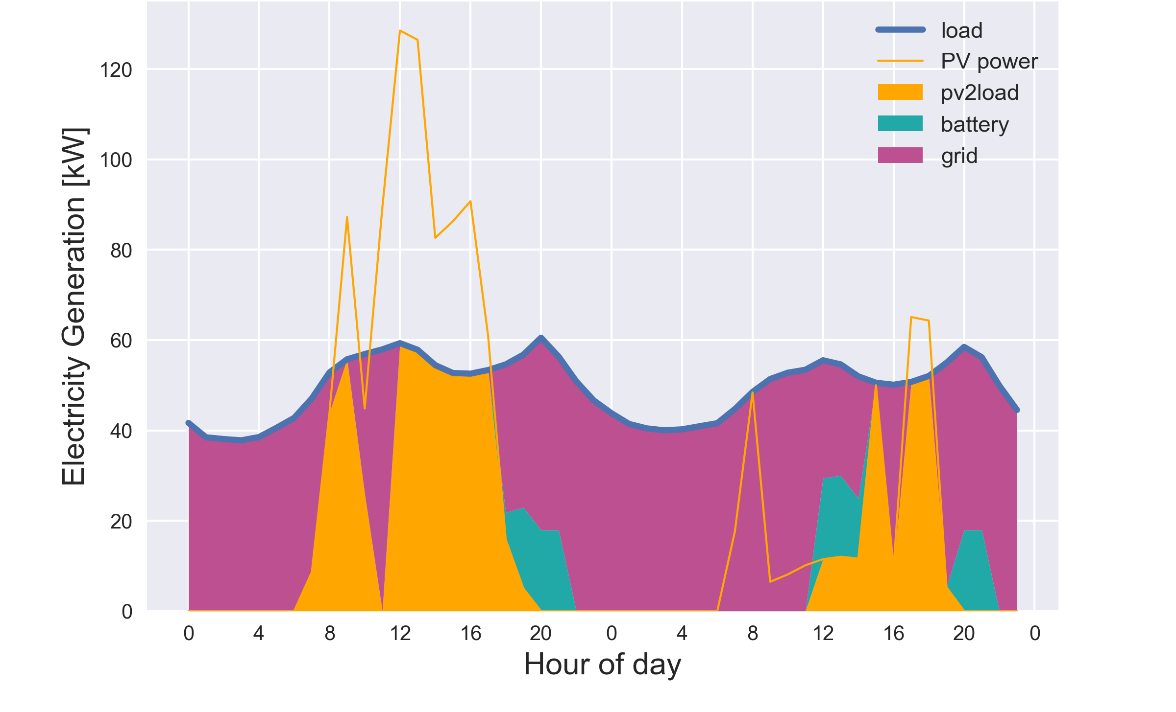
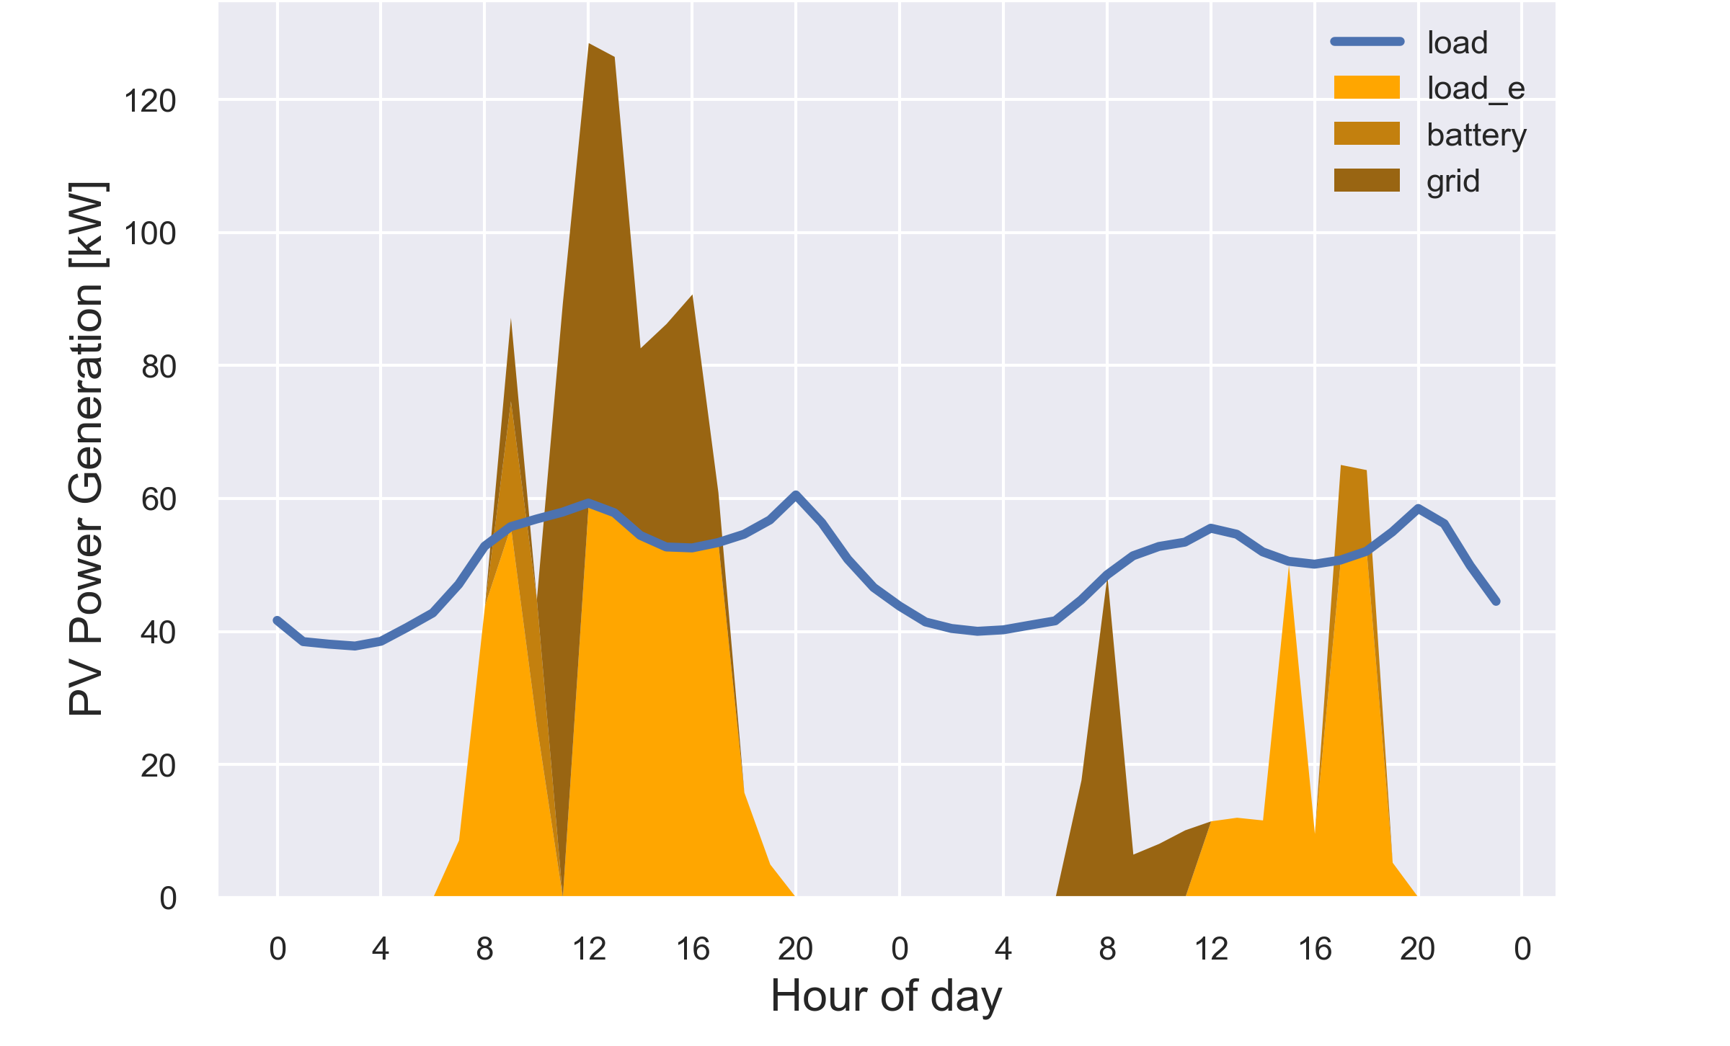
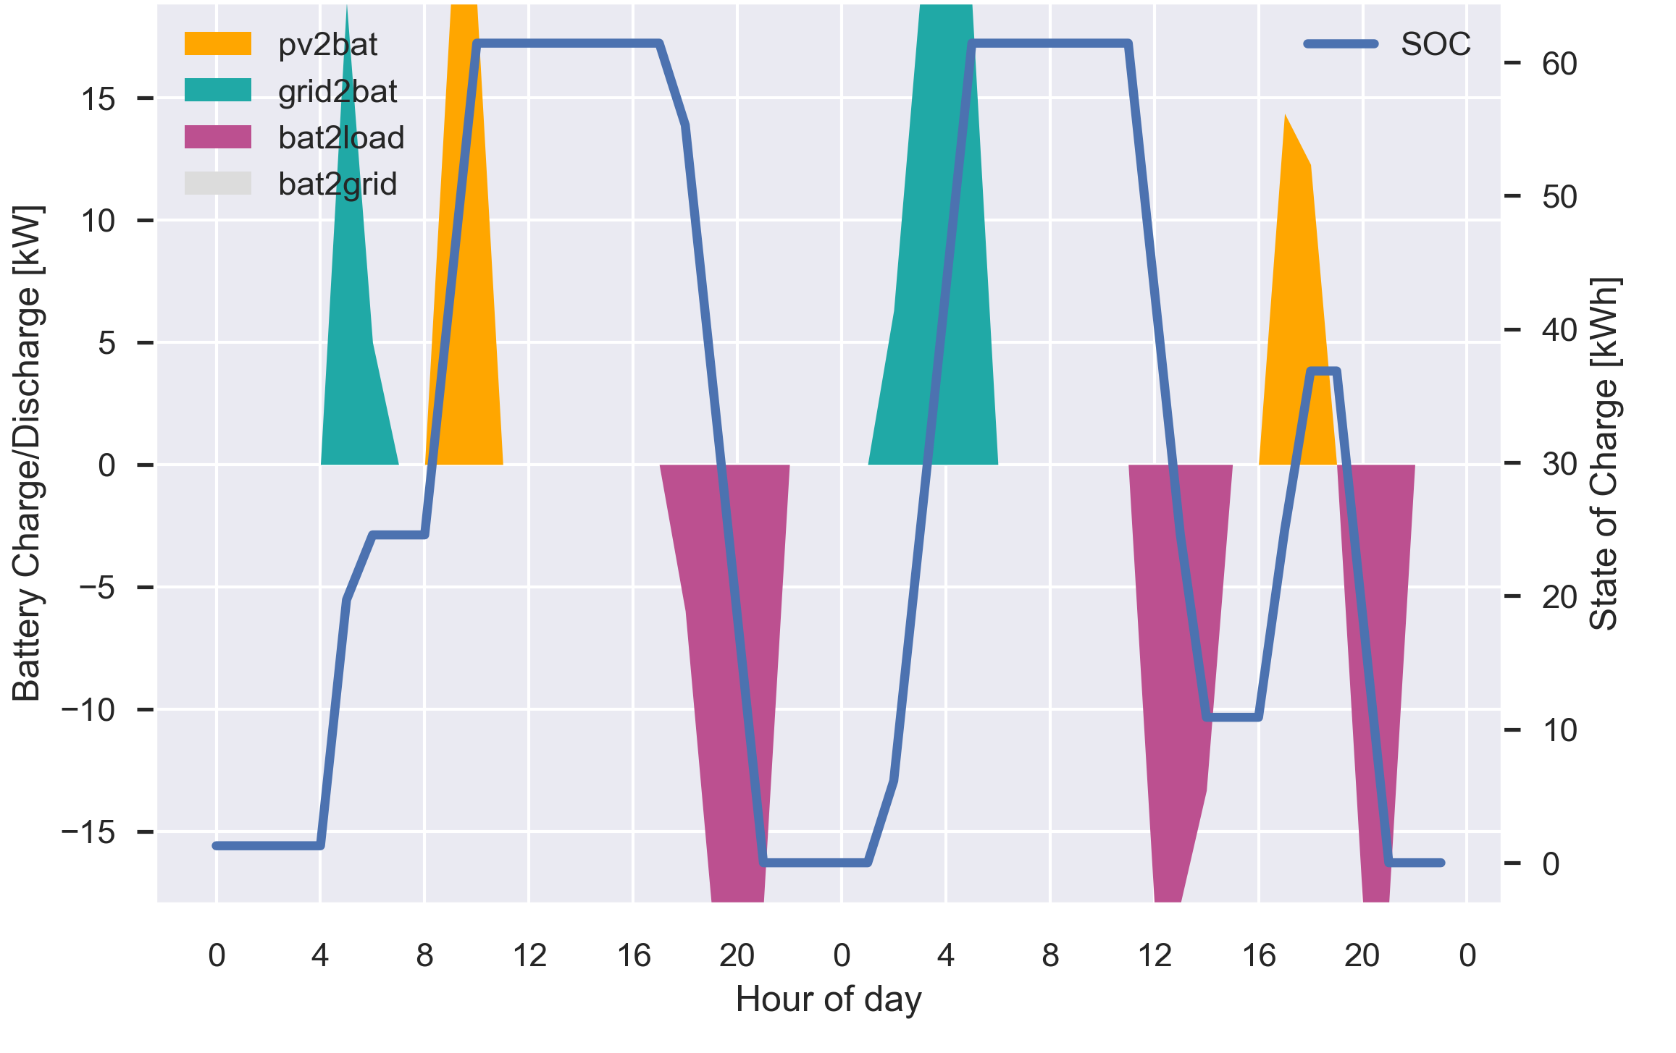
Results

Slide 11
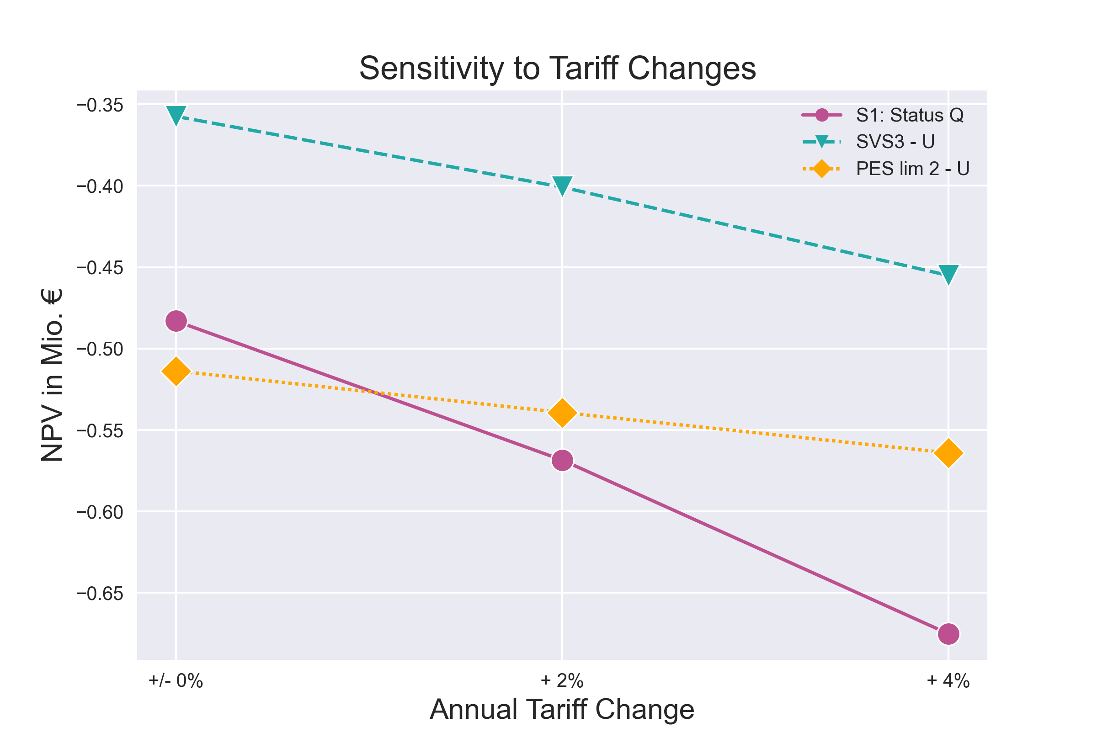
Results

Slide 12

Conclusion
Densely populated districts increasingly difficult
Without enforcement and battery usage negative grid impact
In HRES areas PEDs have more flexibility for primary energy arbitrage → NPV increases
Dynamic PEF balance system:
  Allocation of PEF essential to avoid cheating
  Promising incentive system for island-like systems without own electricity market
Full Paper
Bruck, A., Ruano, S. D., & Auer, H. (2021). A Critical Perspective on Positive Energy Districts in Climatically Favoured Regions: An Open-Source Modelling Approach Disclosing Implications and Possibilities. Energies, 14(16). https://doi.org/10.3390/EN14164864

Slide 13
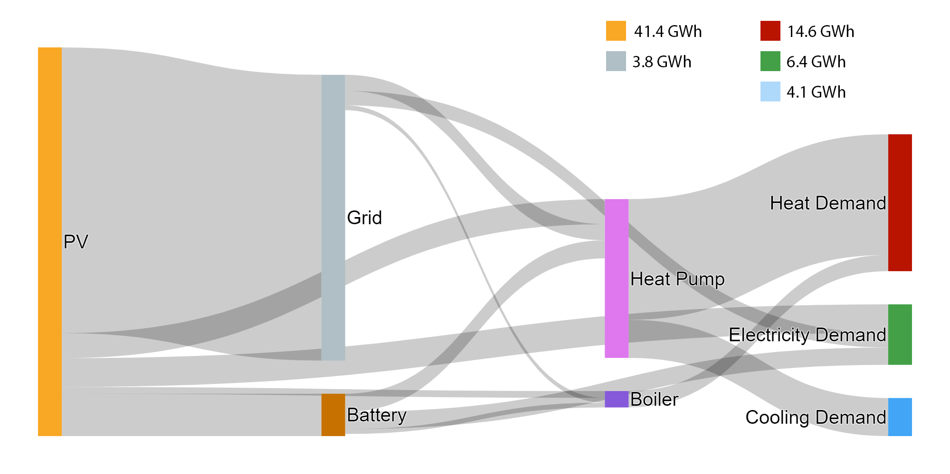
Outlook
Multi-Energy extension
Assessment of the PED potential across Europe
Improvement of dynamic PEF balancing mechanism → cheat proof

Slide 14

THANK YOU

