Slide 1

Flexibility Potential of a Generic Cold Warehouse IEWT 2021, PhD day, TU Wien
^{Ehsan Khorsandnejad}
^{Oberhausen, 07.09.2021}

Slide 2
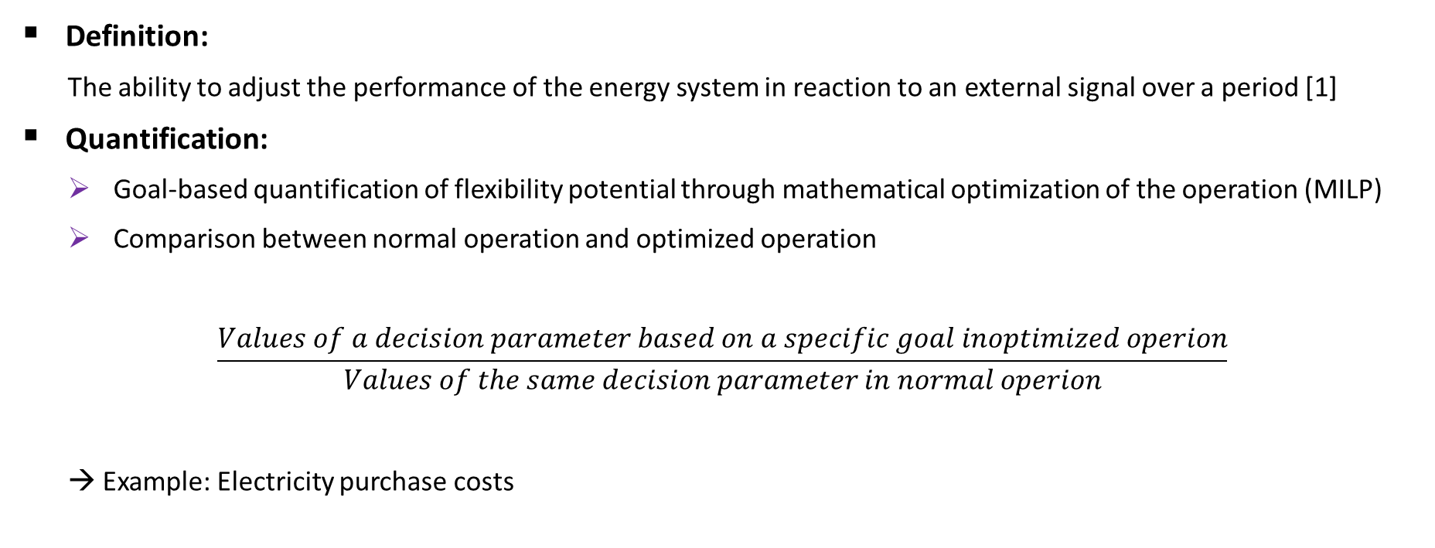
flexibility
Definition:
The ability to adjust the performance of the energy system in reaction to an external signal over a period [1]
Quantification:
Goal-based quantification of flexibility potential through mathematical optimization of the operation (MILP)
Comparison between normal operation and optimized operation
$$\frac{Values of a decision parameter based on a specific goal inoptimized operion}{Values of the same decision parameter in normal operion}$$
→ Example: Electricity purchase costs

Slide 3
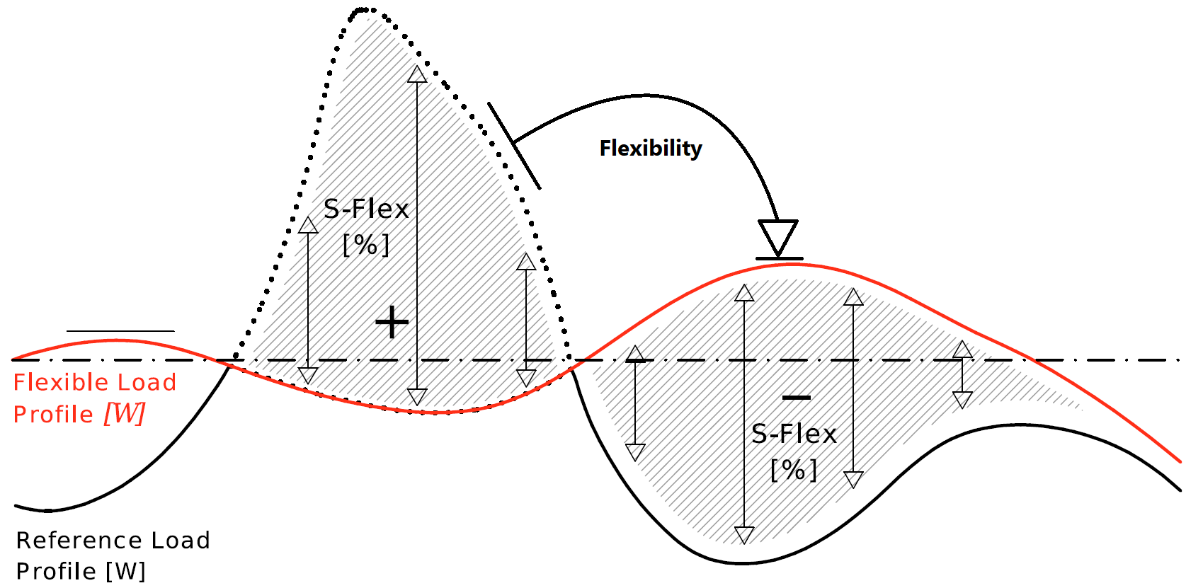
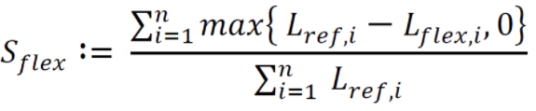

Evaluation of flexibility potential
By means of metrics:
$S_{flex} \text{[}\text{2}\text{]}:shifted flexible loads \left[\%\right]$
Higher $S_{flex}$ → higher load shift
Electricity costs
Energy consumption
CO₂-Emission
Load change: any change in the power consumption of the refrigeration system

Slide 4

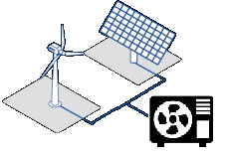

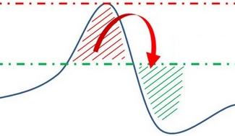
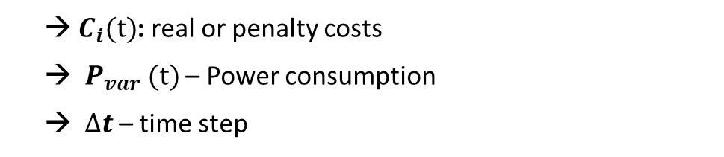

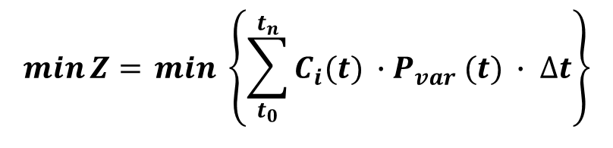
Goals, Objective functions and external signals
$$\min{Z= }min \left\{\sum_{t_{0}}^{t_{n}}{C_{i}(t) ∙P_{var} (t) ∙ ∆t}\right\}$$
→ $C_{i}(t)$: real or penalty costs
→ $P_{var} (t)$– Power consumption
→ $∆t$ – time step
Minimization of electricity purchase costs via electricity prices from EPEX Spot
Minimization of CO₂-Emissions
Penalty costs for CO₂-factor in electricity grid
Negative penalty costs for proportion of electricity from wind and PV-plants in the grid
$$C_{i}(t)$$
Peak shaving
Integration of local RES via a 750 kW PV-plant
Negative penalty costs
$C_{wp}$: work price and $C_{pp}$: power price

Slide 5
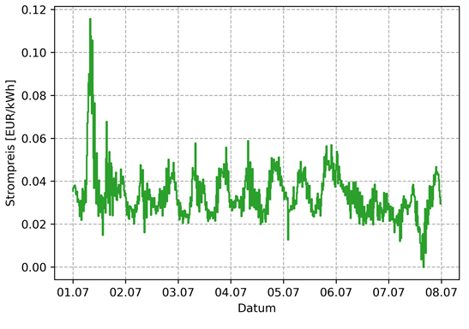
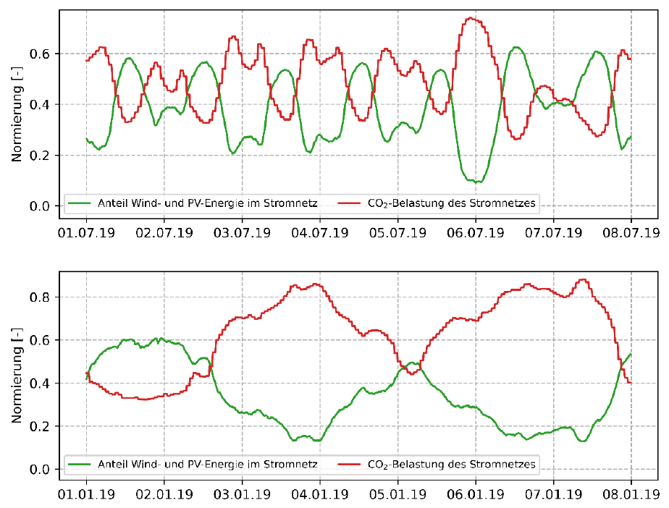
Examples for external signals
Electricity price data from EPEX Spot 2019
Minimization of CO2-Emissions
Source: [1]
Sources: [3, 4]

Slide 6
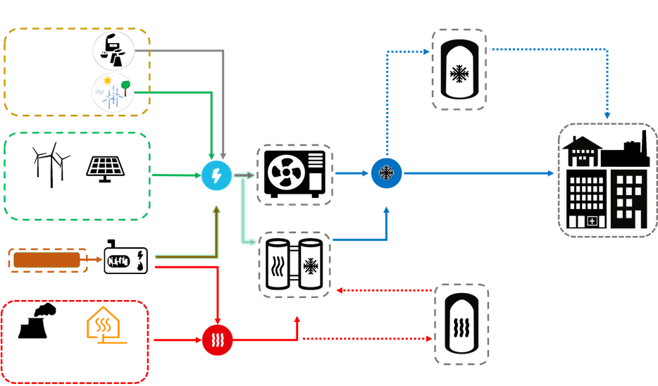
Configuration of a cold supply system
Energy sources
Energy
Conversion
Energy storage
Energy Consumers
Conventional
Power plants
Central RES
VCRS
Cold storage
Local RES
Electricity
Cold energy
Fuels
CHP
ARS
Different heat sources
Heat
Heat storage

Slide 7
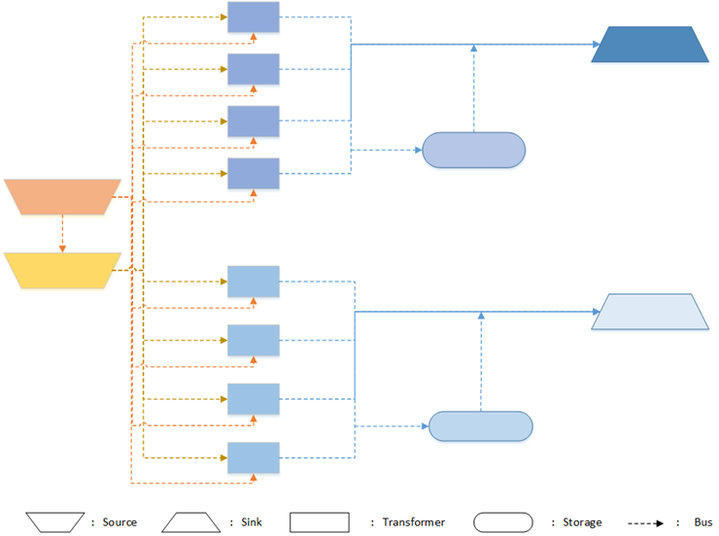
Optimization model
VCRS
Deep Cooling
1
Deep Cooling
2
Tool:
Open Energy Modelling Framework (EOMOF)
Optimization type: MILP
For the year 2019
Time resolution: 15-minute intervals
Rolling horizon: 24-hour periods
Programming language:
Python
3
Inherent
cold storage
4
PV-plant
VCRS
Normal Cooling
Electricity grid
1
Normal Cooling
2
3
Ice storage
4

Slide 8

Detail degree of models
For VCRS
Minimum run-time
Influence of ambient temperature
Partial load behaviour
Stepwise operation
Maximum number of starts
Re-cooling
For ARS
Minimum run-time
Influence of ambient temperature
Partial load behaviour
Cold start
Warm start
Energy storage
Energy loss – based on storage filling level
Energy input and output loss
Energy input and output capacity

Slide 9
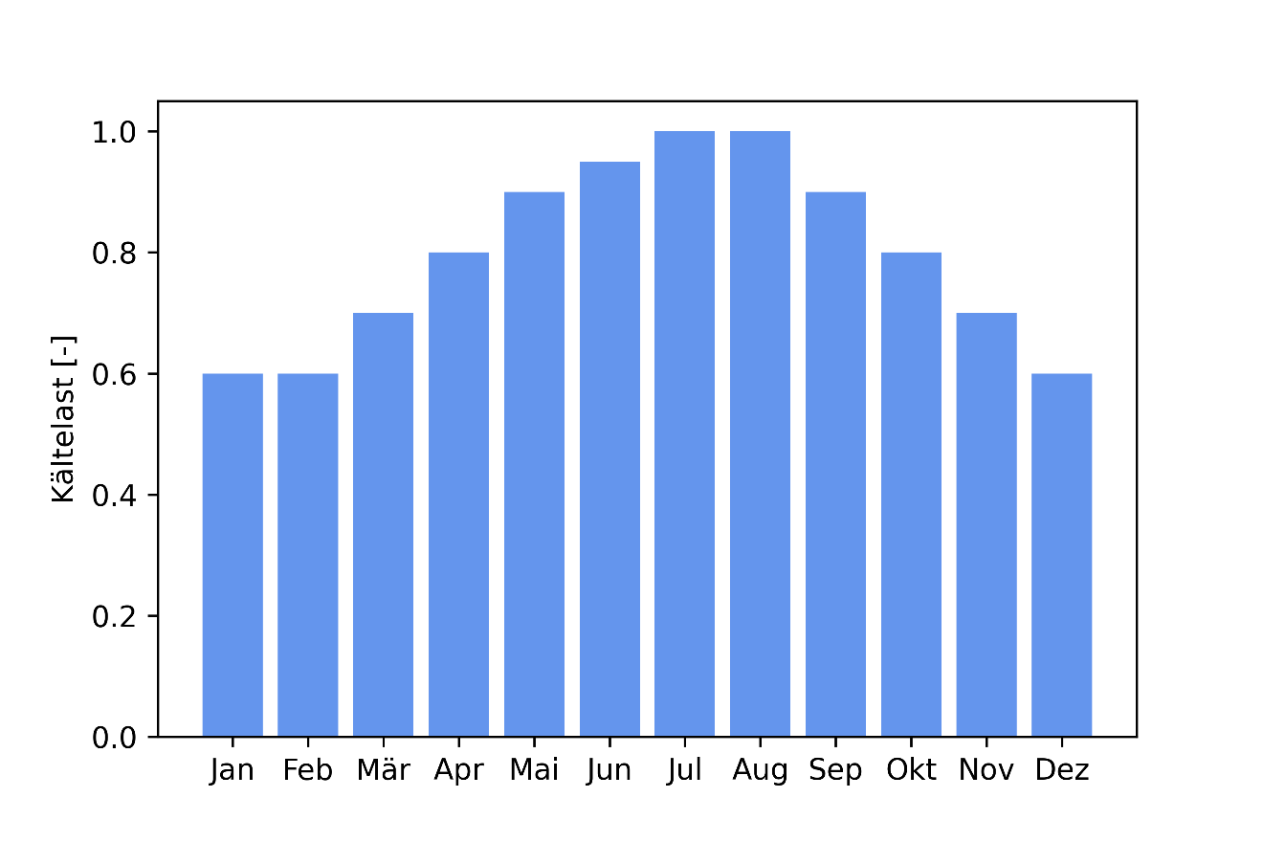
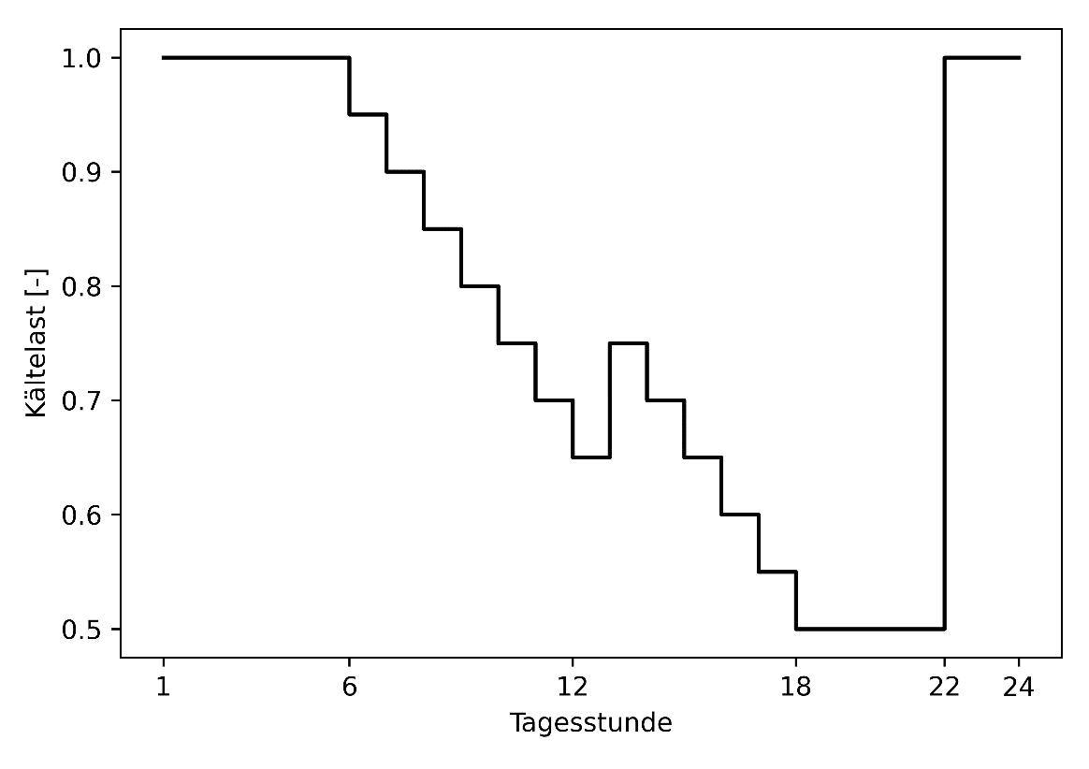
Refrigeration demand
Daily pattern
Yearly pattern
Maximum refrigeration demand: $DR = 720 kW; NR = 320 kW$
×
Source: [5]
Source: [5]

Slide 10
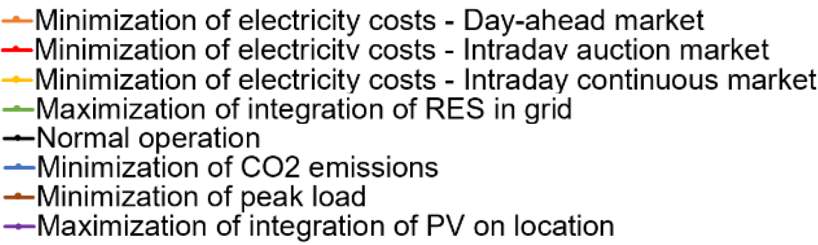
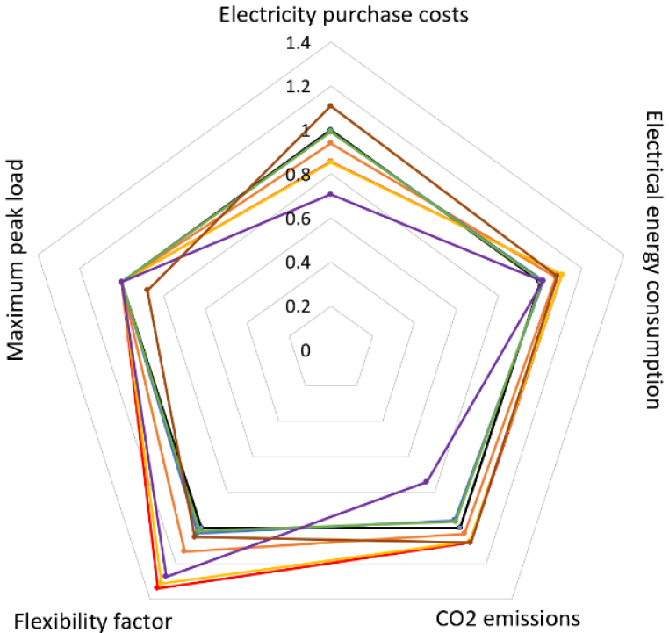
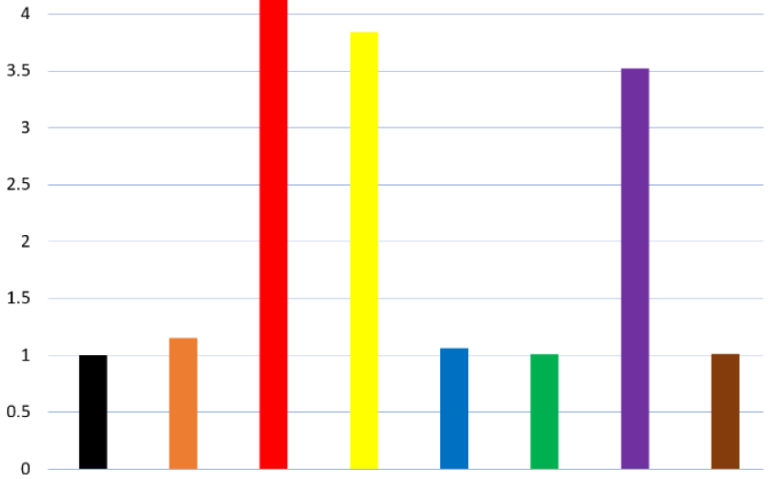

Results

Slide 11
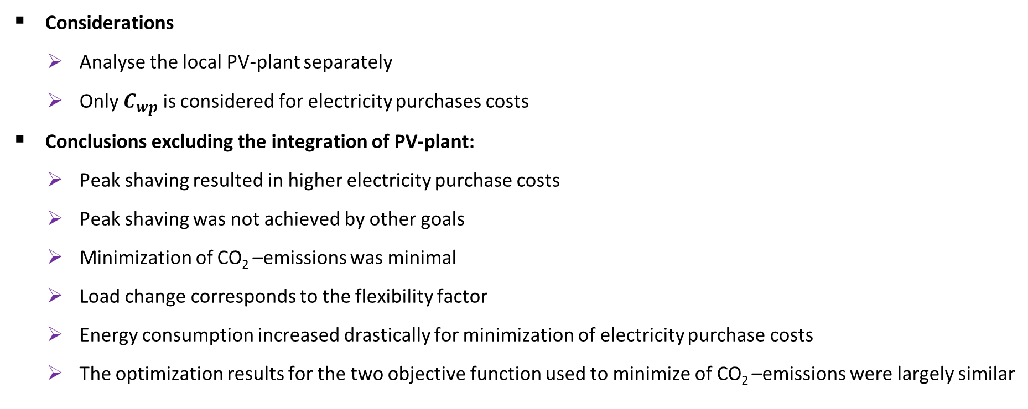
Considerations and conclusions
Considerations
Analyse the local PV-plant separately
Only $C_{wp}$is considered for electricity purchases costs
Conclusions excluding the integration of PV-plant:
Peak shaving resulted in higher electricity purchase costs
Peak shaving was not achieved by other goals
Minimization of CO₂ –emissions was minimal
Load change corresponds to the flexibility factor
Energy consumption increased drastically for minimization of electricity purchase costs
The optimization results for the two objective function used to minimize of CO₂ –emissions were largely similar

Slide 12
Thank you for your attention

Slide 13
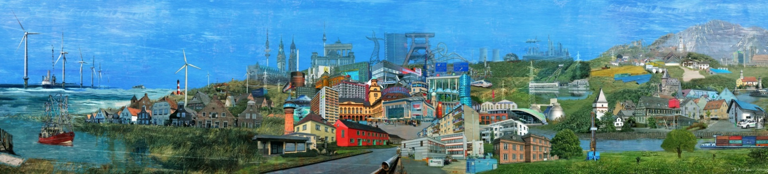
KONTAKTDATEN
M.Sc. Ehsan Khorsandnejad
Doktorand und Wissenschaftlicher Mitarbeiter
Telefon: +49 208 / 8598-1518 E-Mail: Ehsan.Khorsandnejad@umsicht.fraunhofer.de
Fraunhofer UMSICHT Osterfelder Straße 3 46047 Oberhausen, Germany E-Mail: info@umsicht.fraunhofer.de Internet: http://www.umsicht.fraunhofer.de

Slide 14
Referenzen
[1] EPEX Spot (2019): Market Data. Online verfügbar unter https://www.epexspot.com/en/market-data?data_mode=map&modality=Auction&sub_modality=DayAhead&product=60&de-livery_date=2021-03-30&trading_date=2021-03-29, zuletzt geprüft am 29.03.21.
[2] Weiß, Tobias; Rüdisser, Daniel; Reynders, Glenn (2019): Tool to evaluate the Energy Flexibility in Buildings. A short manual. Hg. v. Energy Technology Network. Energy in Buildings and Communities Programme.
[3] Agora Energiewende (2019): Strompreis und Emissionen. Online verfügbar unter https://www.agora-energiewende.de/service/agorameter/chart/power_price_emission/01.01.2019/31.12.2019/, zuletzt geprüft am 04.03.2021.
[4] Bundesnetzagentur (Hg.) (2019): Markttransparenzstelle für den Großhandel mit Strom und Gas; Aufgaben nach REMIT; SMARD-Strommarktdaten.
[5] Grein, Arne; Pehnt, Martin; Markus, Duscha; Holger, Kellerbauer (2009): Modellstadt Mannheim in der Metropolregion Rhein-Neckar, Mannheim.
© Fraunhofer UMSICHT | Bernd Röttgers

Slide 15
Referenzen
[1] Thomas Langrock, Siggi Achner, Christian Jungbluth, Constanze Marambio, Armin Michels, Paul Weinhard, Bastian Baumgart, Achim Otto (2015): Potentiale regelbarer Lasten in einem Energieversorgungs-system mit wachsendem Anteil erneuerbarer Energien.
[2] VDE-Studie (2012): Lastverschiebungspotenziale in Deutschland. "Demand Side Integration".
[3] B. K. Nalini, M. Eldakadosi, Z. You, M. Zade, P. Tzscheutschler and U. Wagner, "Towards Prosumer Flexibility Markets: A Photovoltaic and Battery Storage Model," 2019 IEEE PES Innovative Smart Grid Technologies Europe (ISGT-Europe), 2019, pp. 1-5, doi: 10.1109/ISGTEurope.2019.8905622.
[4] Weiß, Tobias; Rüdisser, Daniel; Reynders, Glenn (2019): Tool to evaluate the Energy Flexibility in Buildings. A short manual. Hg. v. Energy Technology Network. Energy in Buildings and Communities Programme.
[5] Bauknecht, Dierk; Heinemann, Christoph; Koch, Matthias; Ritter, David; Harthan, Ralph; Sachs, Anja et al. (2016): Systematischer Vergleich von Flexibilitäts- und Speicheroptionen im deutschen Stromsystem zur Integration von erneuerbaren Energien und Analyse entsprechender Rahmenbedingungen. Hg. v. Öko-Institut e.V. und Energynautics GmbH. Freiburg, Darmstadt.
[6] EPEX Spot (2019): Market Data. Online verfügbar unter https://www.epexspot.com/en/market-data?data_mode=map&modality=Auction&sub_modality=DayAhead&product=60&de-livery_date=2021-03-30&trading_date=2021-03-29, zuletzt geprüft am 29.03.21.
[7] Agora Energiewende (2019): Strompreis und Emissionen. Online verfügbar unter https://www.agora-energiewende.de/service/agorameter/chart/power_price_emission/01.01.2019/31.12.2019/, zuletzt geprüft am 04.03.2021.
[8] Bundesnetzagentur (Hg.) (2019): Markttransparenzstelle für den Großhandel mit Strom und Gas; Aufgaben nach REMIT; SMARD-Strommarktdaten.
[9] Grein, Arne; Pehnt, Martin; Markus, Duscha; Holger, Kellerbauer (2009): Modellstadt Mannheim in der Metropolregion Rhein-Neckar, Mannheim.
© Fraunhofer UMSICHT | Bernd Röttgers

