Slide 1
Quantifying the Economic Granularity Gap by Model Coupling: The Case of Prosumer Self-Consumption in Germany
12. Internationale Energiewirtschaftstagung (IEWT) 2021
8.-10. September 2021
Seyedfarzad Sarfarazi
Department of Energy Systems Analysis
Institute of Networked Energy Systems
German Aerospace Center (DLR)
Acknowledgment goes to:
Dr. Karl-Kien Cao,
Shima Sasanpour,
Prof. Valentin Bertsch

Slide 2
Motivation
Economic granularity gap in energy system modelling
Models are applied to gain insights into possible futures of the energy system; e.g., to serve for decision support in energy policy and industry.
Drafting ideal system designs by energy system optimization models provide templates for navigating the system transformation into the right direction.
  Discrepancies between the optimal and the real world occur.
  Granularity gaps arises across several model dimensions
Global
Decades
Broad
Macroeconomic
Continents
Investment planning
Energy-water-land
World economy
Countries
Seasonal weather
Sector coupling
Markets
Economic granularity gap
Districts
Fluctuation of renewables
Power generation mix
Companies
Instead of extending the existing models, we can integrate their strengths by model coupling to address the granularity gap
Households
Secure system operation
Process simulation
Individuals
  Agent-based simulation
Local
Seconds
Accurate
Microeconomic
Spatial scale
Temporal scale
Technological
scale
Economic perspective
  Energy system optimization
Cao, Karl‐Kiên, et al. "Bridging granularity gaps to decarbonize large‐scale energy systems—The case of power system planning." Energy Science & Engineering (2021).

Slide 3
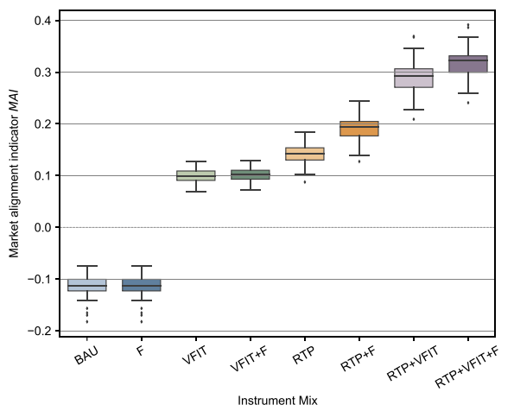
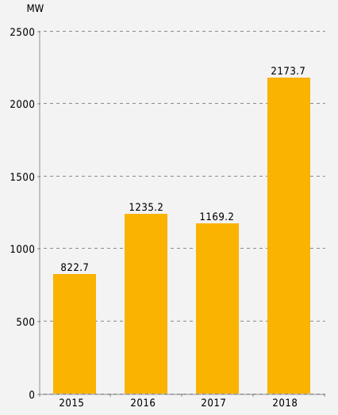
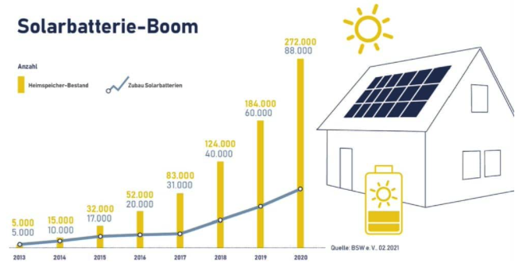
Motivation
Economic granularity gap in case of prosumer self-consumption
Market alignment of PV-storage systems for different instrument mixes. [3]
Distributed PV generation potential and PV battery storage in Germany is increasing.
Studies suggest that current business models and regulatory frameworks cannot incentivize a system friendly operation of PV-storage systems.
Energy system optimization models assume an optimal dispatch of PV-storage systems.
Does the economic granularity gap in the case of prosumer self-consumption significantly affect system designs that result from an energy system optimization model?
  Newly installed rooftop PV capacity [1]
  Number of existing and newly installed PV-storage systems in Germany [2]
Existing
Newly installed
[1] : Bundesnetzagentur: Marktstammdatenregister. Auswertung des Registers durch das ZSW Baden-Württemberg.
[2] Bundesverband Solarwirtschaft e. V.
[3] : Klein, Martin, Ahmad Ziade, and Laurens De Vries. "Aligning prosumers with the electricity wholesale market–The impact of time-varying price signals and fixed network charges on solar self-consumption." Energy Policy 134 (2019): 110901.

Slide 4
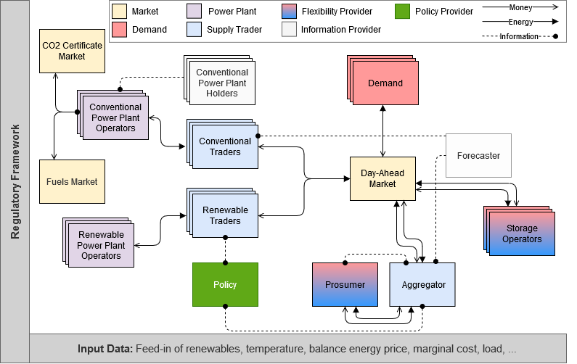
Methodology
Applied models
We investigate our research question by coupling the energy system optimization model REMix and the agent-based model of wholesale electricity market AMIRIS.
For this analysis we consider perfect foresight and hourly resolution in both models.
In our analysis we split Germany into two virtual regions:
 | REMix | AMIRIS
Primary purpose | Investment and dispatch optimization of energy system | Simulation of the electricity market under a certain regulatory scheme
Math. Model type | Linear optimization | Agent-based simulation
Economic scope | Central planner minimizes total system costs | Each agent minimizes her own costs
Geographical focus | Europe and north Africa | Germany
Rest of Germany
For this analysis two new actors are implemented in AMIRIS:
Aggregator
Receives a forecast of market prices (price tacker)
Construct electricity tariffs for prosumers
Supply and demand bids based on the prosumers grid interaction
Prosumers
Receive the electricity prices from the aggregator (price tacker)
Optimize the dispatch of the PV-storage system to minimize their costs
Aggregated prosumer

Slide 5
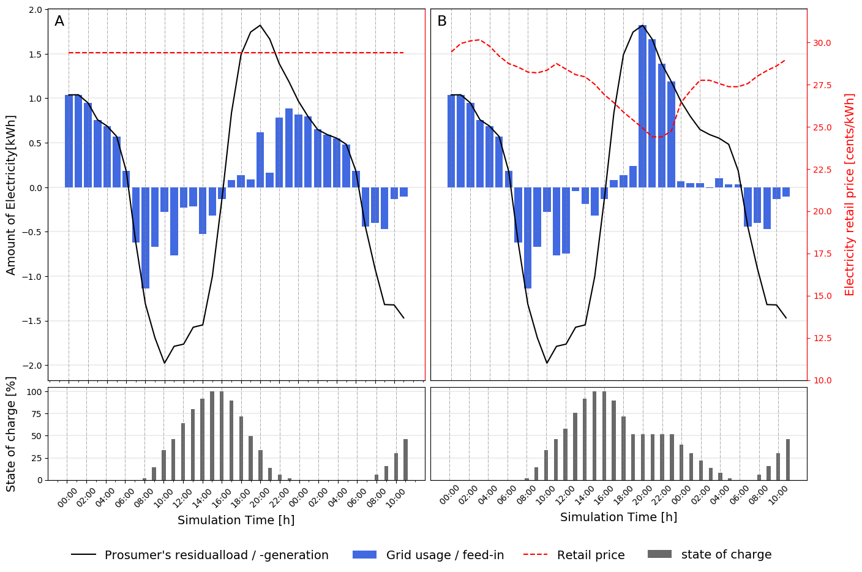
PV-Storage optimization
Exemplary dispatch
Business As Usual (BAU)
Real-time pricing (RTP)
Optimization goal is to minimize the costs of the prosumer
Prosumers are exposed to static (BAU) and real-time consumer electricity prices (RTP).
Prosumers receive a FiT as high as 12 Cents/kWh, when feeding the electricity into the grid.
Due to high electricity consumer prices, the residual generation is stored for later self-consumption.
Real-time pricing incentivize a charging in specific hours.

Slide 6
Methodology
Model Coupling Workflow
Our model coupling workflow consists of 4 steps.
We validate our model coupling by harmonizing the models after step 3: In the absence of uncertainty, regulatory framework and other distortions the results from both models should be the same.
- Weather
- Techno-Economic
- Etc.
Input parameters for the next step
Step-wise flow of new information
Flow of information from previous steps
1
4
3
REMix
Merit order simulation
Prosumer optimization
Optimize dispatch
Grid, Storage and power plant expansion planning
PV-storage dispatch
AMIRIS
Differentiation between central and decentral technologies:
PV: Central or decentral (without storage) or prosumer (with storage)
Li-Ion battery: Large scale or PV-storage
Demand profiles considering prosumers, import/export and storage operations
Installed capacities
Storage dispatch
iog2x
2
Translate
Split

Slide 7
Model harmonization
To validate the model coupling a step-wise harmonization of models is performed.
Prices (market prices in AMIRIS and shadow prices in REMix) are observed not to be a good indicator for the harmonization.
Resulting system costs are compared for the harmonization.
Merit order curve
Merit order curve
Price
Price
System costs
System costs
marginal shift in electricity generation lead to significant price changes

Slide 8
Preliminary results
Reference scenario for 2030
Due to higher investment costs of decentral PV and battery systems, the expansion of these technologies cannot be calculated in the energy system optimization results from REMix.
  Therefore, the installed capacity of PV rooftop systems is set exogenously.
  It is assumed that the PV-storage systems are installed proportional to the PV-rooftop systems (1 to 2 ratio).
We assume that households install 1 kW PV systems for an annual electricity demand of 750 kWh.
Installed PV

Slide 9
Preliminary results
Impact of prosumer self-consumption on the system design
PV-storage systems charging pattern in case of BAU deviates from optimal storage dispatch.
Winter
Summer
Comparative results of several system indicators
Delta
Delta
REF
BAU
Abs
Rel
Self-consumption pattern in BAU leads to inefficiencies from the system perspective.
Li-Ion large scale battery capacity [GW] | 0.189 | 0.247 | 0.058 | 30.8 %
Curtailed PV [TWh] | 9.77 | 9.70 | -0.0735 | -0.75 %
Imported electricity [GW] | 297.59 | 297.45 | -0.139 | -0.04 %
Transmission grid expansion [GW] | 115.238 | 114.565 | -0.672 | -0.58 %
Generated electricity from conv. power plants [TWh] | 82.40 | 82.42 | 0.022 | 0.03
CO2 Emissions [kt] | 57569.3 | 57598.9 | 29.625 | 0.05 %
System costs [M€] | 9732728 | 9438344 | 5615 | 0.05 %
System costs total [M€] | 167109544 | 167163788 | 54243 | 0.03 %
Germany
Increased
Decreased
*operation costs + investment costs in new power plants

Slide 10
Conclusion
Granularity gap often emerges across several model dimensions in energy system modeling.
For investigate if the economic granularity gap in the case of prosumer self-consumption significantly affect system designs that result from an energy system optimization model.
Coupling an energy system optimization model with an agent-based model can address the emerging economic granularity gap in energy system modelling.
Our results show that the status quo self-consumption patterns can lead to:
  lower electricity import and transmission grid expansion.
  inefficient usage of flexibility form the system perspective, higher CO2 emissions and system costs.
Limitation
In our analysis we have used an standard load profile for prosumers. The behaviour of individual prosumers deviate from the modeled one.
Exogenous differentiation between central and decentral technologies in REMix.
Except prosumers, all other actors in AMIRIS behave similar to those in REMix.
Outlook
Comprehensive country-specific analysis of results.
Analysis of real-time pricing tariffs for the prosumer, as an instrument to narrow the economic granularity gap.
The behavior of more actors deviates from the determined operation by the central planner happens, e.g., Renewable energy feed-in pattern under the influence of market premium incentives.

Slide 11
Thank you for your attention!
M.Sc. Seyedfarzad Sarfarazi
German Aerospace Center (DLR)
Institute of Networked Energy Systems, Department of Energy Systems Analysis Curiestraße 4, 70563 Stuttgart
Telefone: 0711/6862-8290
Email: Seyedfarzad.Sarfarazi@dlr.de

