Slide 1

Agent-based simulation of neighbourhood-level integrated retrofitting adoption
Ardak Akhatova
Energy Economics Group, TU Wien
Supervisors:
Lukas Kranzl, TU Wien
Reinhard Haas, TU Wien
12.IEWT, 08.09.2021, Energie in Gebäuden II

Slide 2
Outline of the presentation
Introduction
Motivation
Background
Research aim
Methodology – Agent-based model concept
Preliminary results (Verification) and discussion
Conclusion
Limitations and outlook

Slide 3
Motivation Need to stimulate energy-efficient building retrofitting (EER)
Despite numerous policy incentives [1], the rate of energy-efficient renovation/retrofitting (EER) in Europe is very low (0.4-1.2%) [2].
Energy-efficient retrofits (EER) of buildings, including:
building envelope insulation
improvement of heating systems
integration of renewable energy systems (RES)
are necessary measures to reduce energy demand and the related emissions attributed to buildings [2].
More holistic neighbourhood-scale approaches could be a promising avenue in exploring how to stimulate EER.
In line with:
IEA EBC Annex 75: Building Renovation at District Level
Positive Energy Districts
[1] Wilson et al (2015). Why do homeowners renovate energy efficiently? Contrasting perspectives and implications for policy. DOI: 10.1016/j.erss.2015.03.002
[2] European Commission. (2019). Comprehensive study of building energy renovation activities and the uptake of nearly zero-energy buildings in the EU Final report. www.navigant.com
Notes:
Benefits from energy savings might be uncertain or poorly explained and understood, especially by the end-users. They can be difficult to measure and monetise.
Buildings are responsible for approximately 40% of EU energy consumption and 36% of the greenhouse gas emissions. (Energy performance of buildings directive)
At least 75% of today’s buildings will still exist by 2050 [1]
Examples of policies at place (Wilson et al., 2015):
energy audits and assessments;
energy performance certificates or ratings at the point of sale;
financial incentives and capital support (including grants, subsidies, tax credits, low interest loans, and third party financing);
certification and training of contractors;
community or neighbourhood renovation schemes (collective procurement, support for vulnerable or low income households);
marketing and information campaigns.

Slide 4
Background Integrated retrofitting on a neighbourhood level
Integrated retrofitting
renovation packages, i.e. combination of single measures (more ambitious and “complex, fragmented offers can be integrated into offers of higher value proposition” [3]).
Neighbourhood-level retrofitting
Many benefits: driving down the costs by the economies of scale, awareness, more social acceptance and neighbourhood engagement.
Main stakeholders
Homeowners – decision-makers about EER
Intermediary actors – facilitators
Agent-based model as a main method: Socio-technical system, interaction between stakeholders
Non-profit Organizations (the project Isol’action)
Neighbourhood authorities (e.g. redevelopment in Griesheim-Mitte, Frankfurt)
One-Stop-Shops
Market development team in the Energiesprong initiative.
Other private companies doing integrated building retrofitting (e.g. GreenHome)
[3] Boza-Kiss, B. and Bertoldi, P. (2018). One-stop-shops for energy renovations of buildings. JRC Science for policy report.
Notes:
Benefits from energy savings might be uncertain or poorly explained and understood, especially by the end-users. They can be difficult to measure and monetise.
Buildings are responsible for approximately 40% of EU energy consumption and 36% of the greenhouse gas emissions. (Energy performance of buildings directive)
At least 75% of today’s buildings will still exist by 2050 [1]
Examples of policies at place (Wilson et al., 2015):
energy audits and assessments;
energy performance certificates or ratings at the point of sale;
financial incentives and capital support (including grants, subsidies, tax credits, low interest loans, and third party financing);
certification and training of contractors;
community or neighbourhood renovation schemes (collective procurement, support for vulnerable or low income households);
marketing and information campaigns.

Slide 5
Aims & Research questions Pathways to positive and net-zero energy districts via retrofitting
Research aim
To explore under which conditions retrofitting of whole neighbourhoods can take place.
Objective
To develop and present a simplified agent-based model (ABM) that simulates the adoption (i.e. ‘diffusion’) of specified retrofitting options by heterogeneous building owners (under a ‘hypothetical’ neighbourhood-level retrofitting program).
Rationale
Building owner agents are rational entities who ‘decide’ whether to implement ‘retrofitting packages’. Their decisions may be influenced by neighbouring homeowners (and intermediate actors).
Research Question
What levels of energy demand (and emission*) reduction can be achieved via neighbourhood-level integrated retrofitting program under different scenarios?
*To be explored in the further work
Notes:
What socio-techno-economic conditions enable the integrated net-zero retrofitting of existing neighbourhoods towards PEDs?
What are the retrofitting options (technology) available for building archetypes in a selected neighbourhood?
What are the potential energy and cost savings from neighbourhood-level integrated net-zero retrofitting?
Under which framework conditions (or policy interventions) would the housing providers and homeowners adopt retrofitting packages?
What pathways should a neighbourhood take to become an affordable and inclusive Positive Energy District/Neighborhood and why?

Slide 6

Methodology General model framework
Techno-economic analysis
Results
Number of adopters
Packages adopted
Energy savings
Emission savings
Mesa on Python 3+
Scenario 1
Evaluate the final energy demand in building archetypes present in the selected neighbourhood
Agent-based simulation of the diffusion of retrofitting packages
Scenario 2
Design integrated retrofitting packages, calculate respective energy savings and costs
…
Scenario n

Slide 7
Methodology Core elements of agent-based modelling (in Mesa)
Agents (here: Homeowner Agents)
Attributes (parameters & state variables)
Decision-making strategy
Interaction with other entities
Model (global level)
Initialization: number of agents, input data
Scheduling of the agent ‘actions’
Model
num_agents: integer
Num_agents_adopted: integer
Agent 0
-unique_id: integer
-interest: boolean
-budget: integer
-value_orientation: string
-prob_being_interested: float
-adoption_status: Boolean
-adopted package: object
Agent n
-adopted_package: object
-interest()
-affordability()
-decision()

Slide 8
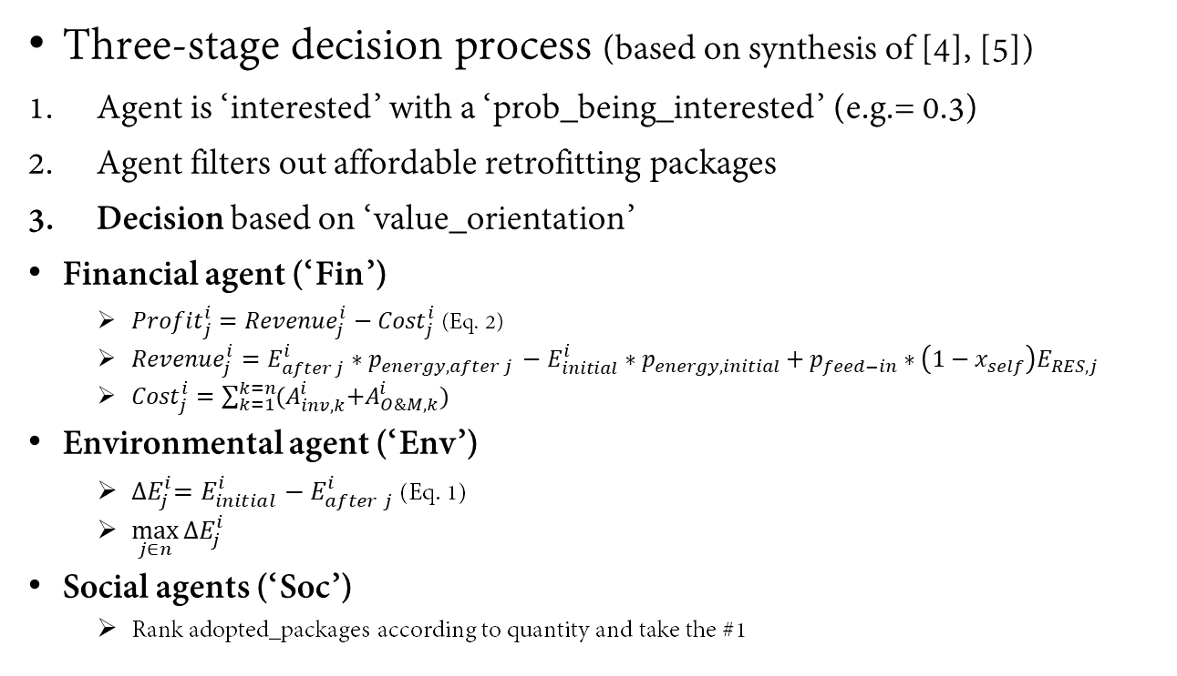
Methodology Homeowner agents’ decision-making framework
Three-stage decision process (based on synthesis of [4], [5])
Agent is ‘interested’ with a ‘prob_being_interested’ (e.g.= 0.3)
Agent filters out affordable retrofitting packages
Decision based on ‘value_orientation’
Financial agent (‘Fin’)
${Profit}_{j}^{i}={Revenue}_{j}^{i}−{Cost}_{j}^{i}$ (Eq. 2)
${Revenue}_{j}^{i}=E_{after j}^{i}∗p_{energy, after j }−E_{initial}^{i}∗p_{energy,initial}+p_{feed−in}∗{\left(1−x_{self}\right)E}_{RES,j}$
${Cost}_{j}^{i}=\sum_{k=1}^{k=n}{{(A}_{inv, k}^{i}+A_{O\&M,k}^{i})}$
Environmental agent (‘Env’)
${∆E}_{j}^{i}=E_{initial}^{i}−E_{after j}^{i}$ (Eq. 1)
$\max_{j∈n}{{∆E}_{j}^{i}}$
Social agents (‘Soc’)
Rank adopted_packages according to quantity and take the #1
1.Interest
‘interested’: True or False
2.Affordability
Cost of ‘affordable_packages’ <= ‘budget’
3.Decision
‘Fin’: Max profit
‘Soc’: Imitate neighbours
‘Env’: Max energy savings
Based on ‘prob_being_interested’
[4] Arning et al (2020). The challenge of improving energy efficiency in the building sector: Taking an in-depth look at decision-making on investments in energy-efficient refurbishments.
[5] Wilson et al. (2018). Quantitative modelling of why and how homeowners decide to renovate energy efficiently

Slide 9
Methodology Simulation process
Loop over agent
2.1. Intermediary agent ‘contacts’ n homeowner agents
Simulation starts
2.1. Homeowner agent is interested in EER?
N
2.1. Homeowner agent withdraws the EER program
1. Initialization
Y
Loop over agent
2.2. Intermediary agent gives customized information on EER packages
Define simulation length
Load Building archetypes→ N of agents
Load retrofitting packages
2.2. Homeowner agent affords at least one EER package?
N
2.2. Homeowner agent withdraws the EER program
Number of adopters over time
Packages adopted by the end
Y
Loop over agent
2.3. Intermediary agent ‘can’ advice further (or even influence the decision)*
2.3. Homeowner agent decides on the EER package?
N
2.3. Homeowner agent withdraws the EER program
Loop over time
5. The results are collected
Y
3. Homeowner agent adopts one of the EER packages
(based on its own ‘goal’)
Simulation ends
4. Agent decisions are implemented and the state variables are updated

Slide 10
Methodology Scenarios and Inputs
Table 1. Building archetypes selected in the illustrative example
3 test scenarios
Budget (socio-economic status of the neighbourhood under study)
Value orientation (social values of the population)
Subsidies for homeowners (policy intervention)
→ For now no real data, hence, the results are rather useful for the “verification”
Building archetype | Floor area | Energy initial | Energy type | Number
SFH1 (built before 1964) | 143 | 41570,1 | gas | 10
SFH2 (1965-1974) | 135 | 30456 | gas | 15
SFH3 (1975-1991) | 135 | 21411 | gas | 7
Table 2. Input data on retrofitting packages for Building archetype SFH1
Option | Name | Energy demand after [kWh/year] | Renewable energy gen. [kWh/year] | Cost [€/year] | Energy carrier after
1 | A | 37280,1 | 0 | 2860 | electricity
2 | B | 31560,1 | 1100 | 8580 | electricity
3 | C | 30130,1 | 1200 | 14300 | electricity
4 | D | 35850,1 | 0 | 4576 | electricity
5 | E | 30845,1 | 1000 | 12155 | electricity
6 | F | 28700,1 | 1300 | 14300 | electricity
Table 3. Input data on prices
Energy type | Price per kWh
el_feedin | 0,5
el_retail | 0,13
gas | 0,077

Slide 11
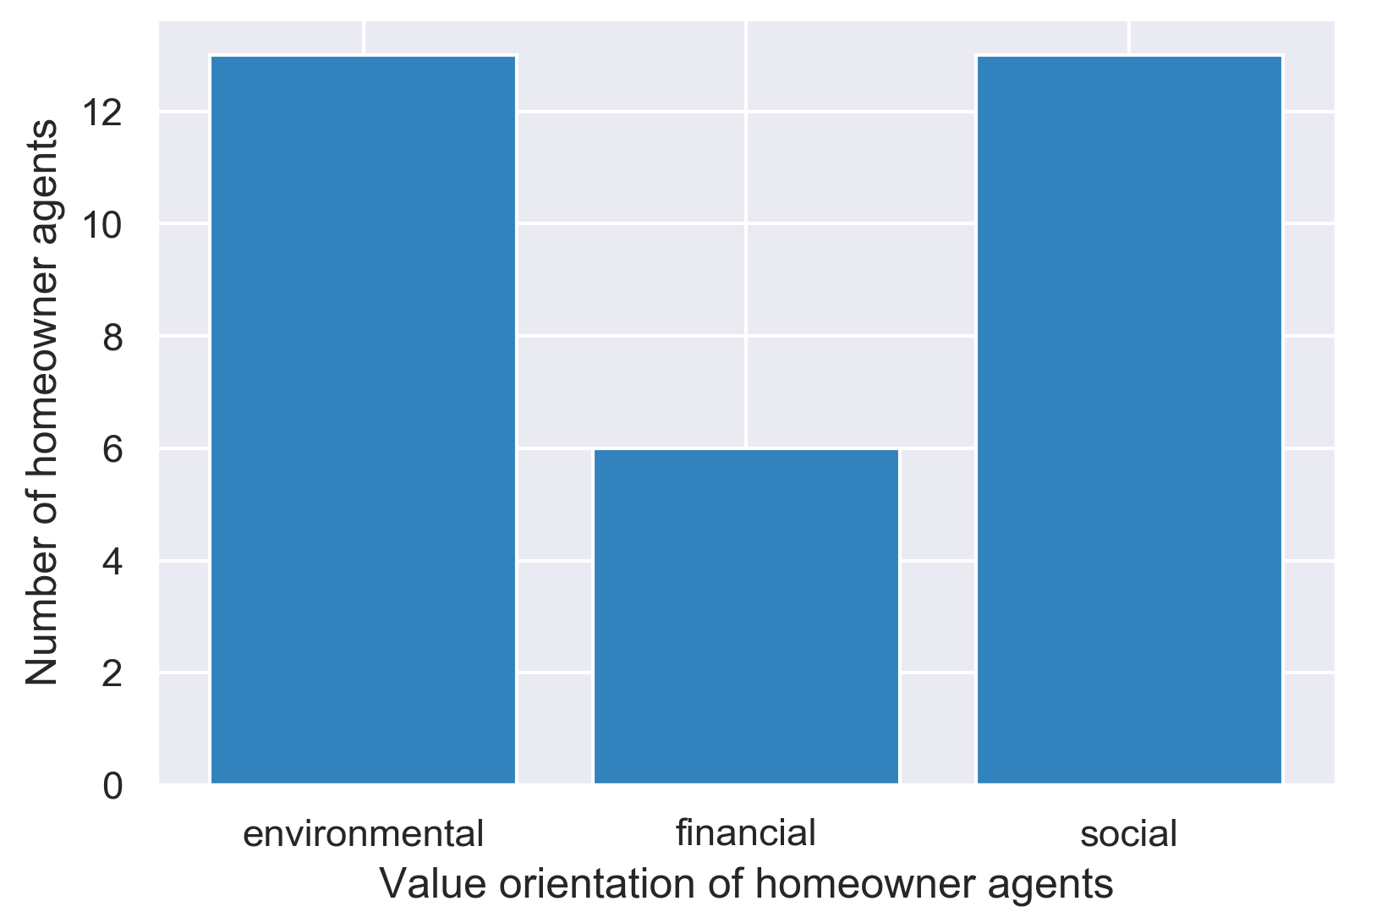
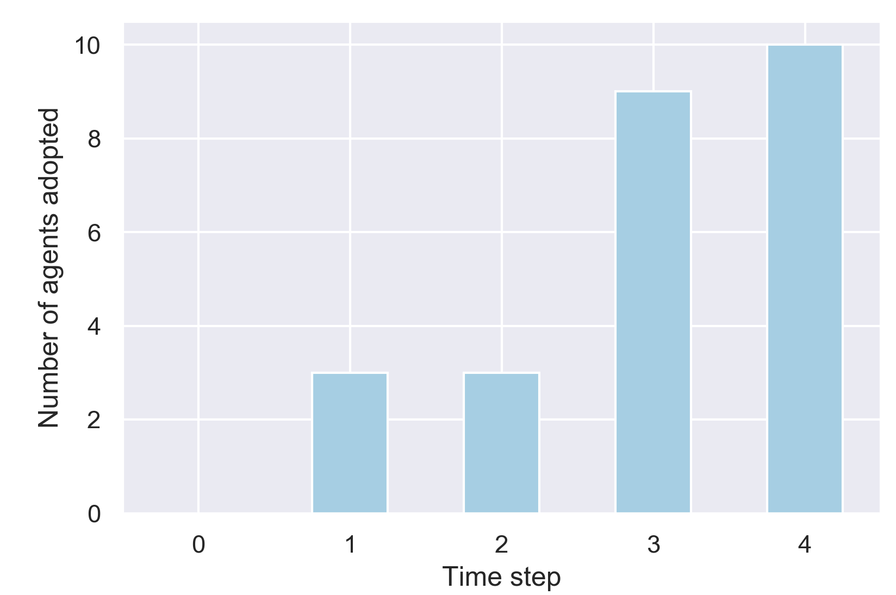
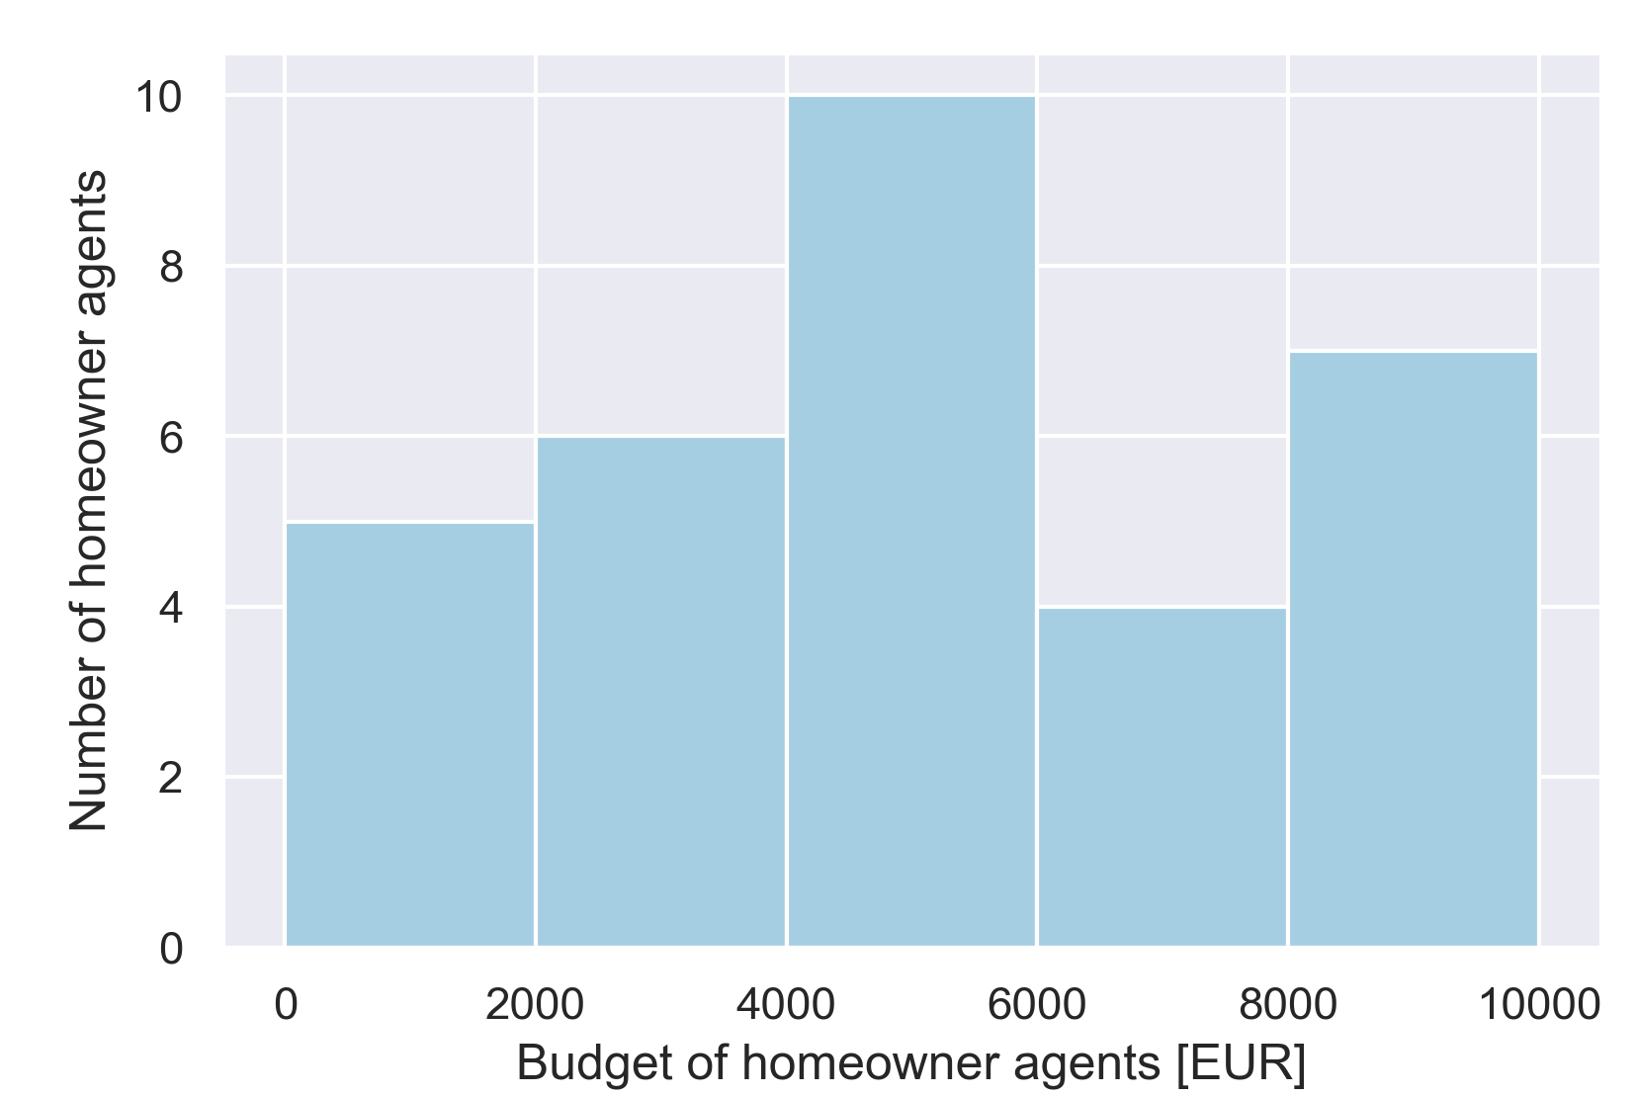
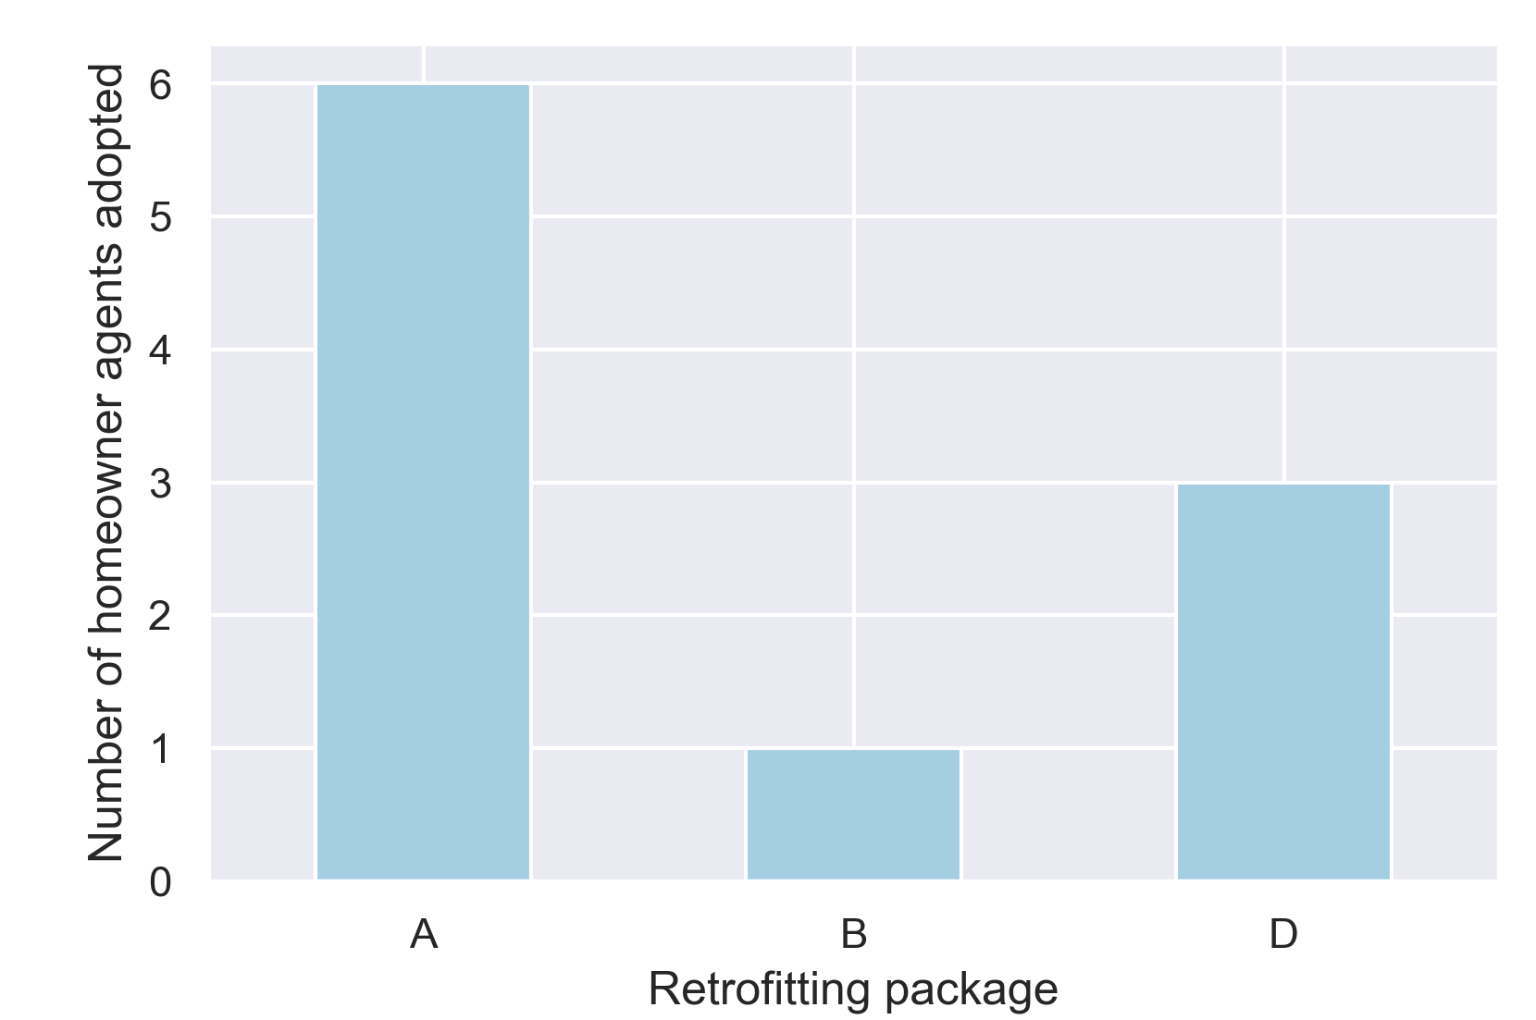
Results Impact of „budget“ on the retrofitting adoption
At initialization (Timestep = 0)
Results (Timestep = 4)
What is ‘budget’ available for EER?
→ share of income of the neighbourhood under study
2 cases:
lower budget
(1,000-10,000)
Value orientations
# of adopted agents (per time step)
# of adopted retrofitting packages (total)
Budget

Slide 12
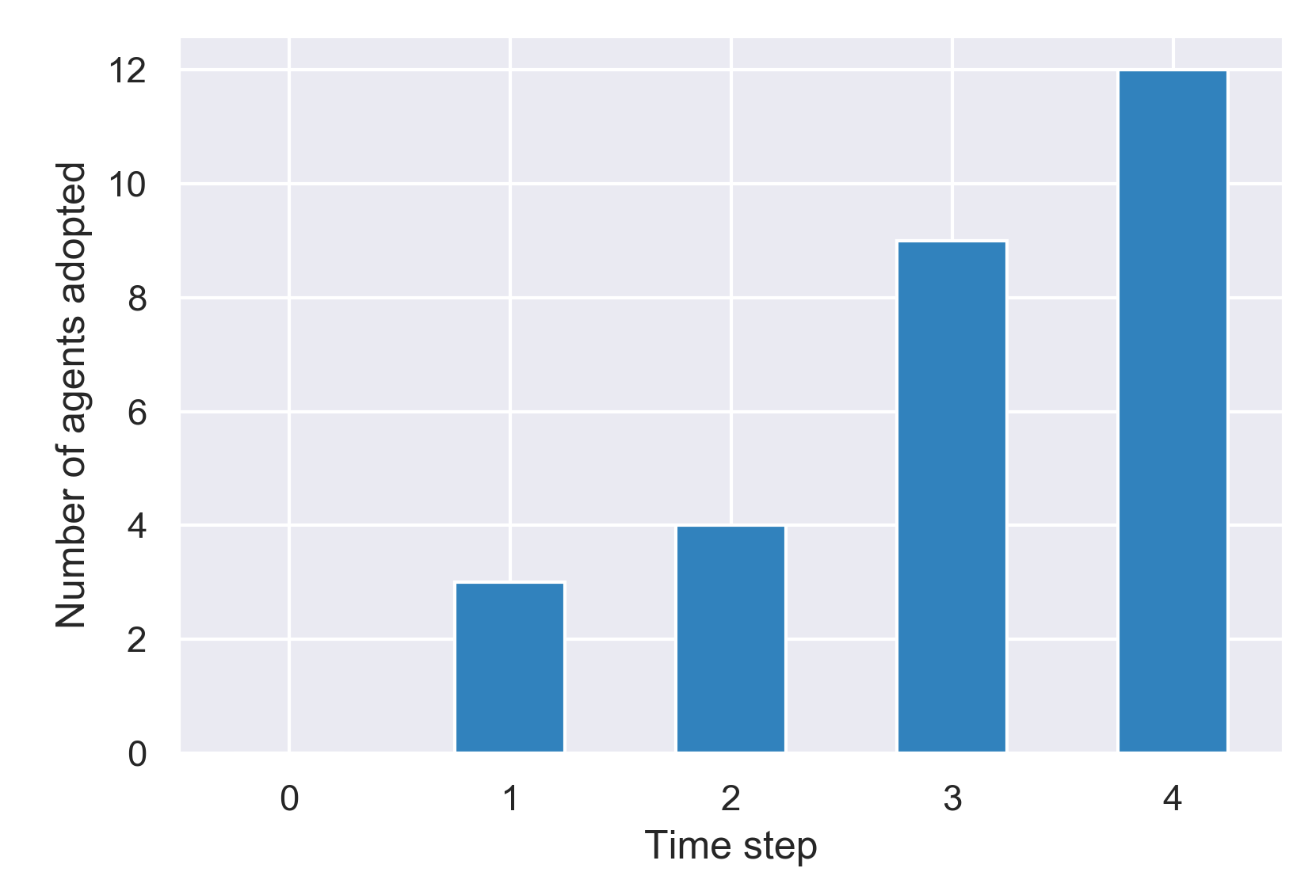
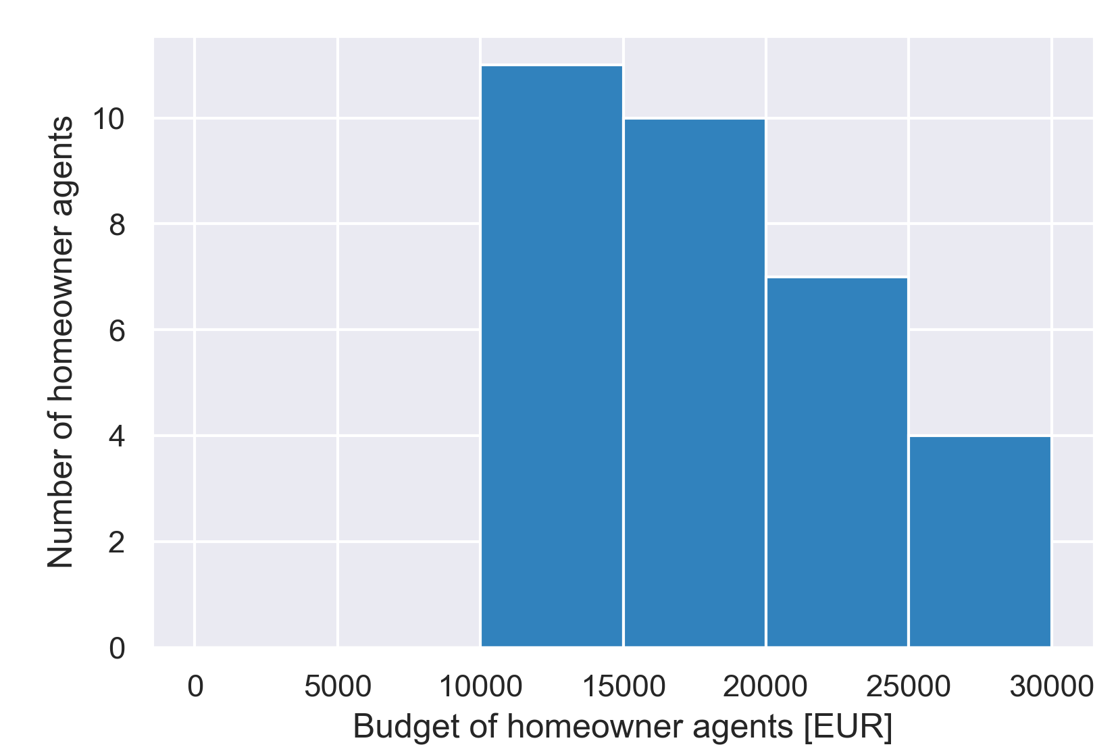
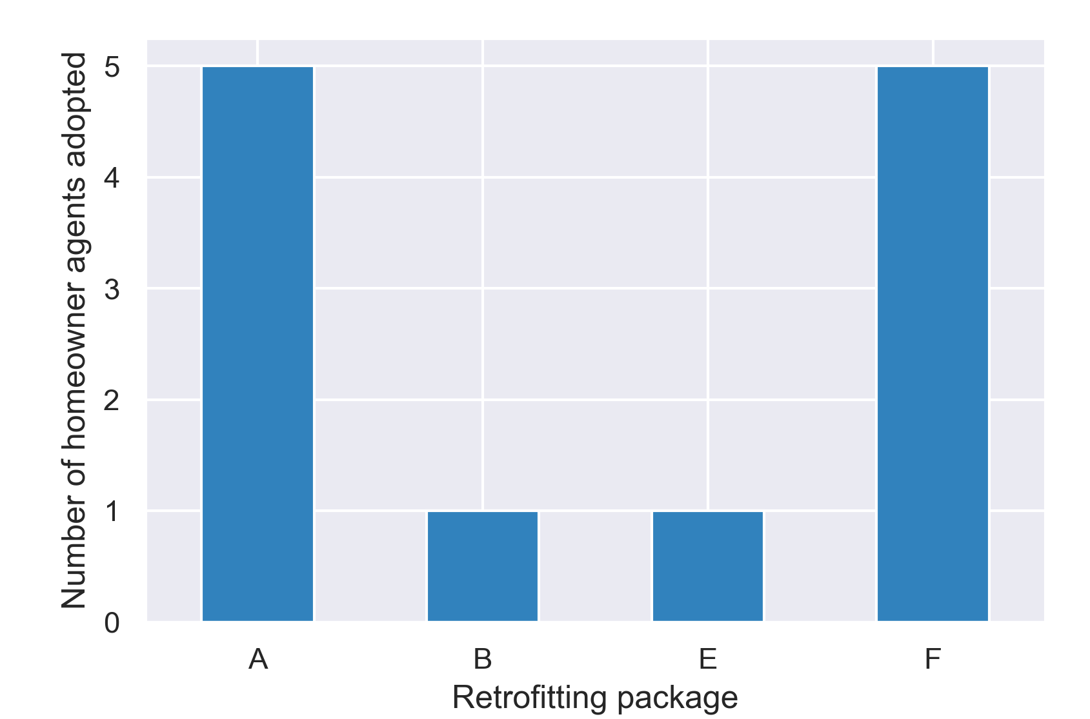
Results Impact of „budget“ on the retrofitting adoption
At initialization (Timestep = 0)
Results (Timestep = 4)
What is ‘budget’ available for EER?
→ share of income of the neighbourhood under study
2 cases:
higher budget
(10,000-30,000)
Value orientations
# of adopted agents (per time step)
# of adopted retrofitting packages (total)
Budget

Slide 13
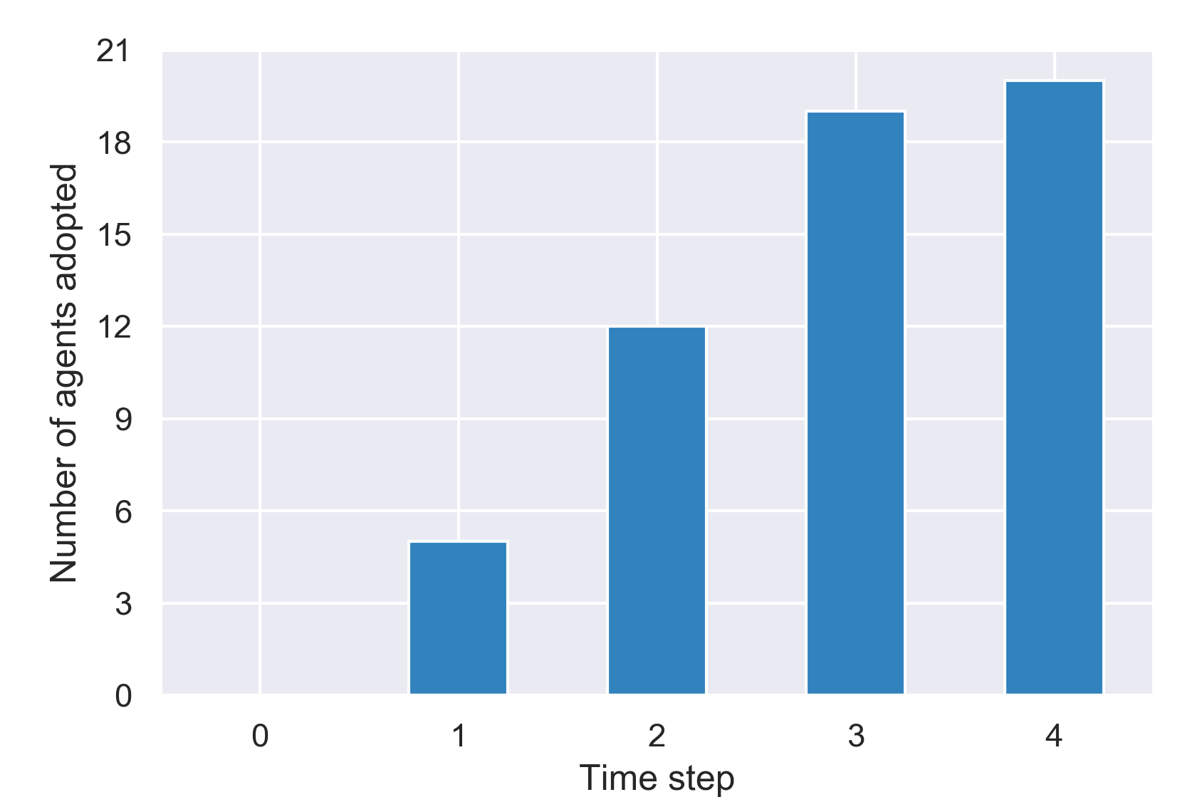
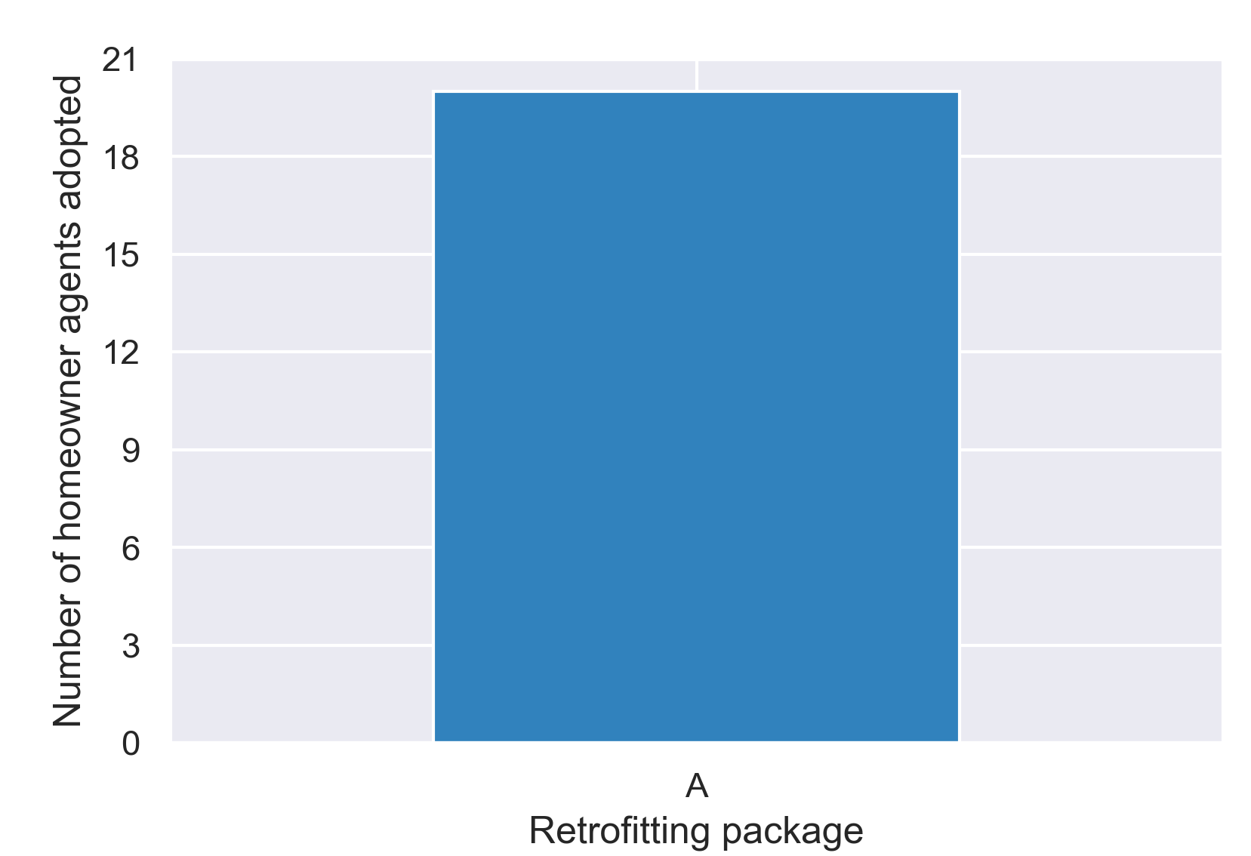
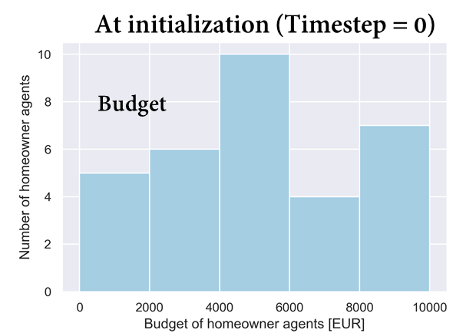
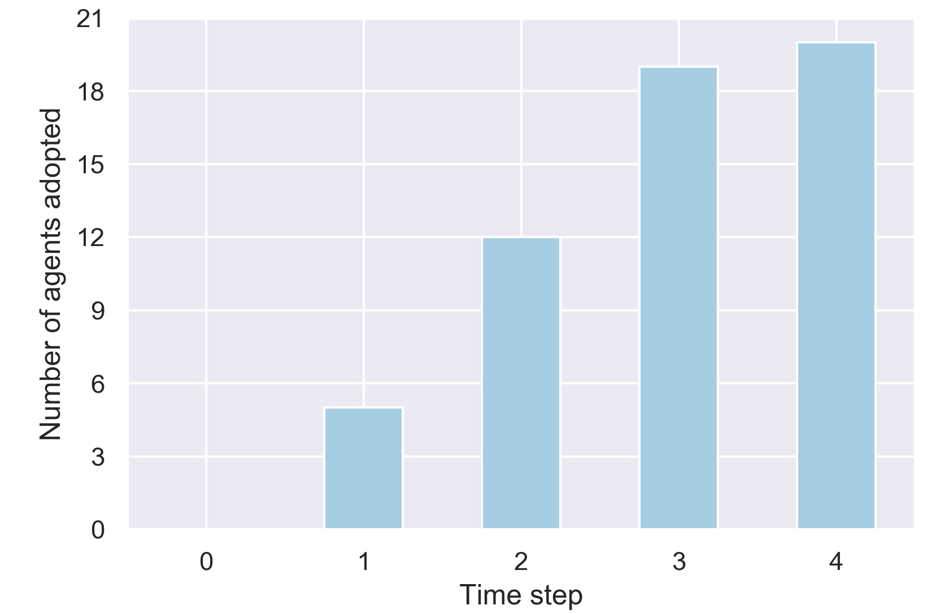
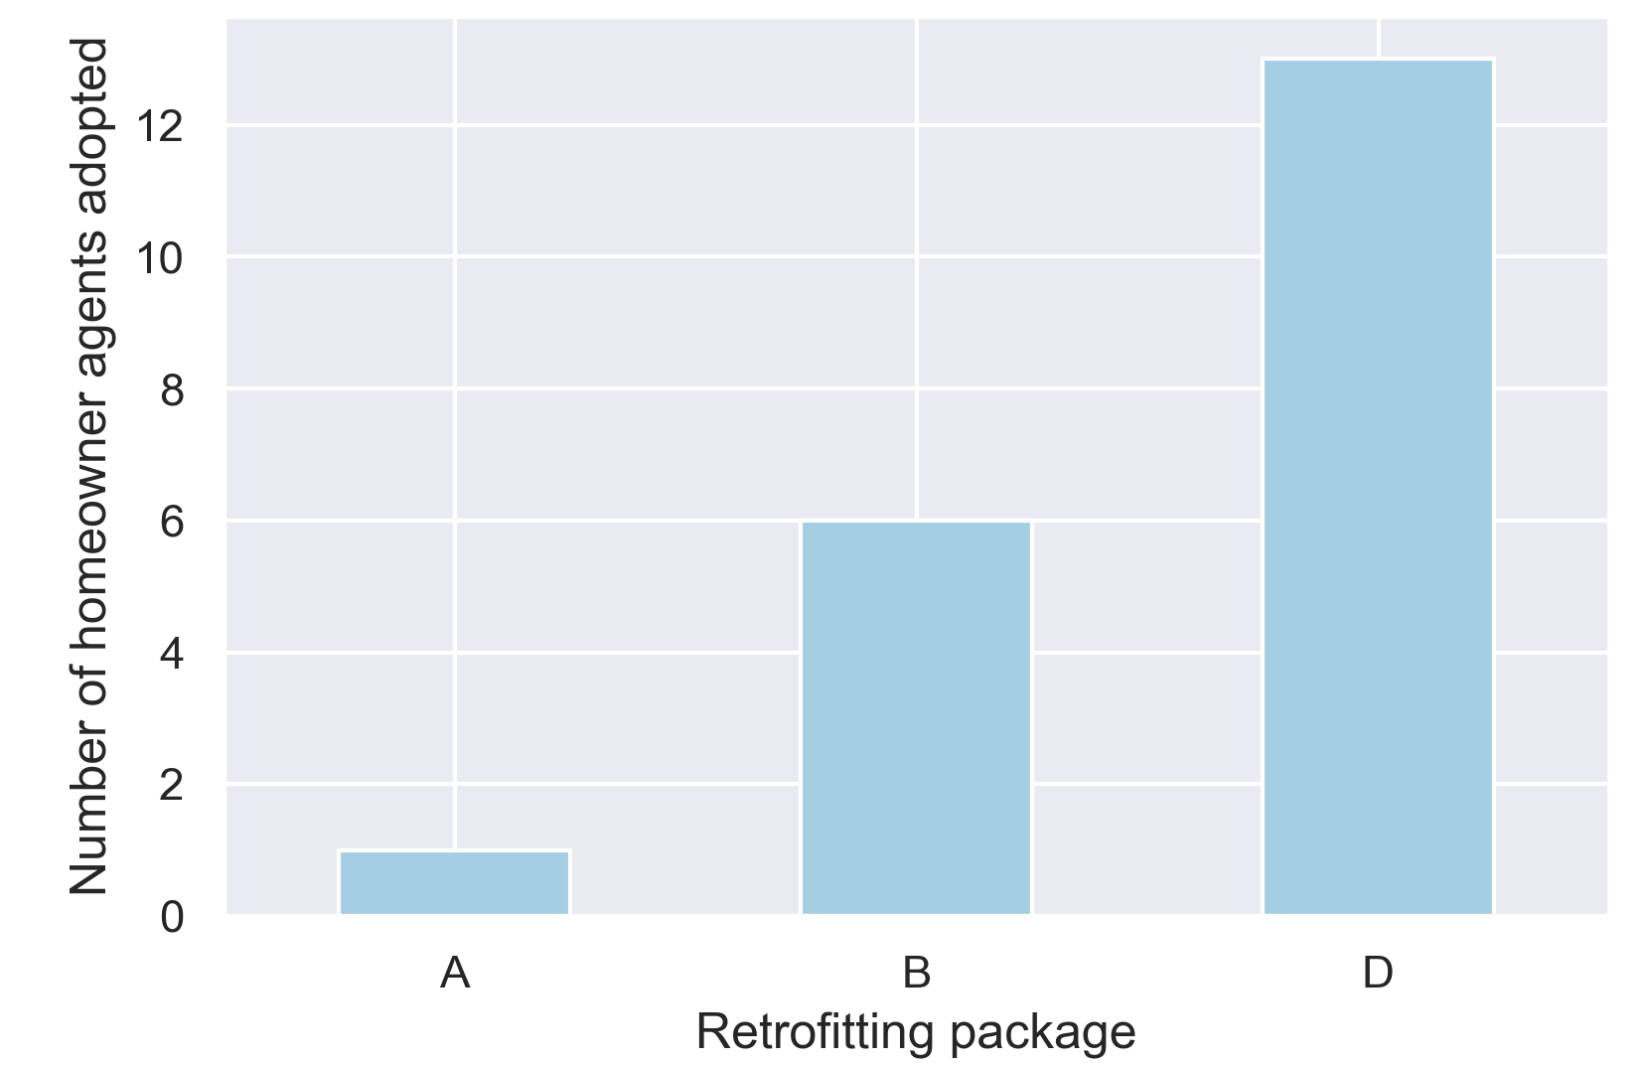
Results Impact of „Value orientation“
# of adopted agents (per time step)
# of adopted retrofitting packages (total)
Only financial
Only environmental
Only social → nobody adopts
# of adopted agents (per time step)
# of adopted retrofitting packages (total)

Slide 14
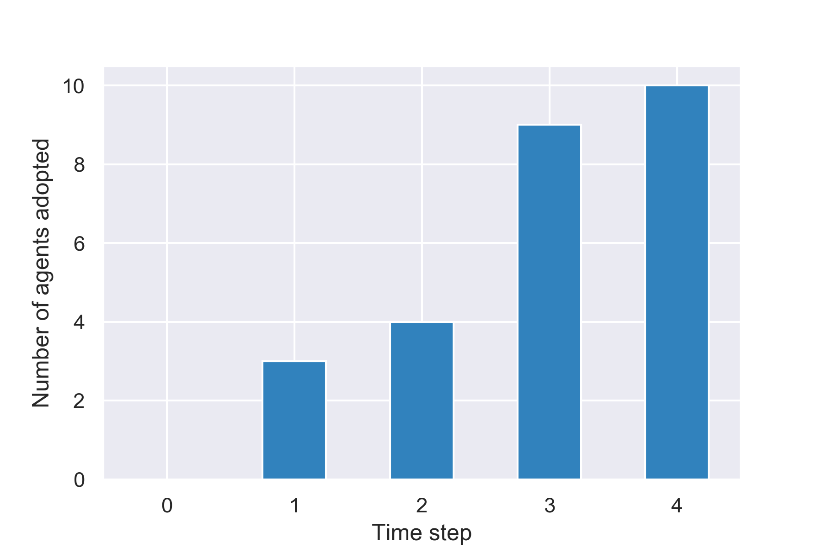
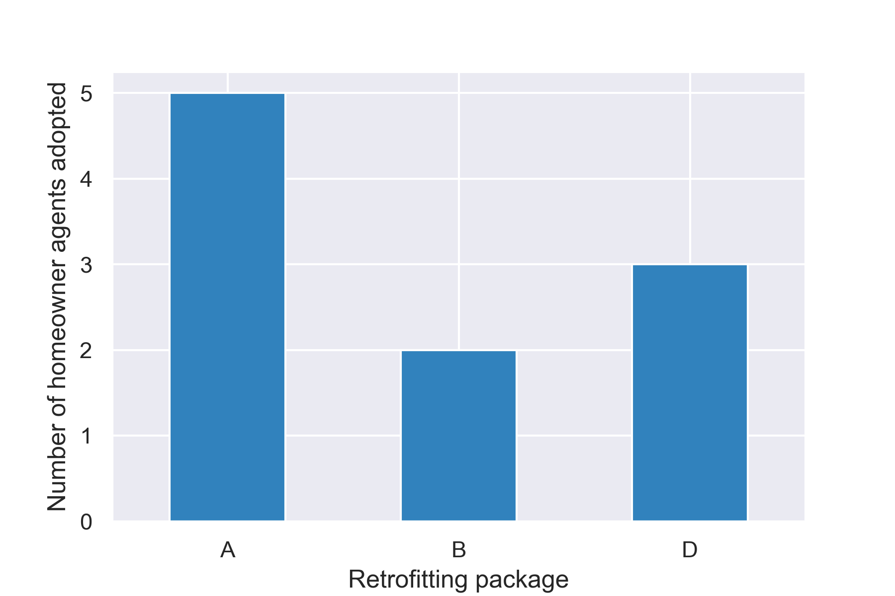
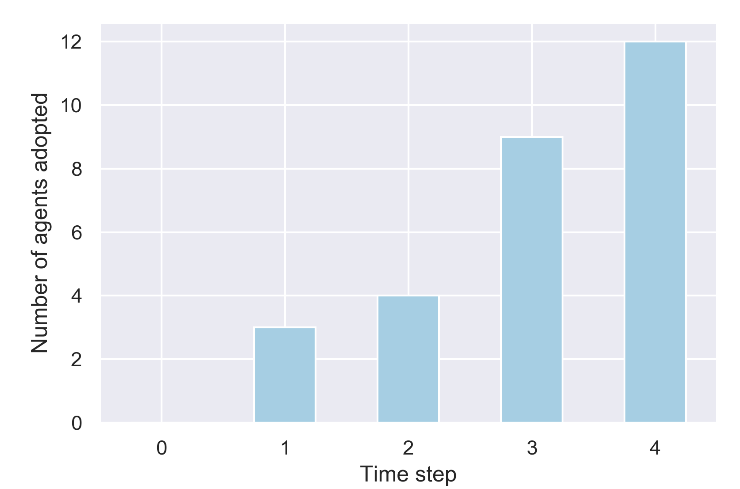
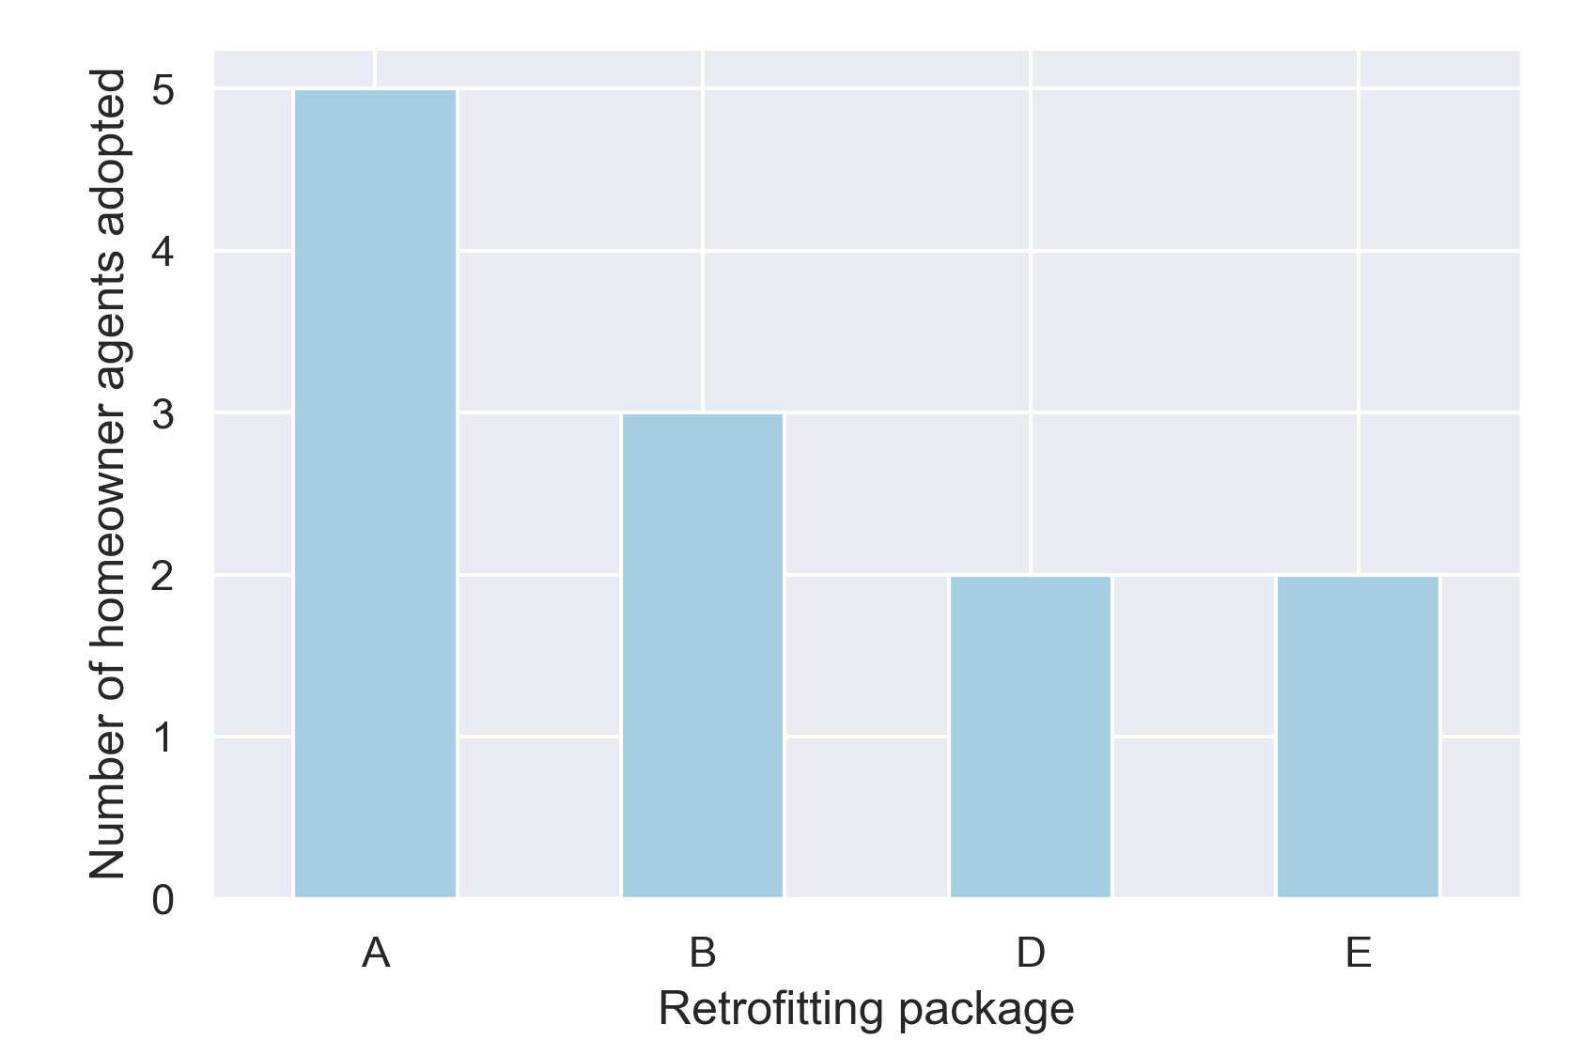
Results Policy intervention: subsidies to all homeowner agents
2 levels of subsidy compared
Lower (1,000)
Higher (5,000)
→subsidies only to lower income households?
# of adopted agents (per time step)
# of adopted retrofitting packages (total)
# of adopted agents (per time step)
# of adopted retrofitting packages (total)

Slide 15
Conclusion
Model concept is implemented correctly
Added value/Novelty:
new approach for analysing how retrofitting implementation could be stimulated (neighbourhood-level, intermediary agent, social and technical ‘foundation’)
Limitations (of the current version)
Agent parameters & decision-making
Intermediary agent’s decision-making strategy
Abstraction of ‘interaction’ (to be defined better)
Neighbourhood-specific scenarios
Outlooks/Next steps:
Case study and data collection to parameterize the ‘attributes’ as well as validate the model
→ survey and interview for neighbourhoods in Amsterdam & Frankfurt

Slide 16
Thank you for your attention!
Questions?
Contact details:
ardak.akhatova@tuwien.ac.at

