Slide 1
Central and South Eastern Europe energy connectivity (CESEC) Zusammenarbeit bei der Integration von erneuerbaren Energien
IEWT 2021
Lukas Liebmann, Gustav Resch

Slide 2
The study
“Study on the Central and South Eastern Europe energy connectivity (CESEC) cooperation on electricity grid development and renewables”
1. Highest-potential renewable energy zones with cross-border dimension
Objective: To provide significant and practical contributions towards facilitation of the integration of renewable energy sources (RES) in the CESEC region
2. Infrastructure and interconnection needs to ensure RES integration in the CESEC region
through
Approach: Analysis of studies, data & projects
Cross-verification with relevant (national) data
Modelling
Stakeholder consultation
Interviews
3. Challenges and barriers to RES deployment and cross-border cooperation in the CESEC region
4. Conclusions & recommendations
Notes:
Ziel: Erhebliche und praktische Beiträge zur Erleichterung der Integration erneuerbarer Energiequellen (RES) in der CESEC-Region leisten
Ansatz: Analyse von Studien, Daten & ProjektenQuerverifizierung mit relevanten (nationalen) DatenModellieren Stakeholder-KonsultationVorstellungsgespräche

Slide 3







The team
Content manager
Gustav Resch
(TU Wien)
Process manager
Marie-Jose Zondag
(Ecorys)
Quality Control
Monique Voogt
(SQ Consult)
CESEC team
1. Renewable energy potential
Gustav Resch
Lukas Liebmann
2. Infrastructure needs & potential projects
Laszlo Szabo & Karsten Lüdorf
András Mezősi, Enikő Kácsor, Alfa Diallo
3. Barriers for implementation
Jenny Winkler
Ammar Maghnam
Hazem Abdel-Khalek
4. Conclusions & recommendations
Marie-Jose Zondag
Iulia Falcan
Laura Heidecke
5. Stakeholder involvement
Marie-Jose Zondag
Laura Heidecke
Yoeri Dijkhof

Slide 4
1. Highest-potential renewable energy zones
Objectives
Identify areas with the highest and most cost-effective potential for RES (“renewable energy zones”)
(based on energy resources, related cost, commercial interest)
Identify possible cost-effective “cross-border renewable energy projects” with a cross-border dimension
(to be further assessed and taken up in the CESEC framework)

Slide 5
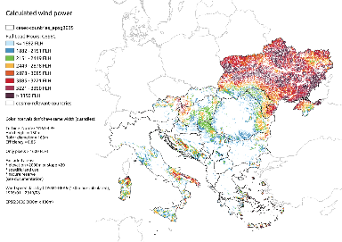
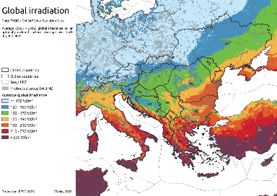
Approach highest-potential renewable energy zones
used as basis for subsequent modelling:
Assessment of RES potentials in the CESEC region
A comprehensive literature survey as basis for subsequent analysis …
… complemented by an own GIS-based analysis for solar and wind energy using meteorological and land use data, considering e.g. distance rules and environmental constraints for wind energy
Example: GIS-based analysis for wind (above) and solar (below)
Example: Literature survey on hydropower potentials in CESEC

Slide 6
Approach highest-potential renewable energy zones
used in model-based RES analysis:
Modelling system
TGM
Figure: Model coupling between Green-X, EPMM and TGM
for an assessment of RES developments
in the electricity sector under distinct grid topologies

Slide 7
Approach highest-potential renewable energy zones
used in model-based RES analysis:
Both scenarios are replicated to analyze the impact of Cross-Border RES cooperation:
Domestic RES target fulfilment
(-NoCoop):
focus on using domestic resources
With (full) RES cooperation across the CESEC region
(-Coop):
a region-wide, least-cost approach within the CESEC region.
Scenario definition
Two pairs of scenarios for the RES uptake towards 2050:
Reference RES scenarios (RefRES): in accordance with national planning (National Energy and Climate Plans or alternative sources where not applicable)
High RES scenarios (HighRES): assessing the feasibility of reaching a higher level of RES deployment in accordance with decarbonization needs / European Green Deal perspective
Reference RES
NoCoop
Coop
High RES
NoCoop
Coop

Slide 8
Brief recap of 2030 RES targets (at EU level)
2030 RES shares by EU MS according to NECP ambitions vs Green Deal needs
(Source: NECP
& own analysis)
Notes:
The EU Green Deal raises the need for a stronger uptake of renewables: assumed increase in RES target from 32% to 40% require high increases of the targeted 2030 RES share for e.g. Slovenia, Austria, Slovenia, Hungary, or Slovakia
Moderate impacts for Greece or Croatia

Slide 9
RES uptake in the electricity sector (CESEC)
At CESEC level:
53.1% (HighRES scenarios)
49% (RefRES scenarios)
2030 share of electricity generation from renewables in gross electricity demand
(Source: Eurostat, NECP & Green-X modelling)
Notes:
Figure: Status quo (2019), planned (NECP target) and modelled 2030 RES shares by CESEC country according to assessed scenarios (RefRES and HighRES scenarios)
Green Deal needs vs national planning in CESEC:
By 2030 only small difference between both perspectives in CESEC:
RES-E share:
53.1% (HighRES scenarios)
49% (RefRES scenarios).
Reasons?
ambitious policy planning as
(cf. Austria, Greece, Italy, North Macedonia)
practical limits to market growth in several other countries
(e.g. Kosovo, Moldova or Ukraine)

Slide 10
Cross-border RES cooperation in the 2030 context (CESEC)
2030: Change of RES-E share in gross electricity demand (in percentage points) driven by RES cooperation
surplus
deficit
(Source: Green-X modelling)
Notes:
Cross-border RES cooperation suggests to reallocate RES investments:
Modelling reveals that Albania, Bosnia and Herzegovina, Italy, Montenegro and Slovakia may offer promising RES potentials not required for own RES target achievement.
Similar trends are applicable under both assessed policy perspectives (RefRES and HighRES scenarios).

Slide 11
RES uptake in the electricity sector (CESEC)
At CESEC level:
88.6% (HighRES scenarios)
75% (RefRES scenarios)
2050 share of electricity generation from renewables in gross electricity demand
(Source: Eurostat, NECP & Green-X modelling)
Notes:
Figure: Status quo (2019), planned (NECP target) and modelled 2030 RES shares by CESEC country according to assessed scenarios (RefRES and HighRES scenarios)
Green Deal needs vs national planning in CESEC:
By 2030 only small difference between both perspectives in CESEC:
RES-E share:
53.1% (HighRES scenarios)
49% (RefRES scenarios).
Reasons?
ambitious policy planning as
(cf. Austria, Greece, Italy, North Macedonia)
practical limits to market growth in several other countries
(e.g. Kosovo, Moldova or Ukraine)

Slide 12
Development of electricity generation from RES:
(Source: Green-X modelling)
Notes:
Figure: Development of electricity generation from RES at CESEC level up to 2050, exemplified for the RefRES-NoCoop (left) and the HighRES-Coop scenario (right)
Changing the technology mix:
the dominance of hydropower in electricity supply is expected to diminish.
Solar electricity and wind power will become the major contributor to future electricity supply.
Of interest, wind energy may act as marginal generation option, reaching the highest share among all technologies within total electricity generation from RES only if a strong RES ambition is imposed (HighRES scenarios).

Slide 13
Changing the RES technology mix
Country-specific technology mix of installed RES capacities at present (2020 - top) and in future (2050 - bottom)
(Source: Green-X modelling)

Slide 14
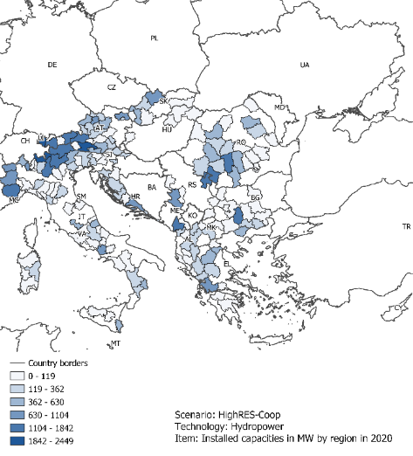
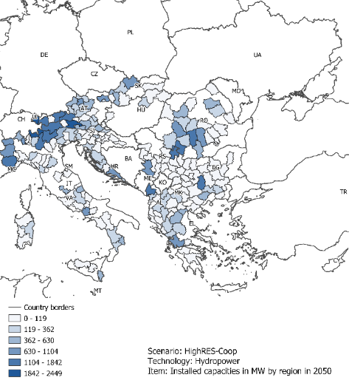
Identification of promising CB RES projects in the CESEC region
Insights from the mapping exercise:
Trends in hydropower exploitation
2020
2050
(Source: Green-X modelling
& own analysis)
Notes:
Figure: Mapping of current (2020) (left) and future (2050 (right)) hydropower installations in the CESEC region according to modelling (HighRES-Coop scenario)

Slide 15
Identification of promising CB RES projects in the CESEC region
GIS-based analysis of solar potentials
(Source: Own analysis)

Slide 16
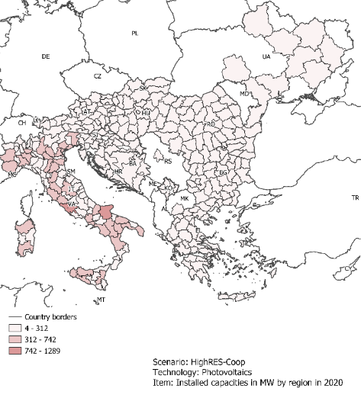
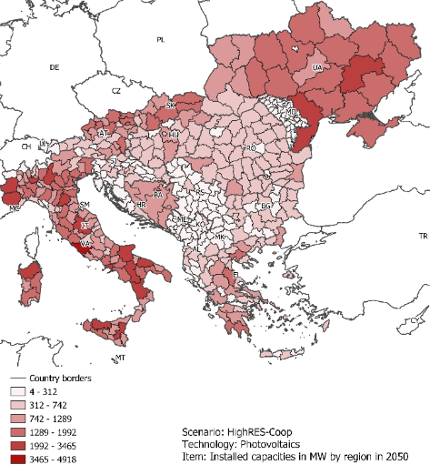
Identification of promising CB RES projects in the CESEC region
Insights from the mapping exercise:
Trends in photovoltaics
exploitation
2020
2050
(Source: Green-X modelling
& own analysis)
Notes:
Figure: Mapping of current (2020) (left) and future (2050 (right)) PV installations in the CESEC region according to modelling (HighRES-Coop scenario)

Slide 17
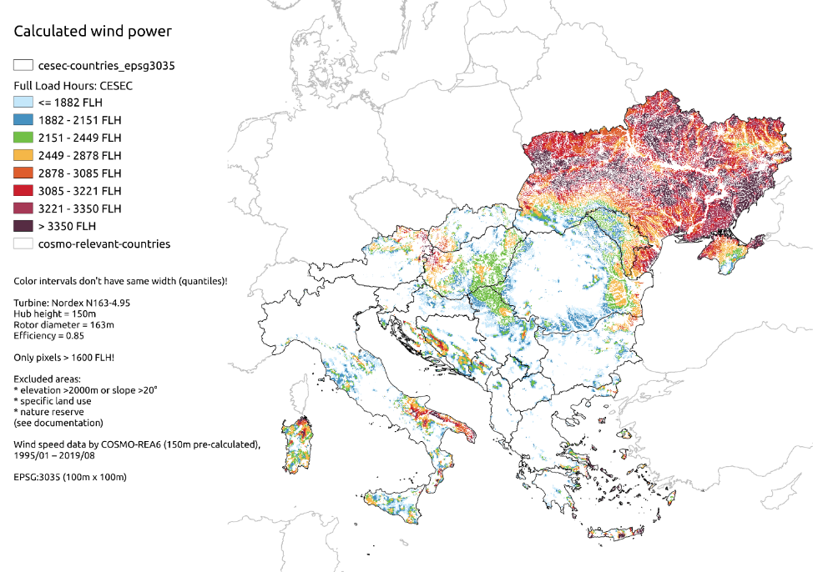
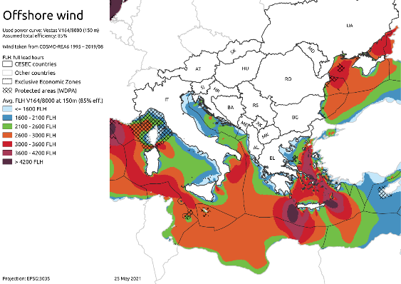
Identification of promising cross-border RES projects in the CESEC region
GIS-based analysis of wind potentials
(onshore & offshore)
(Source: Own analysis)

Slide 18
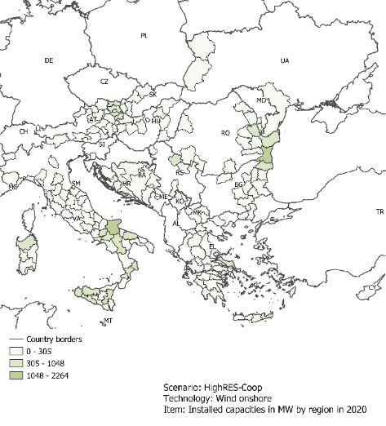
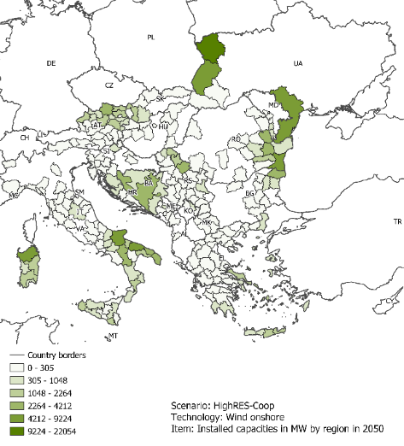
Identification of promising CB RES projects in the CESEC region
Insights from the mapping exercise:
Trends in wind
(onshore)
exploitation
2020
2050
(Source: Green-X modelling
& own analysis)
Notes:
Figure: Mapping of current (2020) (left) and future (2050 (right)) wind onshore installations in the CESEC region according to modelling (HighRES-Coop scenario))

Slide 19
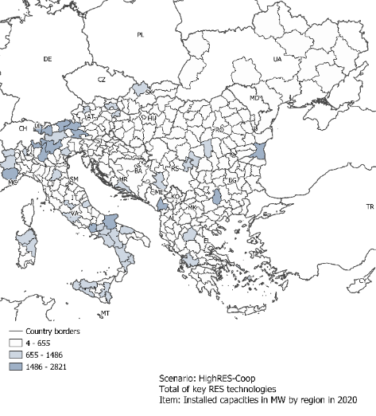
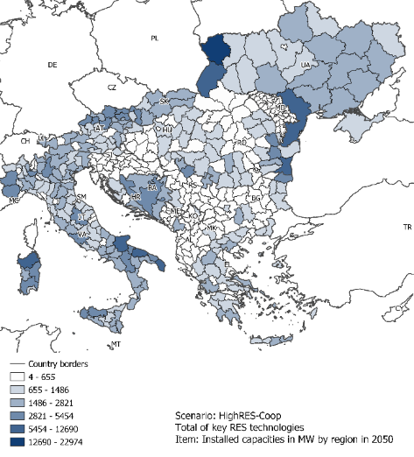
Identification of promising CB RES projects in the CESEC region
Insights from the mapping exercise:
The aggregated trend
(hydro + wind + PV)
2020
2050
(Source: Green-X modelling
& own analysis)
Notes:
Figure: Mapping of current (2020) (left) and future (2050 (right)) RES installations (key RES: wind, PV, hydro) in the CESEC region according to modelling (HighRES-Coop scenario))

Slide 20
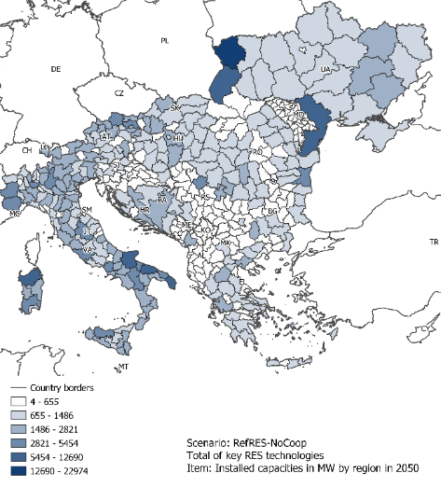
Identification of promising CB RES projects in the CESEC region
Insights from the mapping exercise:
Comparing
the aggregated trend by 2050
(hydro + wind + PV)
RefRES
HighRES
(Source: Green-X modelling
& own analysis)
Notes:
Figure: Comparing the mapping of future (2050 (right)) RES installations (key RES: wind, PV, hydro) in the CESEC region according to modelling (RefRES vs HighRES-Coop scenario))

Slide 21
Identification of promising cross-border RES projects in the CESEC region
Mapping exercise for the CESEC region reveals the massive energy transition envisaged: Renewables expected to dominate power supply in future
Photovoltaics is a key technology already today and in future, representing a promising generation asset at a local level
→ broadened geographical distribution of RES installations
If certain areas offer economically viable potentials also for other key RES technologies (onshore wind) → power density increases significantly.
Combination of solar PV and wind energy at regional level
→ areas with most promising site conditions, serving as basis for further elaboration of CB RES and infrastructure cooperation
Notes:
The mapping exercise performed within this study for the CESEC region reveals the massive energy transition envisaged. Renewables are expected to dominate power supply in future and this is getting apparent also in the widespread of their geographical distribution.
Thanks to photovoltaics, a key technology already today and in future, which represents a promising generation asset at a local level, one can identify the broadened geographical distribution of RES installations.
If certain areas offer economically viable potentials also for other key RES technologies like onshore wind the power density increases significantly.
Thus, the combination of solar PV and wind energy at regional level allows to identify those areas with most promising site conditions, serving as basis for further elaboration of CB RES and infrastructure cooperation.

Slide 22
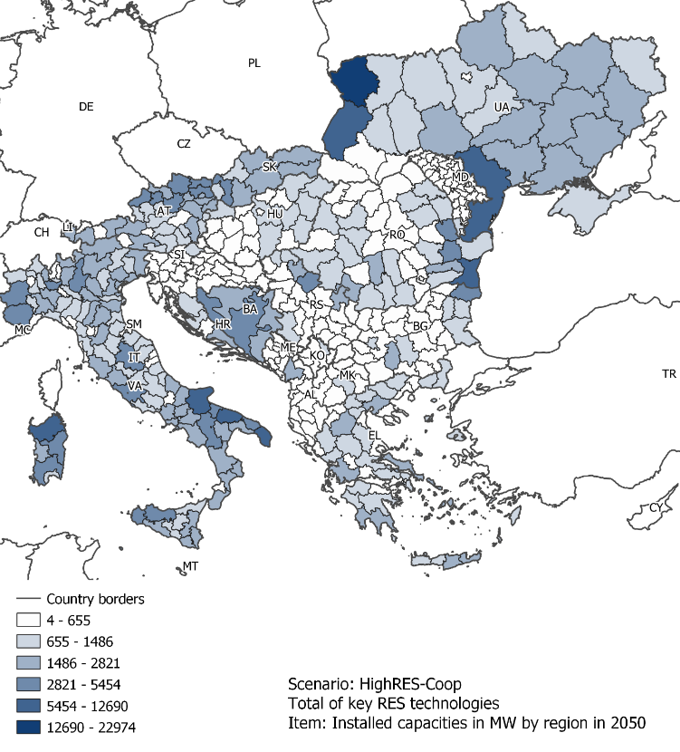
Identification of promising
Cross-Border RES projects in the CESEC region
Notes:
A first draft shortlist of such areas / zones:
Austria, Hungary and Slovakia: Border region with promising site conditions specifically for onshore wind but also solar PV
Bosnia and Herzegovina: combination of solar and wind onshore, specifically in the South-Eastern part
Bulgaria: North Eastern border of Bulgaria – wind onshore and solar PV
Croatia: solar PV in combination with onshore wind, specifically in the Southern parts
Greece: several locations offer promising site conditions for both solar PV and wind onshore – infrastructure needs occur with neighbouring countries.
Italy: South-Eastern part (at the Adriatic coast) – combination of solar and wind onshore
Romania: Eastern parts – wind onshore and solar PV
Serbia: Norther border area – onshore wind in combination with solar PV
Ukraine: Western and Southern parts (thanks to remarkably good site conditions for onshore wind)

Slide 23
Conclusions
1. Highest-potential renewable energy zones
Austria, Hungary and Slovakia: border region with promising site conditions specifically for onshore wind but also solar PV;
Bosnia and Herzegovina: a combination of solar and wind onshore, specifically in the South-Eastern part;
Bulgaria: North Eastern border of Bulgaria – wind onshore and solar PV;
Croatia: solar PV in combination with onshore wind, specifically in the Southern parts;
Greece: several locations offer promising site conditions for both solar PV and wind onshore – infrastructure needs occur with neighbouring countries;
Italy: South-Eastern part (at the Adriatic coast) – a combination of solar and wind onshore;
Romania: Eastern parts – wind onshore and solar PV;
Serbia: Norther border area – onshore wind in combination with solar PV;
Ukraine: Western and Southern parts (thanks to remarkably good site conditions for onshore wind).

Slide 24
Thank you
Lukas Liebmann, liebmann@eeg.tuwien.ac.at
Gustav Resch, resch@eeg.tuwien.at

