Slide 1

On the way to low-emission European buildings: investigating the role of non-ETS CO₂ pricing in the residential and tertiary sectors
Presented by Şirin Alibaş
Co-authors: Tobias Fleiter
Pia Manz
Rainer Elsland

Slide 2
Buildings of the EU (EU27+UK)
The buildings of the EU responsible from 37% of the total final energy demand, approx. 5000 TWh [Eurostat, 2019]
The space heating demand alone makes up ~65% of the final energy demand of residential buildings [Eurostat, 2018]
Fossil fuels provided 58% in 2019 [Eurostat, 2019]
The residential and tertiary sectors (excluding agriculture) responsible for ~15% of total CO₂ emissions

Slide 3
Decarbonization Measures
Improving the energy performance of the building envelope
Installation of efficient equipment
Fuel switch to renewables
Smart operation of buildings
Carbon pricing in the non-ETS sectors
fossil fuel prices are expected to stay constant or slightly decrease towards 2050 [IEA, 2020]
CO₂ price makes the RE carriers financially attractive against fossil fuels
Can the EU building sectors manage to decarbonize by 2050 with the implementation of currently stated policies, including non-ETS CO₂ pricing?
What is the effective non-ETS CO₂ price in the building sectors when applied simultaneously with the other planned policy instruments?

Slide 4
Basic Scenario and CO₂-Price Modifications
Each EU member state decides the implementation and prices nationally
Scandinavian states first to apply, since 1990s. Sweden takes the lead with 119 US$/tCO₂e [World Bank, 2020]
Finland and France follow with 58 and 49 US$/tCO₂e [World Bank, 2020]
Germany, Austria and Luxembourg announced implemention as early as 2021 at a price of around 25 US$/tCO₂e [World Bank, 2020]
5 different non-ETS CO₂-price pathways
VAR0, includes the prices that were announced (introduces appr. prices also in countries who did not announce implementation)
higher intermediate prices in VAR1-VAR4
Basis scenario represents evolution of the building stock under the continuation of declared policies
Regulations on the efficiency and performance of building components and technological devices are captured
Pathway | Unit | 2030 | 2040 | 2050
VAR0 | EUR/tCO₂e | 47 | 63 | 77
VAR1 | EUR/tCO₂e | 102 | 142 | 181
VAR2 | EUR/tCO₂e | 131 | 166 | 201
VAR3 | EUR/tCO₂e | 180 | 240 | 300
VAR4 | EUR/tCO₂e | 200 | 275 | 350

Slide 5
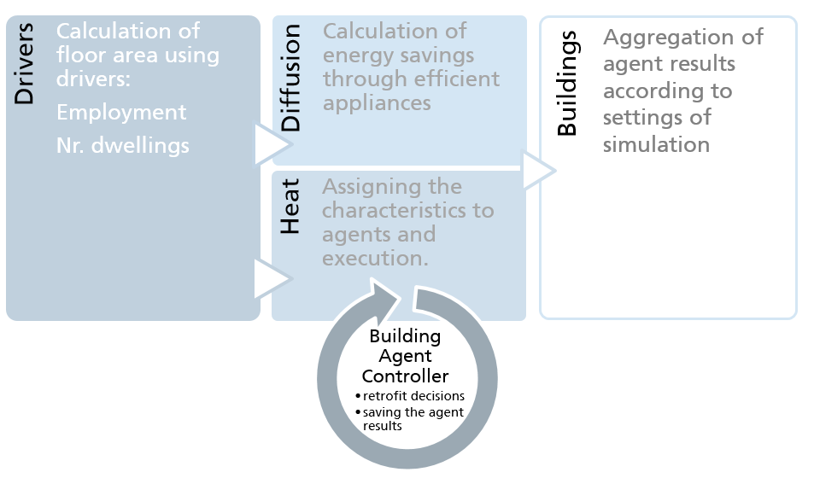
Method – Energy Demand Simulation Model
The building stock, renovation and investment decisions are modelled with the bottom-up simulation model FORECAST™
socio-techno-economic factors
policy instruments
energy carrier specific restrictions

Slide 6
RESULTS

Slide 7
Results - Final Energy Carrier Demand for Building Heating
Strong decrease in fossil fuels
In 2050: 248-384 TWh → 10-15% of heat demand
Fuel switch dominantly towards district heating, biomass and ambient heat (i.e. heat pumps)
Hydrogen is not able to diffuse into the market
high prices of the fuel
investment costs of the heating equipment
Small difference in total heat demand between different price pathways
Demand reduction depends on the renovation activities*
 | 2021-30 | 2031-40 | 2041-50
Residential | 1,6% | 2,1% | 2,4%
Tertiary | 2,7% | 2,9% | 3,5%
*energy-related renovation rates, renovations above light-depth

Slide 8
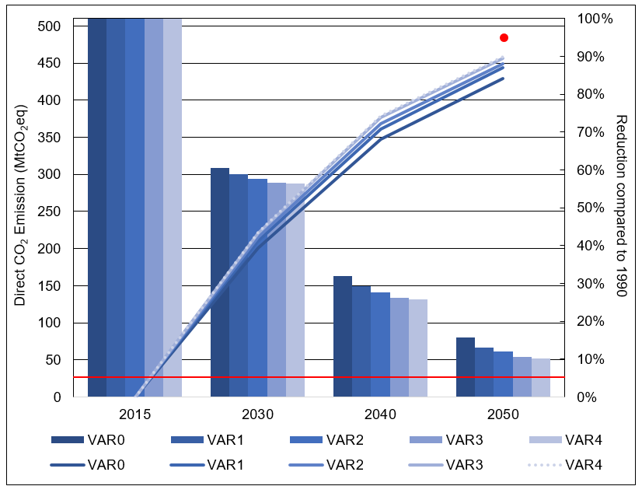
Results – CO₂ Emissions
Reduction of 42% by 2030 and 85% by 2050 comp. to 1990
Doubling to VAR1: direct emissions of the EU building stock drop down to 88% of 1990
Further doubling to VAR4: leads to 90% reduction by 2050
The achieved emission reductions are below the target
Effect of CO₂ pricing in the building sectors, even if significantly high, is limited.
The transition to a fossil-free and low-energy building stock is not fast enough and a considerable amount of fossils has to stay in the system

Slide 9
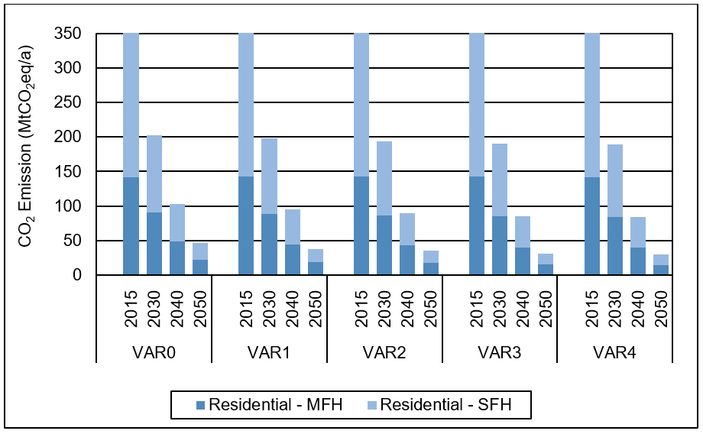
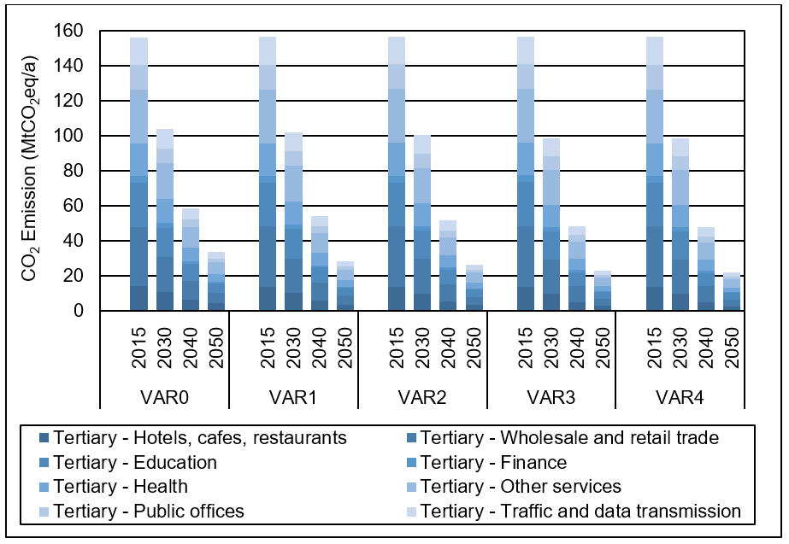
Results - Subsectoral Emissions

Slide 10
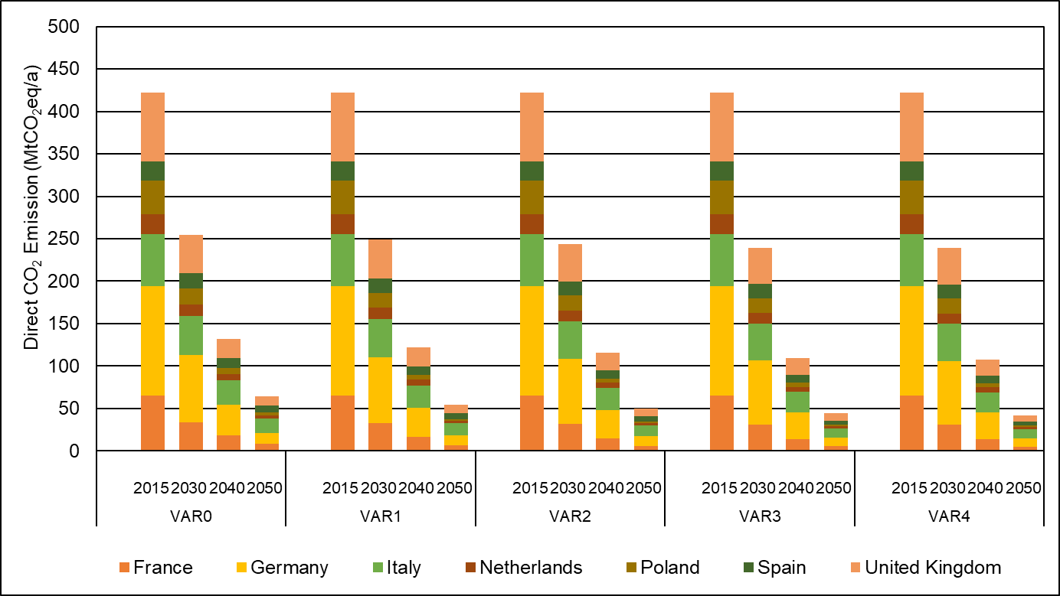
Results - Highest Contributing Countries
Top 3 contributors; Germany, UK and France: 88% (up to 92%) reduction
Italy and Spain: lowest response. 65% (up to 72%) reduction
Most successful in Poland: 92% reduction by 2050, with 15 EUR/t in 2030 and 23 EUR/t in 2050 (VAR0)
Relative price of useful energy is important in determining the success of CO₂ price in buildings. This is specific to each country.

Slide 11
Conclusions
Currently planned price pathway does not carry the sectoral emissions to the target levels
Success of the CO₂ price is linked to the success of other decarbonization measures
Energy demand of the building stock and the replacement speed of the technological stock pose greater barriers
The impact of the CO₂ price is strongly linked to the relative price of energy carriers
The impact of the CO₂ price on the direct emissions does not necessarily get stronger at higher prices
One common CO₂ price for the whole EU is not necessary. Smart to optimize the price specific to each nation
Residential buildings are forecasted to cut their emissions faster than the commercial buildings
Potential of the CO₂ pricing and fuel switch to renewables is higher in the residential sector
Education and health sector buildings require stricter measures to reduce their direct emissions

Slide 12
Outlook
Integration of synthetic methane or heating oil (PtX)
Investigation of the effect of CO₂ pricing in the electricity and district heating supply
energy carrier prices for end-users
overall choice of heating technologies
Modeling social factors such as community awareness, incentives and campaigns for mobilization
turnover of the heating technology stock

Slide 13
References
Eurostat, 2019. Complete energy balances (Accessed in April 2021)
Eurostat, 2018. Disaggregated final energy consumption in households – quantities (Accessed in April 2021)
Eurostat, 2019. Share of fuels in final energy consumption (Accessed in April 2021)
IEA (International Energy Agency), 2020. World Energy Outlook-2020, IEA, Paris, https://www.iea.org/reports/world-energy-outlook-2020.
World Bank, 2020. “State and Trends of Carbon Pricing 2020” (May), World Bank, Washington, DC. Doi: 10.1596/978-1-4648-1586-7. License: Creative Commons Attribution CC BY 3.0 IGO

Slide 14
THANK YOU FOR YOUR ATTENTION!

Slide 15
Country |  | 2021 | 2025 | 2030 | 2035 | 2040 | 2045 | 2050
Austria | EUR/t | 20 | 40 | 65 | 79 | 90 | 101 | 111
Belgium | EUR/t | 20 | 40 | 65 | 79 | 90 | 101 | 111
Cyprus | EUR/t | 2 | 7 | 15 | 17 | 19 | 21 | 23
Czech Rep. | EUR/t | 2 | 7 | 15 | 17 | 19 | 21 | 23
Denmark | EUR/t | 25 | 36 | 42 | 47 | 51 | 55 | 59
Estonia | EUR/t | 3 | 7 | 11 | 14 | 16 | 17 | 19
Finland | EUR/t | 55 | 68 | 81 | 93 | 103 | 113 | 122
France | EUR/t | 47 | 54 | 63 | 70 | 77 | 83 | 89
Germany | EUR/t | 25 | 55 | 65 | 84 | 93 | 103 | 112
Greece | EUR/t | 22 | 39 | 51 | 60 | 67 | 74 | 80
Hungary | EUR/t | 2 | 7 | 15 | 17 | 19 | 21 | 23
Ireland | EUR/t | 26 | 50 | 80 | 97 | 111 | 124 | 136
Italy | EUR/t | 15 | 35 | 50 | 58 | 66 | 72 | 79
Latvia | EUR/t | 12 | 24 | 39 | 54 | 69 | 84 | 99
Lithuania | EUR/t | 12 | 24 | 39 | 54 | 69 | 84 | 99
Luxembourg | EUR/t | 20 | 40 | 65 | 79 | 90 | 101 | 111
Malta | EUR/t | 22 | 39 | 51 | 60 | 67 | 74 | 80
Netherlands | EUR/t | 22 | 39 | 51 | 60 | 67 | 74 | 80
Poland | EUR/t | 2 | 7 | 15 | 17 | 19 | 21 | 23
Portugal | EUR/t | 25 | 36 | 42 | 47 | 51 | 55 | 59
Slovakia | EUR/t | 2 | 7 | 15 | 17 | 19 | 21 | 23
Slovenia | EUR/t | 21 | 32 | 38 | 43 | 47 | 51 | 55
Spain | EUR/t | 22 | 39 | 51 | 60 | 67 | 74 | 80
Sweden | EUR/t | 114 | 132 | 152 | 169 | 186 | 201 | 215
UK | EUR/t | 26 | 50 | 80 | 97 | 111 | 124 | 136
Romania | EUR/t | 2 | 7 | 15 | 17 | 19 | 21 | 23
Bulgaria | EUR/t | 2 | 7 | 15 | 17 | 19 | 21 | 23
Croatia | EUR/t | 21 | 32 | 38 | 43 | 47 | 51 | 55
Average | EUR/t | 21 | 34 | 47 | 56 | 63 | 70 | 77

Slide 16
 |  | CO₂ Emission | Reduction with respect to 1990
 |  | 1990 | 2015 |  | 2030 |  | 2040 |  | 2050
Residential | VAR0 | 343,4 | 353,2 | -3% | 204,7 | 40% | 104,3 | 70% | 47,0 | 86%
 | VAR1 | 343,4 | 353,2 | -3% | 198,2 | 42% | 94,8 | 72% | 38,2 | 89%
 | VAR2 | 343,4 | 353,2 | -3% | 193,8 | 44% | 89,9 | 74% | 35,0 | 90%
 | VAR3 | 343,4 | 353,2 | -3% | 190,4 | 45% | 84,8 | 75% | 31,2 | 91%
 | VAR4 | 343,4 | 353,2 | -3% | 189,3 | 45% | 83,6 | 76% | 29,7 | 91%
Commercial | VAR0 | 193,1 | 156,6 | 19% | 104,1 | 46% | 58,8 | 70% | 33,6 | 83%
 | VAR1 | 193,1 | 156,6 | 19% | 102,0 | 47% | 54,2 | 72% | 28,3 | 85%
 | VAR2 | 193,1 | 156,6 | 19% | 100,4 | 48% | 51,5 | 73% | 26,3 | 86%
 | VAR3 | 193,1 | 156,6 | 19% | 98,7 | 49% | 48,4 | 75% | 22,7 | 88%
 | VAR4 | 193,1 | 156,6 | 19% | 98,7 | 49% | 47,6 | 75% | 21,8 | 89%

