Slide 1
What drives the accuracy of PV output forecasts?
Thi Ngoc Nguyen and Felix Müsgens
BTU Cottbus - Senftenberg

Slide 2
Agenda
Motivation
Methodology
Results and Discussion
Conclusions

Slide 3
Motivation
Historical reviews on PV output forecasts
There is a demand for systemizing the scientific knowledge in PV output forecast field.
No | Authors (Year) | Summary
1 | Ahmed et al. (2020) | A review on the short-term PV output forecasts and highly advanced methodologies such as hybrid models using the latest techniques. It suggests that factors such as time stamp and forecast horizon, and techniques of data processing, weather classification, and parameter optimization can influence the quality of the forecasts and should be taken into account when comparing models.
2 | El hendouzi and Bourouhou (2020) | A review on short-term PV output forecasts that discusses the basic principles, standards, and different methodologies of PV output forecasting.
3 | Mellit et al. (2020) | A complete and critical review on highly advanced methods for PV output forecasts, especially the recent development in ML, DL, and hybrid methods.
4 | Pazikadin et al. (2020) | A review of 87 articles on both solar irradiance and PV output forecasts, focusing on artificial neural network (ANN)-based models only. It highlights the superiority of the ANN hybrid models and emphasizes the importance of data input quality and weather classification.
5 | Rajagukguk et al. (2020) | A review of deep learning (DL) models for PV output forecasts and solar irradiance forecasts. It compares 3 individual deep learning models and one hybrid model using deep learning techniques and shows that the hybrid outperforms the 3 individuals. It also recommends papers using normalized errors to enable inter-model comparison.
6 | Akhter et al. (2019) | A review on ML and hybrid methods for solar irradiance and PV output forecasts that suggests the superiority of ML-based hybrid models.
7 | Das et al. (2018) | A review on the development in PV output forecasts and model optimization techniques. It suggests that ANN and support vector machine (SVM)-based models have very good and robust performance.
8 | Sobri et al. (2018) | A review on PV output forecast methods that indicates the superiority of ANN and SVM-based models. It also suggests ensemble methods have much potential in enhancing the forecast accuracy.
9 | Yang et al. (2018) | A review on both solar irradiance and PV output forecasts using text mining, focusing on the analysis of the features of models and predicting the trend in PV forecasting.
10 | Barbieri et al. (2017) | A review on very short-term PV output forecasts with cloud modelling. It suggests that hybrid models combining physical with statistical models can enhance the forecast accuracy, especially when PV outputs have rapid fluctuations.
11 | Antonanzas et al. (2016) | A review on PV output forecasts that suggests the dominance of ML-based models.
12 | Raza et al. (2016) | A discussion of ML-based and classical methods for PV output forecasts that supports the use of ML models and data processing techniques.
13 | Mellit and Kalogirou (2008) | The first review on ANN-based models for PV output forecasts that suggests a high potential of ML techniques in enhancing the forecast accuracy.
The question “What drives the accuracy of PV output forecasts?” is particularly important.
No historical survey on PV output forecasts could give a concrete and global answer.
Using the statistical analysis of PV output forecast errors, we are the first to concretely answer the question and provide the first “survey of surveys” on PV output forecasts.

Slide 4
Methodology – Statistical Analysis Process
Research question: What drives the accuracy of PV output forecasts?
Relevant research collection
Removing insufficient information papers
Analysing the data base – 1136 observations
Removing daily forecasts
Selecting errors in NRMSE, NMAE, and MAPE
Selecting intra-hour, intra-day and day-ahead forecasts
Data extraction and processing – 66 papers
Preliminary examination
Collecting data of 21 key features and other important information for each observation
Final processing of format, units, ...
Google Scholar – 180 papers
OLS regression, data visualization

Slide 5
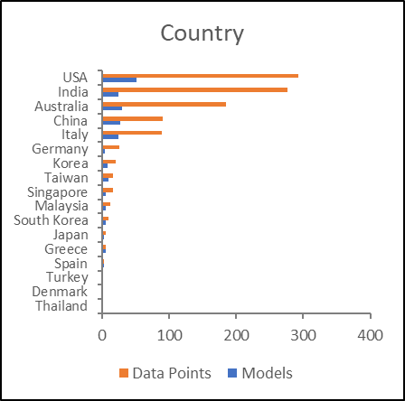
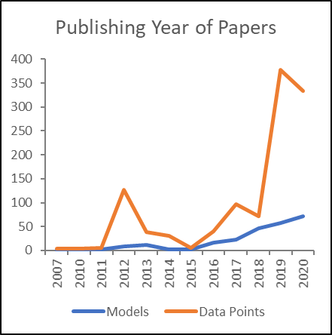
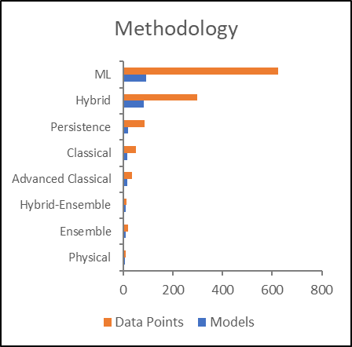
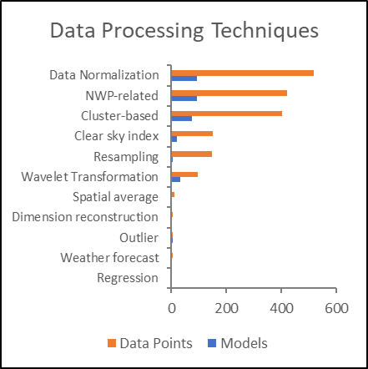
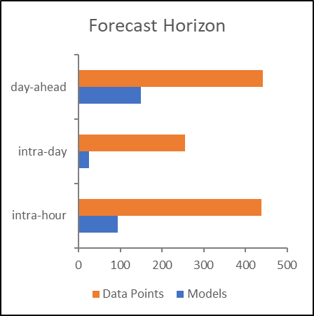
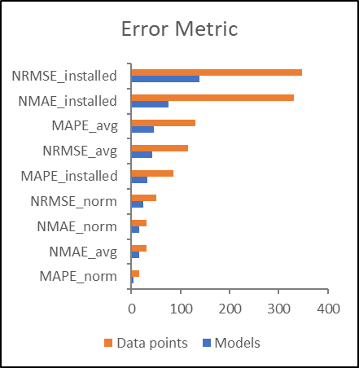
Methodology – Database Overview
Database Overview
1136 observations, 21 variables
74 regions across 17 countries and 4 continents.
State-of-the-art methodologies dominate and cover 81% of the database.
The most used data processing techniques are data normalization, the inclusion of NWP variables, and cluster-based algorithms with 23%-30% of all observations for each.
89% of data concentrates on the top 5 error metrics

Slide 6
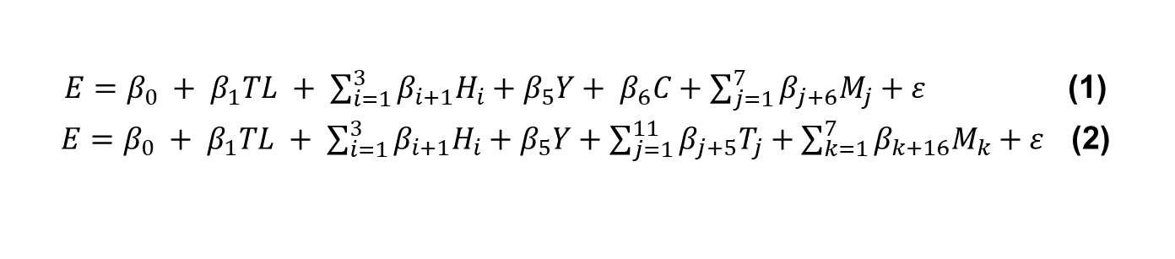
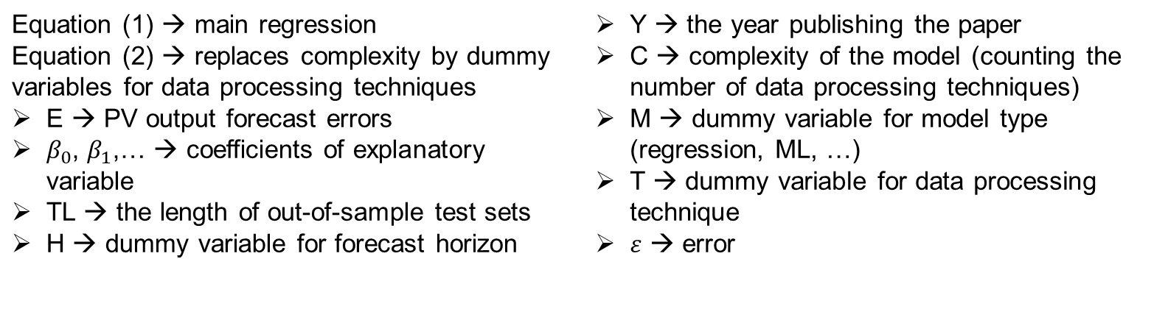
Methodology – Data Analysis
$E=β_{0} + β_{1}TL + \sum_{i=1}^{3}{β_{i+1}H_{i}}+β_{5}Y+ β_{6}C+\sum_{j=1}^{7}{β_{j+6}M_{j}}+ε$ (1)
$E=β_{0} + β_{1}TL + \sum_{i=1}^{3}{β_{i+1}H_{i}}+β_{5}Y+\sum_{j=1}^{11}{β_{j+5}T_{j}}+\sum_{k=1}^{7}{β_{k+16}M_{k}}+ε$ (2)
OLS Regression:
with:
  Regressions are done one the pool of all data, then on the data of long test sets (>= 1 year), and then on the data sets of classical methods compared to state-of-the-art methods.
Other data exploration methods: boxplot and other data visualization methods
Equation (1) → main regression Equation (2) → replaces complexity by dummy variables for data processing techniques E → PV output forecast errors $β_{0}$, $β_{1}$,… → coefficients of explanatory variable TL → the length of out-of-sample test sets H → dummy variable for forecast horizon | Y → the year publishing the paper C → complexity of the model (counting the number of data processing techniques) M → dummy variable for model type (regression, ML, …) T → dummy variable for data processing technique $ε$ → error

Slide 7
Results and Discussion – What factors drive the forecast accuracy? (1)
Test set length increases forecast errors (+ 0.007-0.026 pp).
Long test sets generate more meaningful conclusions on PV output forecast assessment (Adjusted R2 increases from 15% to 35%).
Forecast horizon length increases the forecast errors (+ 3.45-6.12 pp).
PV output forecast errors reduce with time (- 0.64-0.98 pp).
Data processing techniques reduce forecast errors (- 1.25-1.32 pp).
Hybrid models are consistently superior to the others and outperform the classical methods by 3.41-3.93 pp.
Factors influencing the accuracy of PV output forecasts
Deriving the outcomes of interest
 | Dependent variable: error values
 | Whole data base | Test sets >= 1 year (long test sets)
 | All methodologies (1) | All methodologies (2) | Classical models (3) | State-of-the-art (4)
Test set length (days) | 0.008*** | 0.010*** | 0.026*** | 0.007***
 | (0.001) | (0.002) | (0.005) | (0.002)
Intra-day⁽¹⁾ | 1.430* | 3.445*** |  | 3.116***
 | (0.747) | (0.834) |  | (0.825)
Day-ahead⁽¹⁾ | 0.421 | 6.120*** | 7.720*** | 5.912***
 | (0.652) | (0.865) | (2.371) | (0.922)
Publishing Year | -0.832*** | -0.788*** | -0.641 | -0.976***
 | (0.111) | (0.162) | (0.440) | (0.177)
Complexity | -0.340 | -1.249*** | 0.371 | -1.321***
 | (0.234) | (0.379) | (1.106) | (0.407)
Classical⁽²⁾ | -1.633 | -0.906 | 0.784
 | (2.045) | (2.264) | (2.593)
Ensemble⁽²⁾ | 1.840 | 0.923
 | (2.608) | (2.132)
Hybrid⁽²⁾ | -3.410** | -3.934** |  | -4.899***
 | (1.629) | (1.667) |  | (1.547)
Hybrid-Ensemble⁽²⁾ | -1.022 | -0.568 |  | -0.969
 | (3.029) | (2.878) |  | (2.715)
ML⁽²⁾ | -0.451 | 1.579 |  | 0.308
 | (1.571) | (1.729) |  | (1.617)
Physical⁽²⁾ | 6.696** | -2.156 | -0.385
 | (3.269) | (2.866) | (3.211)
Constant | 1,686.488*** | 1,594.978*** | 1,284.590 | 1,976.310***
 | (224.071) | (327.278) | (887.429) | (356.840)
Observations | 1,136 | 389 | 54 | 335
R² | 0.162 | 0.373 | 0.510 | 0.370
Adjusted R² | 0.153 | 0.353 | 0.436 | 0.355
Residual Std. Error | 8.991 (df = 1123) | 5.792 (df = 376) | 6.069 (df = 46) | 5.652 (df = 326)
F Statistic | 18.057*** (df = 12; 1123) | 18.631*** (df = 12; 376) | 6.850*** (df = 7; 46) | 23.957*** (df = 8; 326)
Note: ⁽¹⁾ Dummies of forecast horizon, baseline: intra-hour horizon ⁽²⁾ Dummies of methodology, baselines: column (1-3): Advanced classical models, column (4): Ensemble models *p<0.1; **p<0.05; ***p<0.01
Simulating the change in the mobility demand for each scenario of the road toll
Demand System

Slide 8
Results and Discussion – What factors drive the forecast accuracy? (2)
Factors influencing the accuracy of PV output forecasts
Compared with the classical methods, the state-of-the-art methods perform more robustly to the change in test set lengths and forecast horizon.
The overall progress is also more significant for the state-of-the-art methods.
The effect of data processing techniques is also stronger for state-of-the-art methods, signalling the further improvement that can be made in the long run by this group of methodologies.
Deriving the outcomes of interest
 | Dependent variable: error values
 | Whole data base | Test sets >= 1 year (long test sets)
 | All methodologies (1) | All methodologies (2) | Classical models (3) | State-of-the-art (4)
Test set length (days) | 0.008*** | 0.010*** | 0.026*** | 0.007***
 | (0.001) | (0.002) | (0.005) | (0.002)
Intra-day⁽¹⁾ | 1.430* | 3.445*** |  | 3.116***
 | (0.747) | (0.834) |  | (0.825)
Day-ahead⁽¹⁾ | 0.421 | 6.120*** | 7.720*** | 5.912***
 | (0.652) | (0.865) | (2.371) | (0.922)
Publishing Year | -0.832*** | -0.788*** | -0.641 | -0.976***
 | (0.111) | (0.162) | (0.440) | (0.177)
Complexity | -0.340 | -1.249*** | 0.371 | -1.321***
 | (0.234) | (0.379) | (1.106) | (0.407)
Classical⁽²⁾ | -1.633 | -0.906 | 0.784
 | (2.045) | (2.264) | (2.593)
Ensemble⁽²⁾ | 1.840 | 0.923
 | (2.608) | (2.132)
Hybrid⁽²⁾ | -3.410** | -3.934** |  | -4.899***
 | (1.629) | (1.667) |  | (1.547)
Hybrid-Ensemble⁽²⁾ | -1.022 | -0.568 |  | -0.969
 | (3.029) | (2.878) |  | (2.715)
ML⁽²⁾ | -0.451 | 1.579 |  | 0.308
 | (1.571) | (1.729) |  | (1.617)
Physical⁽²⁾ | 6.696** | -2.156 | -0.385
 | (3.269) | (2.866) | (3.211)
Constant | 1,686.488*** | 1,594.978*** | 1,284.590 | 1,976.310***
 | (224.071) | (327.278) | (887.429) | (356.840)
Observations | 1,136 | 389 | 54 | 335
R² | 0.162 | 0.373 | 0.510 | 0.370
Adjusted R² | 0.153 | 0.353 | 0.436 | 0.355
Residual Std. Error | 8.991 (df = 1123) | 5.792 (df = 376) | 6.069 (df = 46) | 5.652 (df = 326)
F Statistic | 18.057*** (df = 12; 1123) | 18.631*** (df = 12; 376) | 6.850*** (df = 7; 46) | 23.957*** (df = 8; 326)
Note: ⁽¹⁾ Dummies of forecast horizon, baseline: intra-hour horizon ⁽²⁾ Dummies of methodology, baselines: column (1-3): Advanced classical models, column (4): Ensemble models *p<0.1; **p<0.05; ***p<0.01
Simulating the change in the mobility demand for each scenario of the road toll
Demand System

Slide 9
Results and Discussion – Data Processing Techniques‘ Performance
Data Processing Techniques’ Performance
The technique of data normalization is the most effective, reducing the average error of the model by 3.16 pp, followed by resampling technique (-2.88 pp) and the inclusion of NWP model’s output (-2.48 pp). These are also among the most used data processing techniques.
Although cluster-based and WT are also frequently used in data processing, these techniques do not show significant influence on the forecast accuracy.
Deriving the outcomes of interest
Simulating the change in the mobility demand for each scenario of the road toll
Demand System

Slide 10
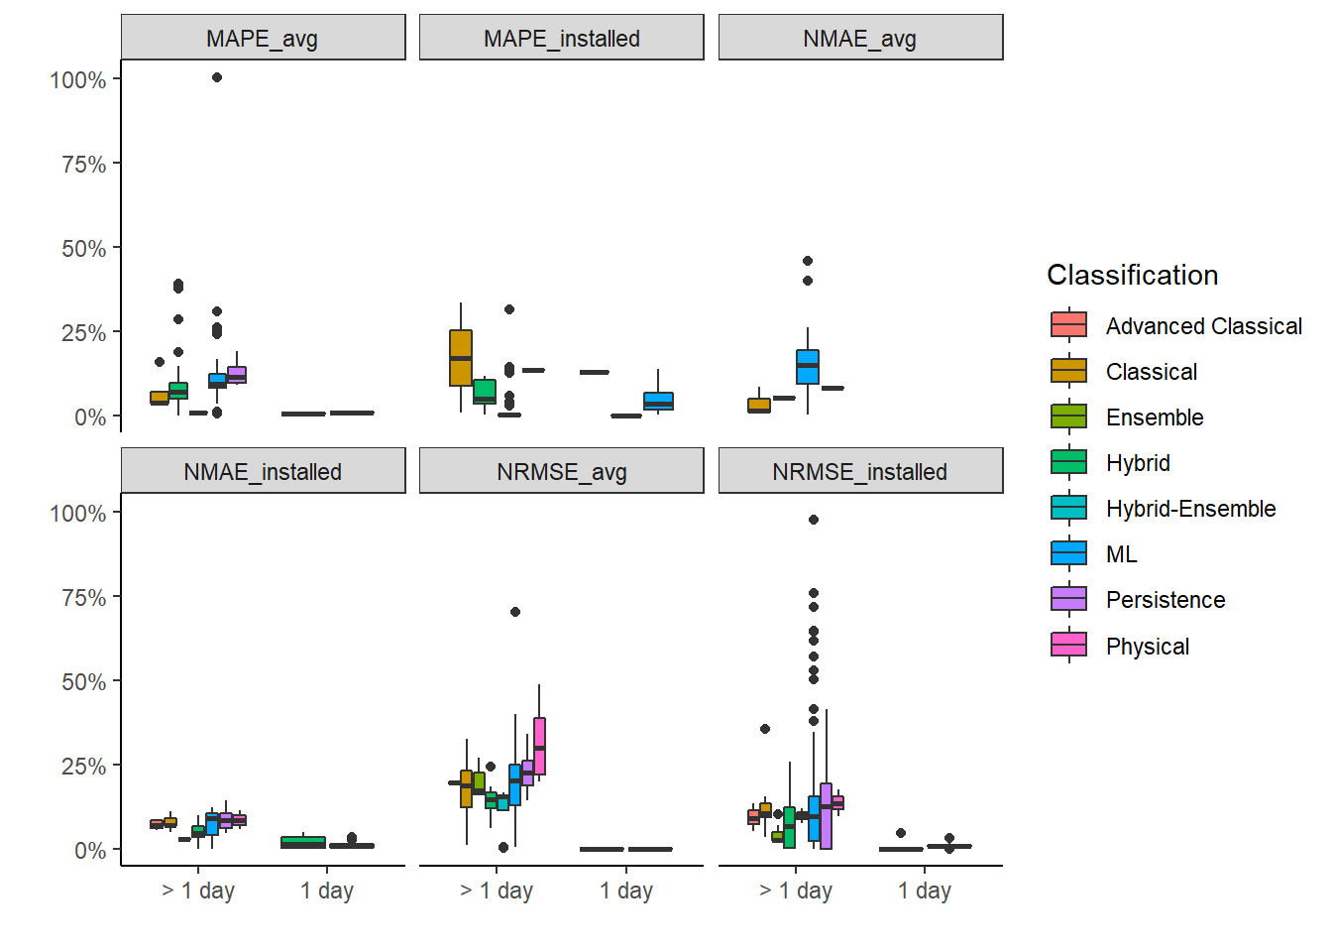
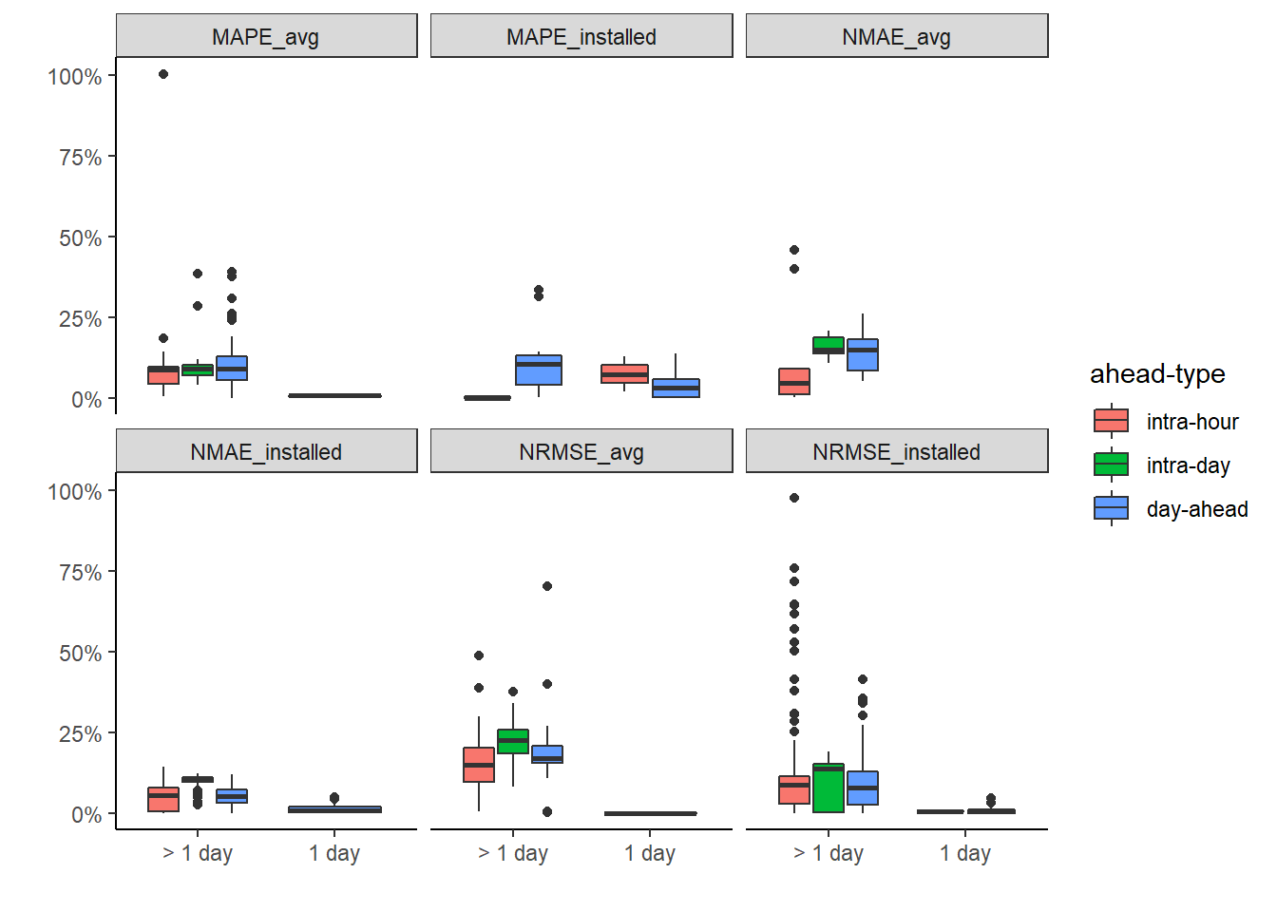
Results and Discussion – “Cherry Picking” Hypothesis
One single day test sets have the average error of 2.7%, which is remarkably lower compared to the other test sets (10%).
This indicates the possibility of “cherry picking” in reporting errors, i.e., to pick the specific days when the forecasting errors are low to report.
The test sets are therefore should be at least one year.
Error values with different lengths of test sets, grouped by methodologies (left panel) and forecast horizons (right panel)
Deriving the outcomes of interest
Simulating the change in the mobility demand for each scenario of the road toll

Slide 11
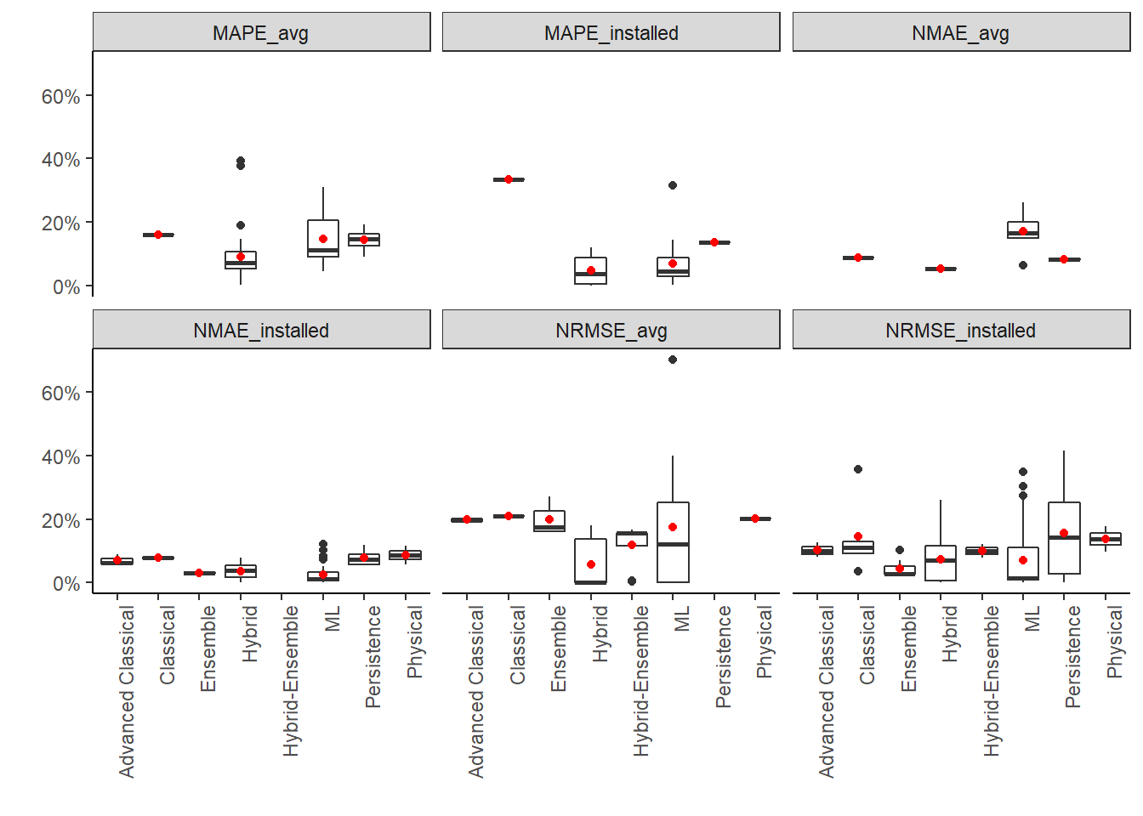
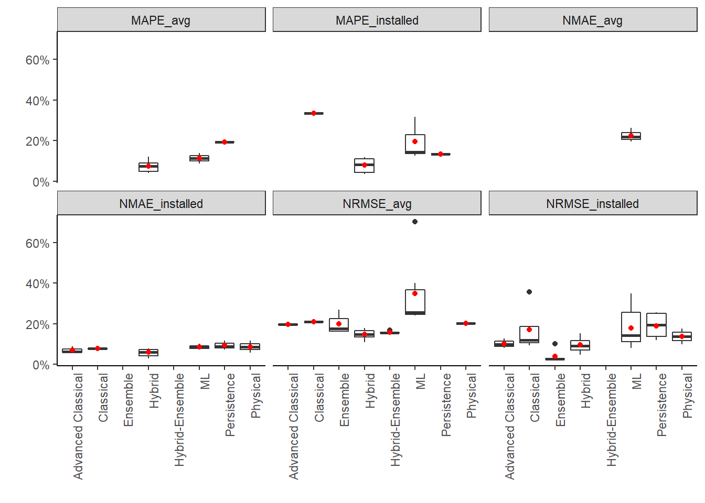
Results and Discussion – Which Methodology Wins? (1)
The hybrid, ensemble, and hybrid-ensemble models are the winners.
The state-of-the-art models outperform the classical by up to 72% on the left but only by up to 24% on the right panels.
ML models also perform worse on the right panels.
→ Importance of removing the risks of bias in inter-model comparison.
Methodologies’ comparative performance using the whole database (left) and removing bias (right)
Deriving the outcomes of interest
Simulating the change in the mobility demand for each scenario of the road toll
→ The complexity-accuracy trade-off can favour the classical methods in the short and medium term.

Slide 12
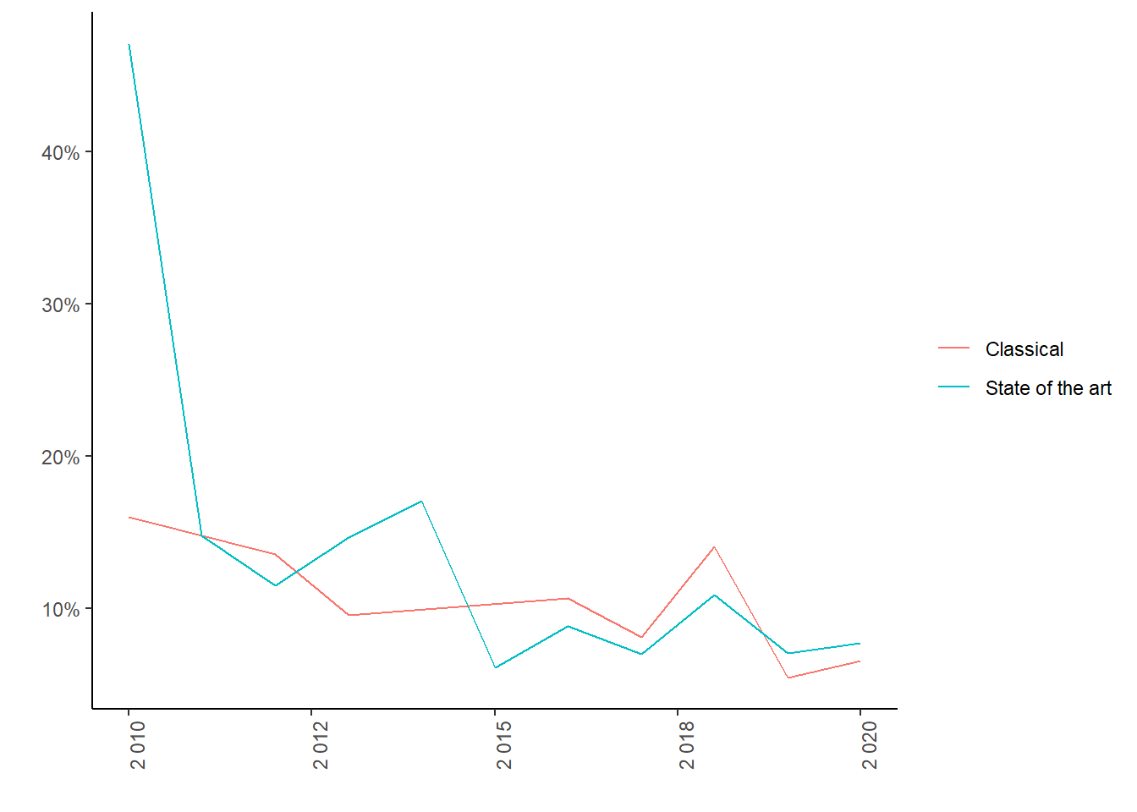
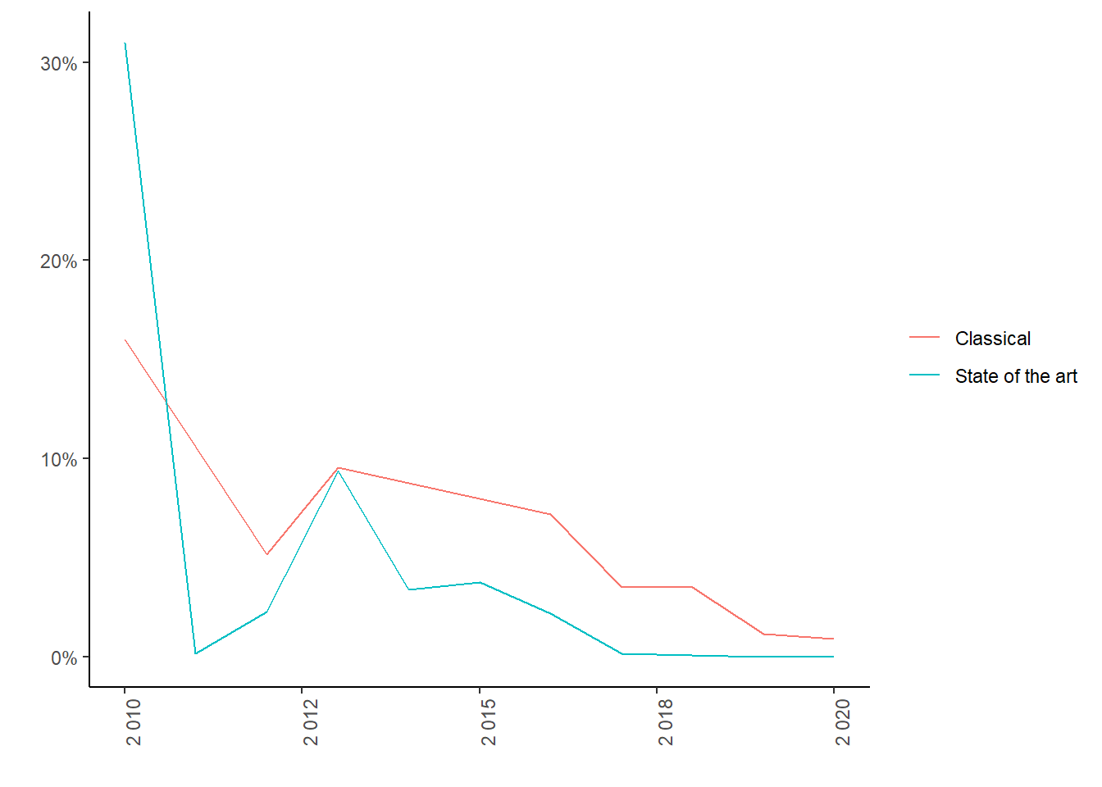
Results and Discussion – Which Methodology Wins? (2)
In the long term:
From the left graph, though classical methods beat the state-of-the-art at some points, on the right graph, there is a large gap in the minimum error value that can be achieved by state-of-the-art methods compared to the classical.
→ State-of-the-art methods drive the future of PV output forecasts.
A comparison of classical and state-of-the-art models' progress
Deriving the outcomes of interest
Average Error Value
Minimum Error Value
Simulating the change in the mobility demand for each scenario of the road toll

Slide 13
Conclusions
-
+
Data processing techniques
State-of-the-art
Time
Forecast horizon length
Test set length
Cherry picking
>= 1 year
Normalization, resampling, NWP
Hybrid, ensemble, hybrid-ensemble methods
ML still long way to go
Removing bias
Short, medium, and long run
Outlook:
A benchmark for inter-methodology comparison is to be established through the following suggested steps:
  Have a standardised suit of evaluation metrics with formal requirements and instructions for the error reporting process.
  Have a bank of standardised data sets for training and testing models.
  Have an open space for the benchmark.
What factors drive the PV output forecast accuracy?

Slide 14
Thank you!
Contact:
M.Sc. Thi Ngoc Nguyen
PhD Candidate
T +49 0355 69 3227 | Email nguyen@b-tu.de
BTU Cottbus - Senftenberg
Faculty 3: Mechanical Engineering, Electrical and Energy System - Chair of Energy Economics
Forschungszentrum 3E - Energiezentrum, Siemens-Halske-Ring 13, 03046 Cottbus

